Slide 1

Social Media Visual Analytics
Siming Chen, Lijing Lin and Xiaoru Yuan
2017/6/18

Slide 2
Outline
Social Media Data Category
Social Media Visualization
Social Media Visual Analytics
Application and System
Discussion and Summary

Slide 3
Social Media
Entity
  Users
  Messages
User behaviors
  Posting messages (Tweet)
  Commenting and Re-posting (Re-tweet)

Slide 4

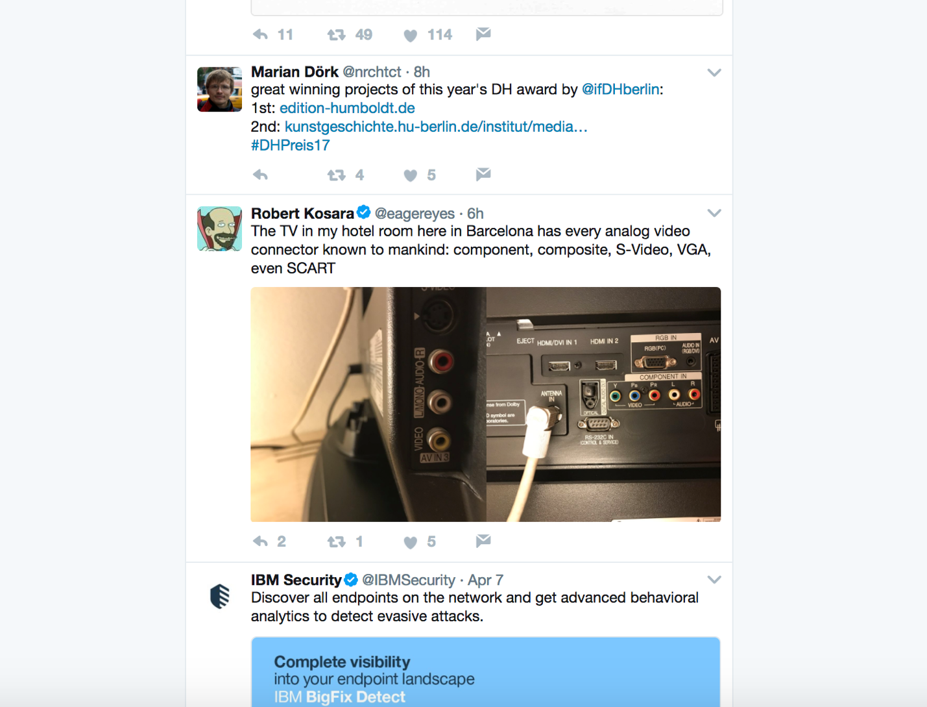
Social Media Data
Users
Messages
  Time
  Location
  Content
  Multi Media
Reposting Behaviors

Slide 5
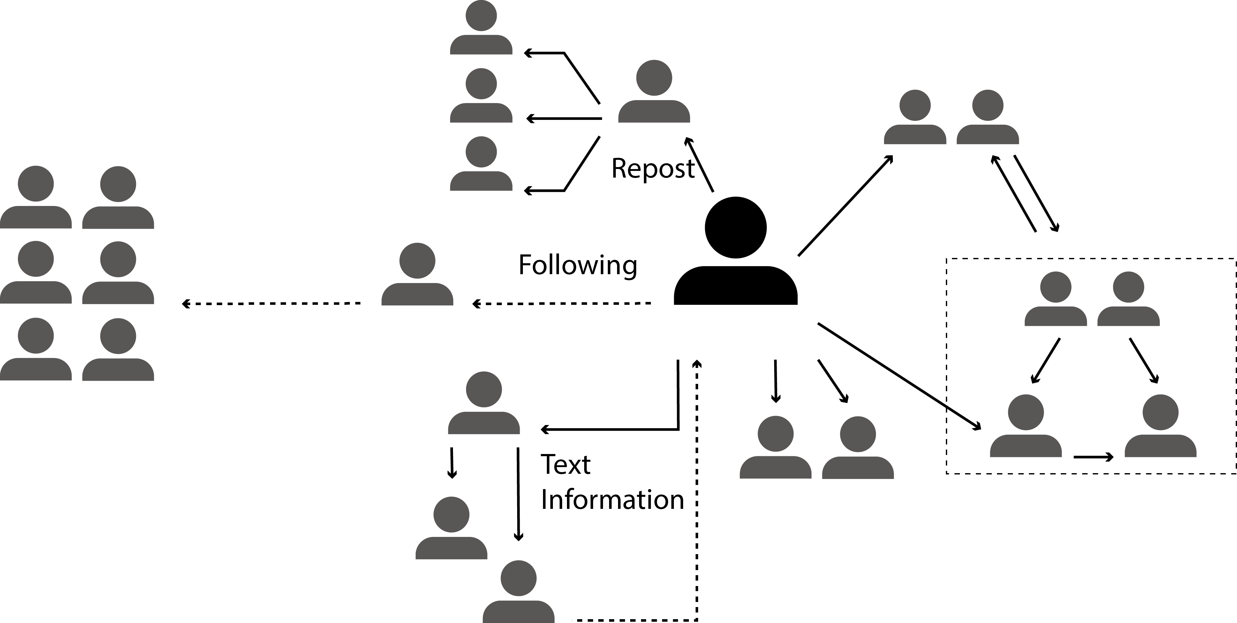
Social Network in Social Media

Slide 6
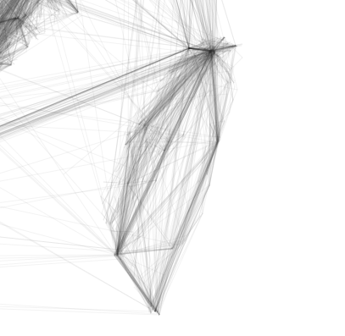
Geo-tagged Social Media

Slide 7
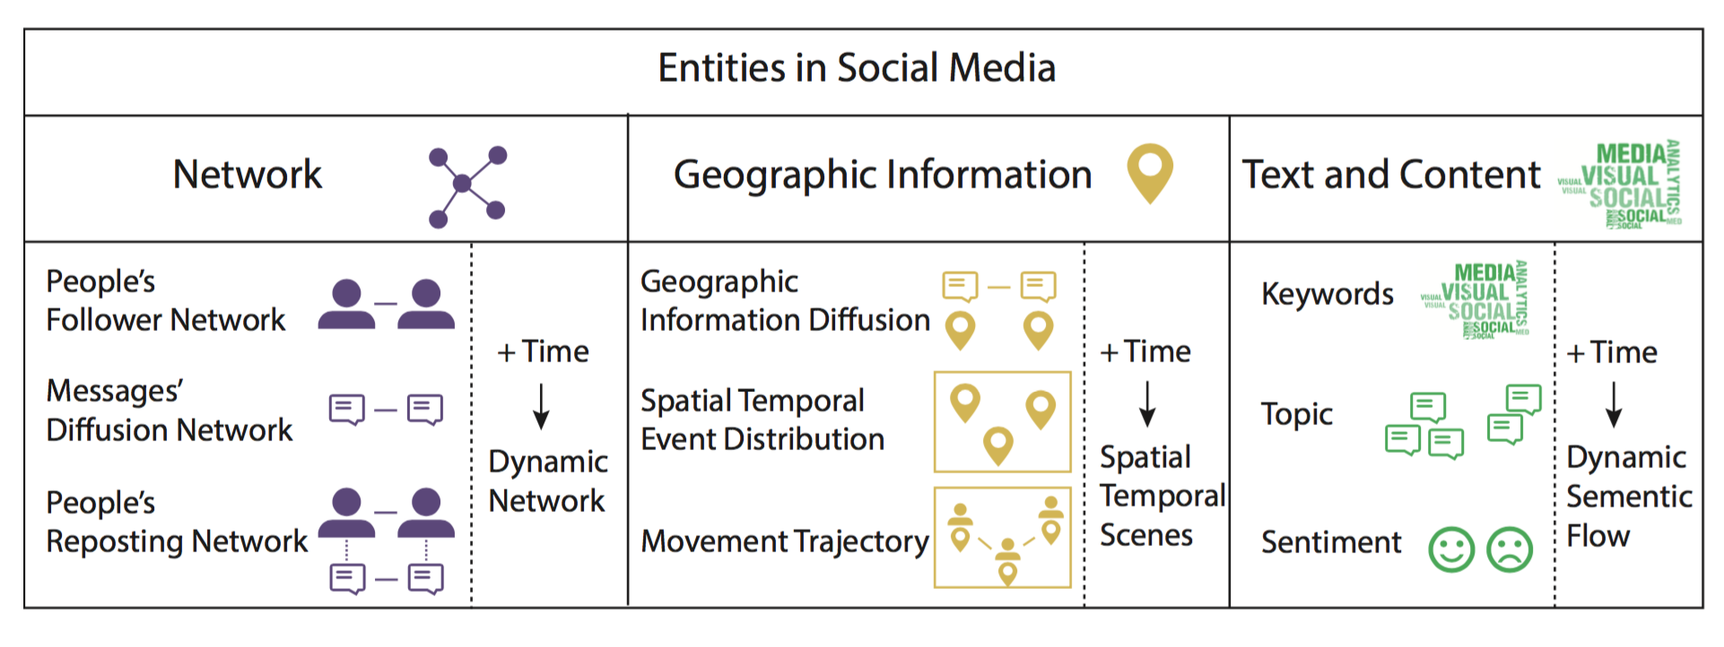
Classification of Social Media Entities and Related Visualization Techniques
Notes:
人和机器共存共创的智能社会。
Add additional materials. 1.无处不在。 2. 引领 2 ppt. 1. 家庭＋社会 组织管理 日常生活 机器 ＋ 国家管理决策 －》个人－》网络 智能国防装备，车，无人机，作战指挥系统，物流，智能武器， 图片 大背景／

Slide 8
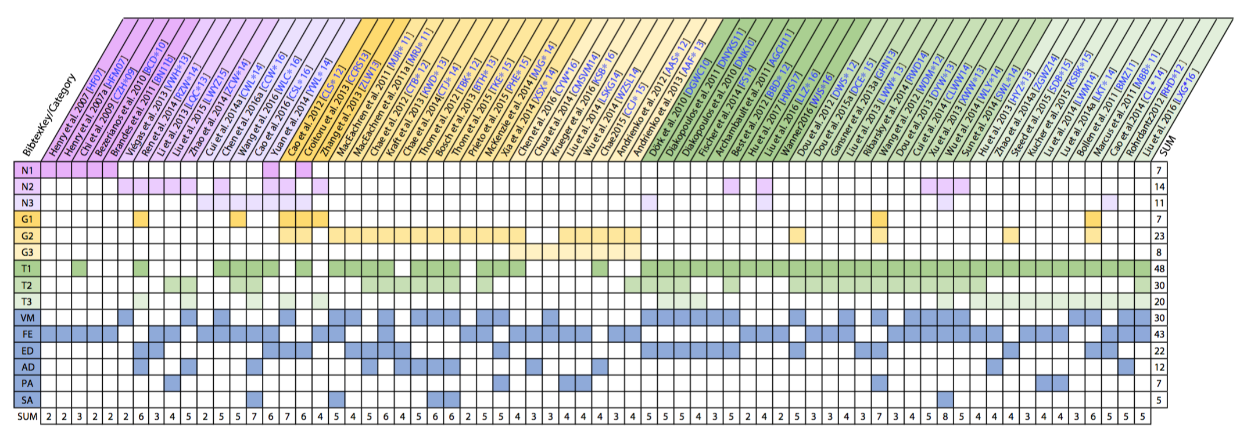
Survey Methodology
N1-N3: Following Network, Information Diffusion Network and Reposting Network;
G1-G3: Geographic Information Diffusion, Spatial Temporal Event Distribution and Movement Trajectories;
T1-T3: Keywords, Topic and Sentiment
VM: Visual Monitoring;
FE: Feature Extraction;
ED: Event Detection;
AD: Anomaly Detection;
PA: Predictive Analysis;
SA: Situation Awareness
Notes:
人和机器共存共创的智能社会。
Add additional materials. 1.无处不在。 2. 引领 2 ppt. 1. 家庭＋社会 组织管理 日常生活 机器 ＋ 国家管理决策 －》个人－》网络 智能国防装备，车，无人机，作战指挥系统，物流，智能武器， 图片 大背景／

Slide 9
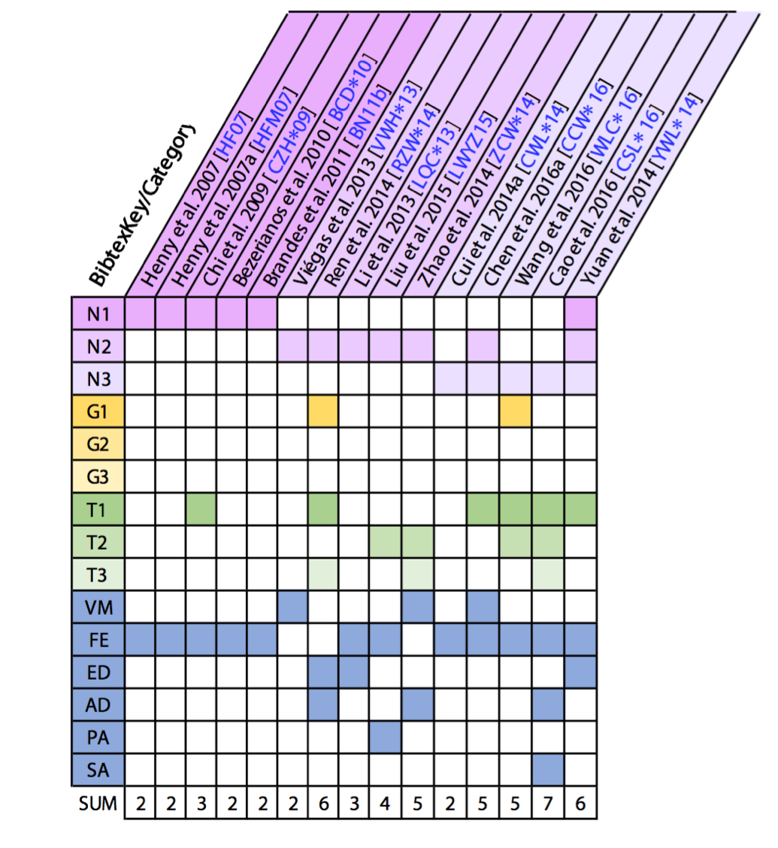
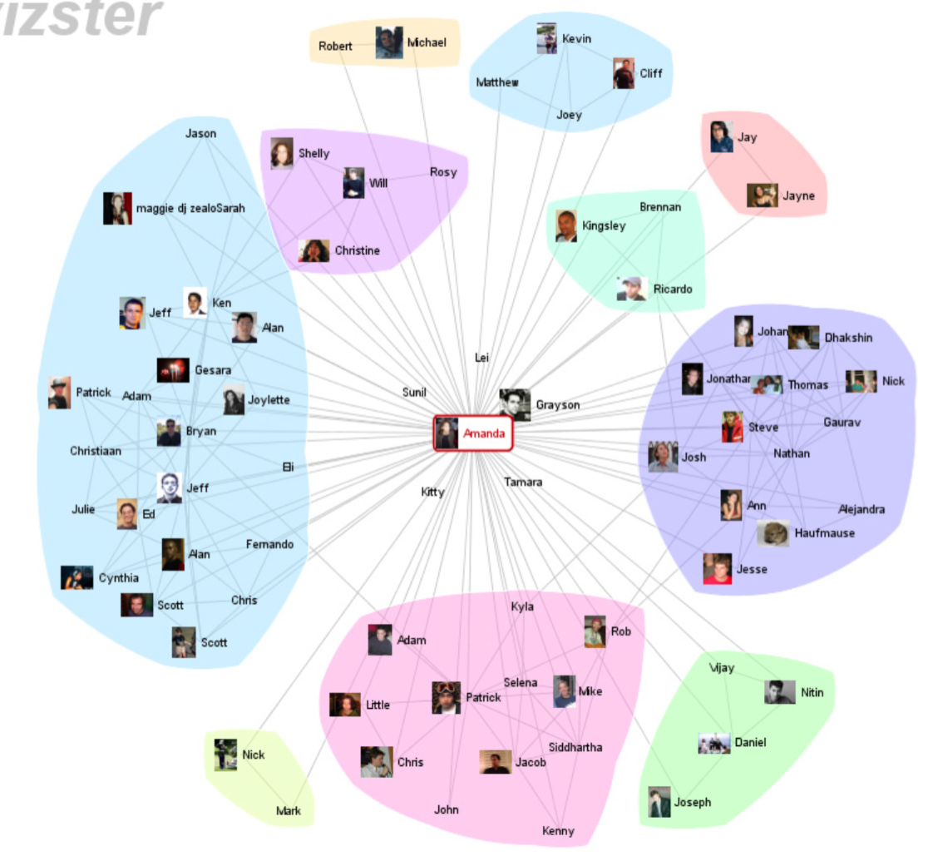
Social Networks
Vizster [HB 05]

Slide 10
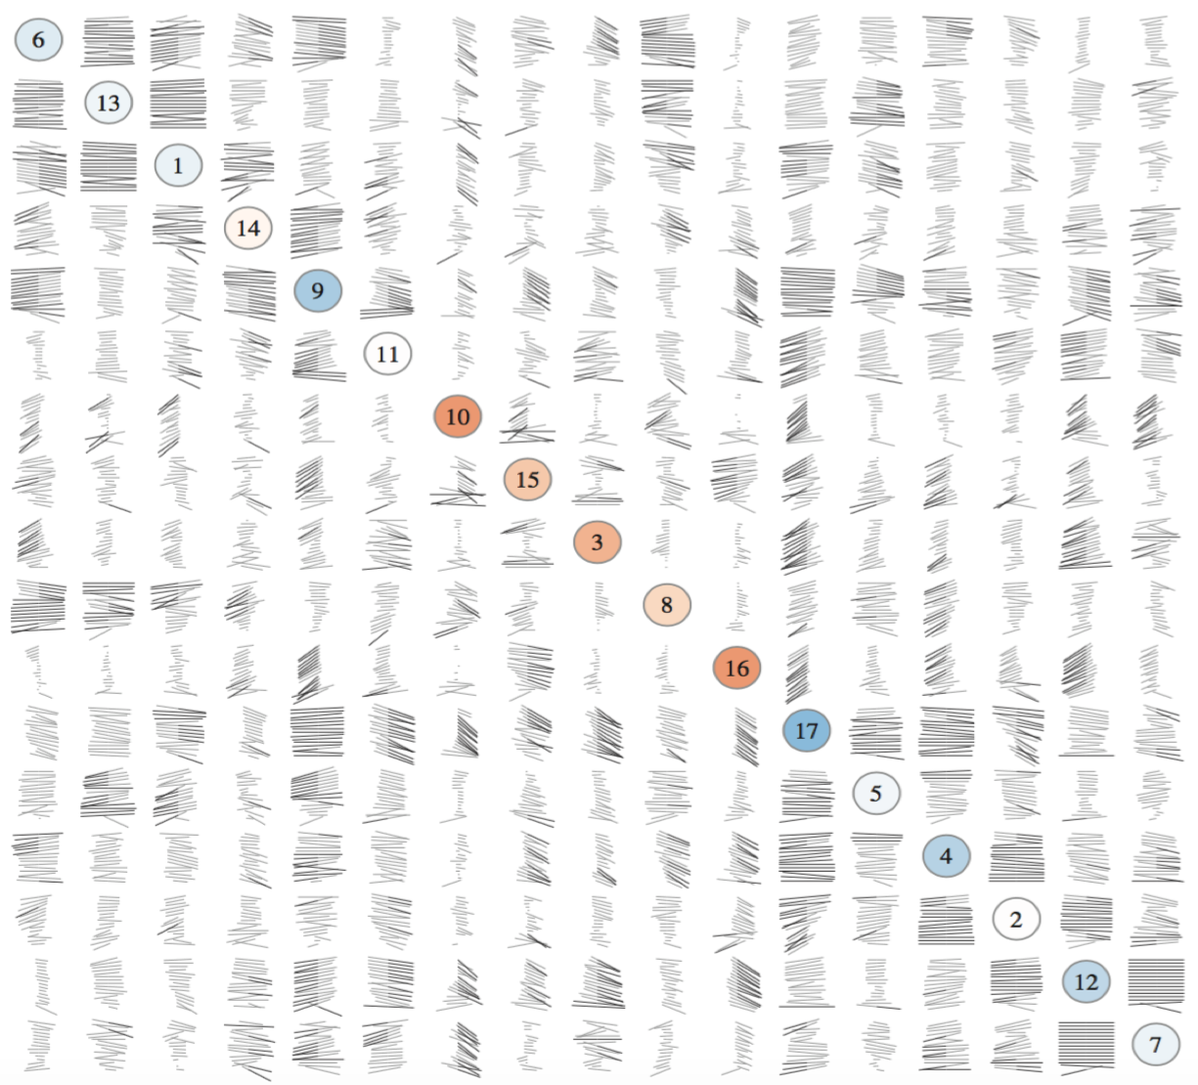
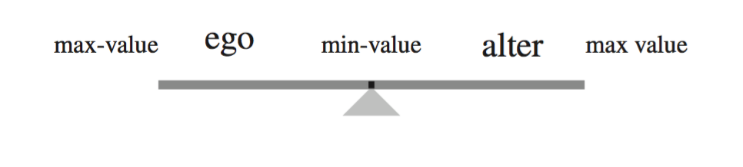
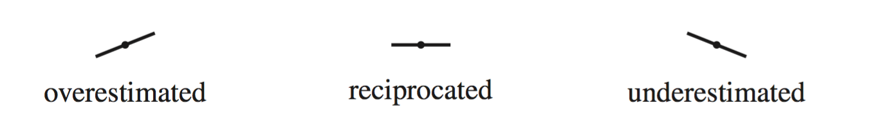
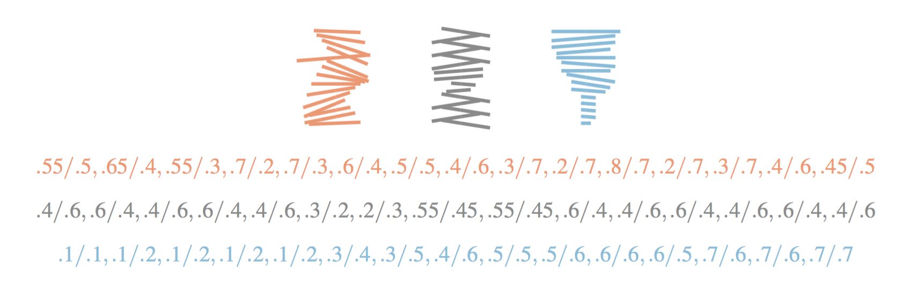
Social Networks – Follower Network Visualization
Social Relationship
  Multiple Attributes
  Dynamic Features
Gestaltmatrix [BN 11]
Notes:
??

Slide 11
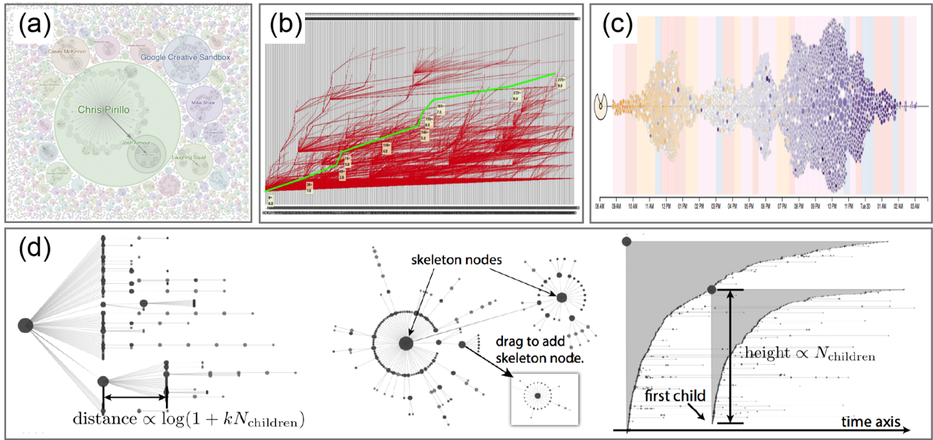
Social Network – Diffusion Network
Entity – Messages
How information diffuse along time
  Topic
  Relationship
(a) Google+ Ripples [VWH∗13], (b) Li et al. [LQC∗13], (c) FluxFlow [ZCW∗14], (d) WeiboEvents [RZW∗14]

Slide 12
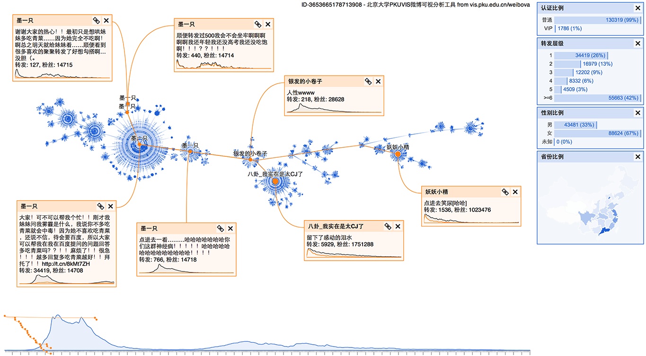
Diffusion Network Visualization: WeiboEvents
– Normal Diffusion Patterns
WeiboEvents [RZW∗14]

Slide 13
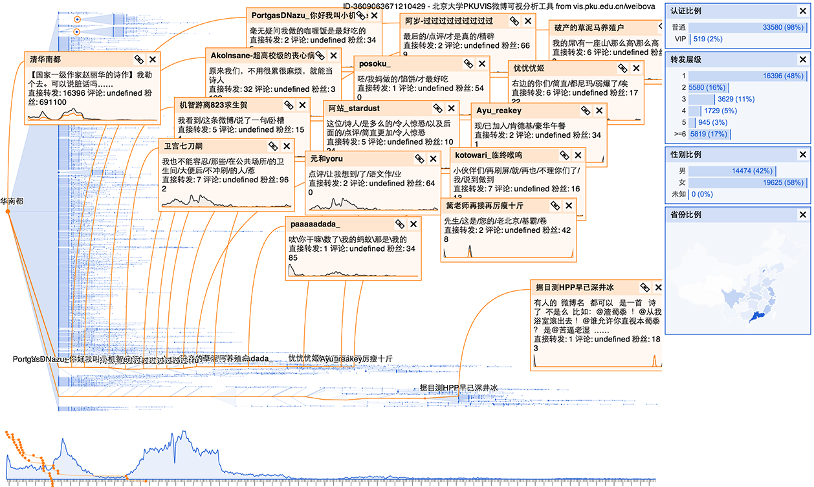
Diffusion Network Visualization: WeiboEvents
– In-depth Discussions
WeiboEvents [RZW∗14]

Slide 14
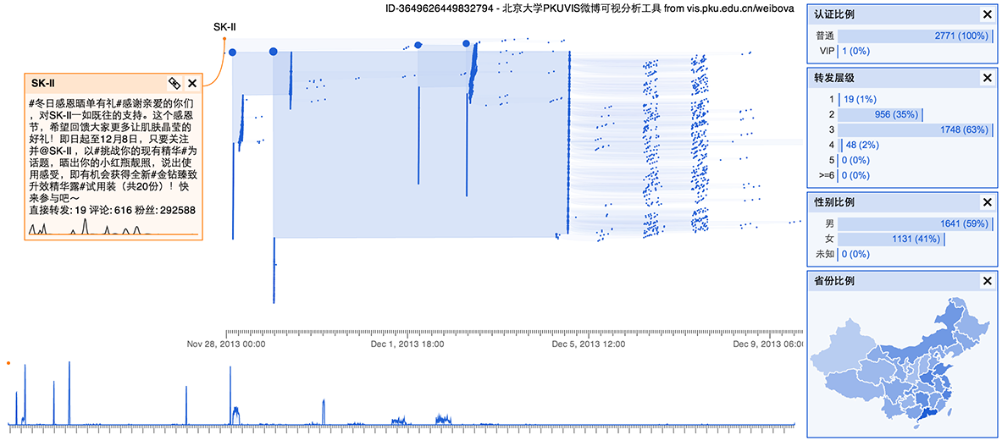
Diffusion Network Visualization:
WeiboEvents: Machine Account Behavior
WeiboEvents [RZW∗14]

Slide 15
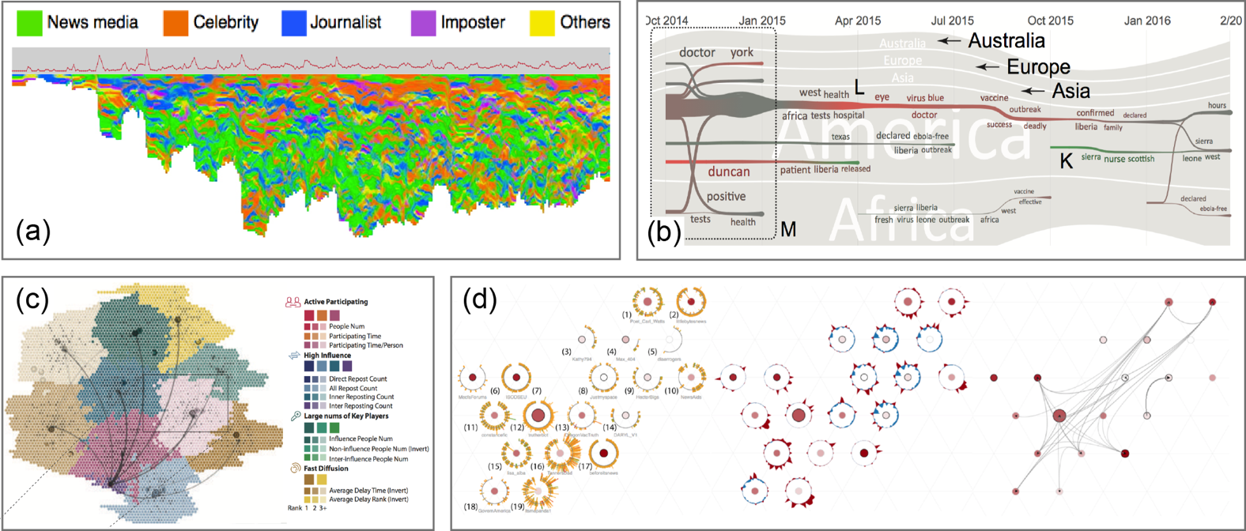
Social Network: Reposter Network
Entities – Social media users
Reposting behaviors leading to information diffusion
  User behavior / type / relationship
  Dynamic scenarios
(a) GraphFlow [CWL*14], (b) IdeaFlow [WLC*16], (c) D-Map [CCW*16], (d) TargetVue [CSL*16]

Slide 16
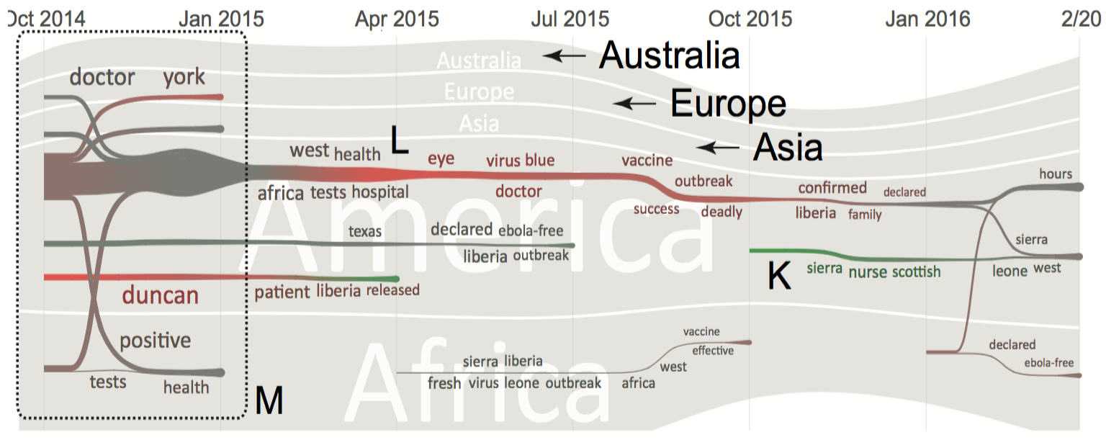
Reposter Network Visualization
IdeaFlow [WLC*16]
Dynamic Relationship
Community Behaviors
Topic Changes
River-based Visual Metaphor
Map-based Visual Metaphor
D-Map [CCW*16]

Slide 17
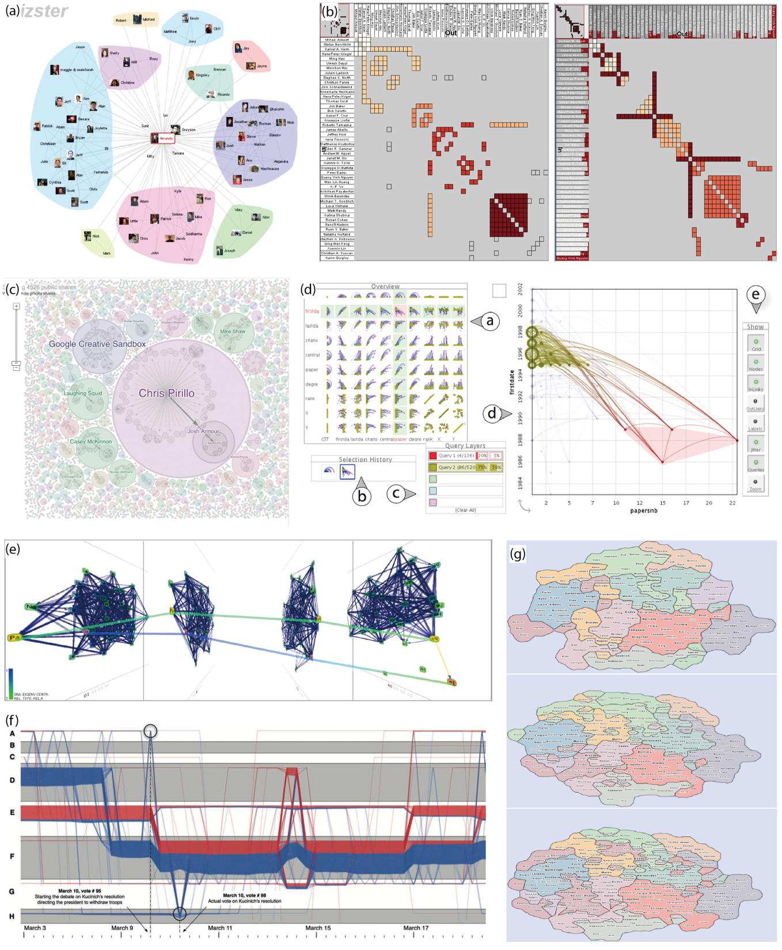
Social Network Visualization Techniques: Summary
Graph-based visualization
  Network [Heer2005]
  Matrix [Henry2006]
  Space filling techniques [Viegas2013]
  Multi-variate exploration [Bezerianos2010]
Dynamic graph visualization
  2.5D representation [Federico2011]
  Storyline [Reda2011]
  Map-like visual metaphor [Hu2012]

Slide 18
Classification of Social Media Entities and Related Visualization Techniques
Notes:
人和机器共存共创的智能社会。
Add additional materials. 1.无处不在。 2. 引领 2 ppt. 1. 家庭＋社会 组织管理 日常生活 机器 ＋ 国家管理决策 －》个人－》网络 智能国防装备，车，无人机，作战指挥系统，物流，智能武器， 图片 大背景／

Slide 19
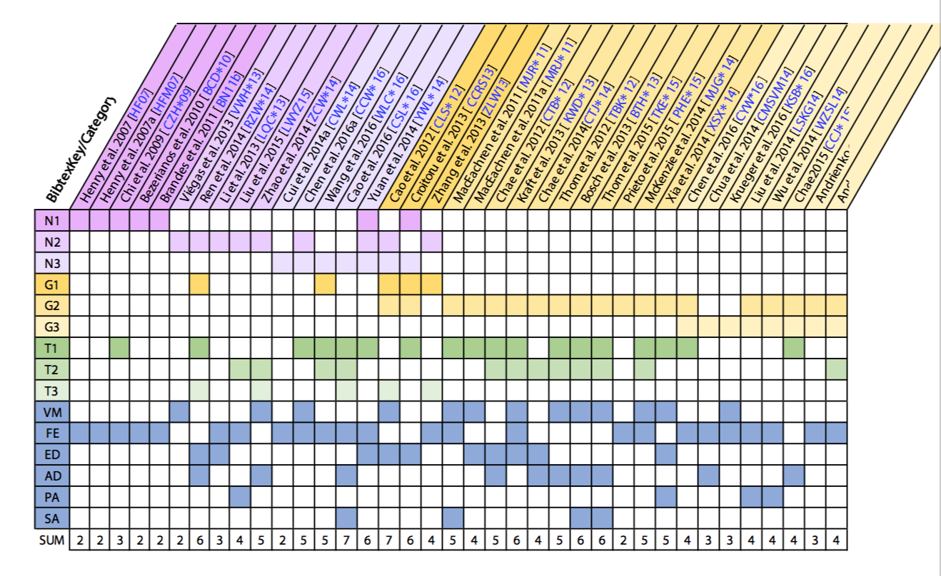
Paper Collections

Slide 20
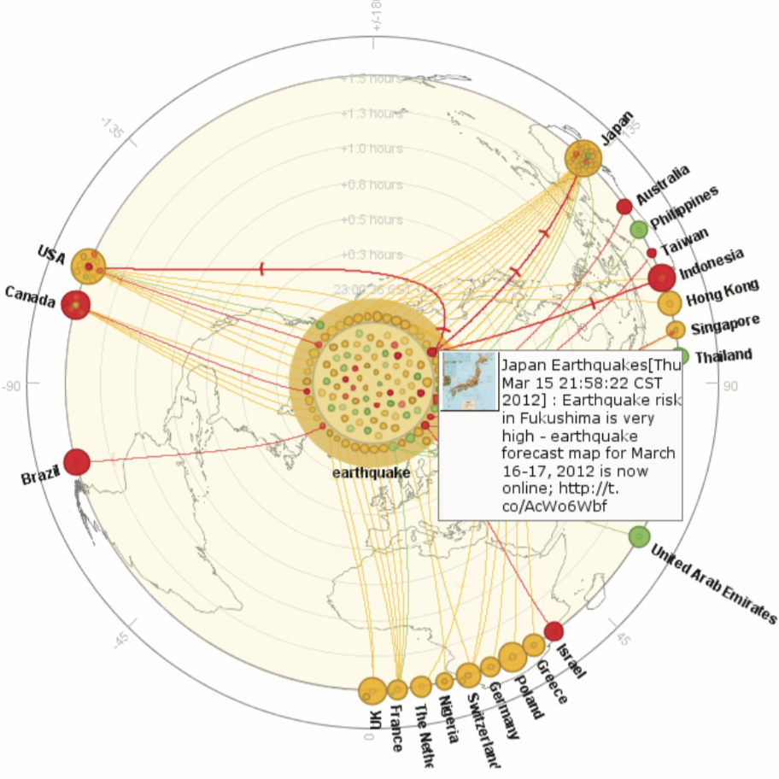
Geographic Information: Geo-tagged
Information Diffusion Visualization
Two sources of geo information
  Where the social media users come from (Relative static)
  Where the social media users post the messages (Dynamic)
Integrating the spatial temporal information and representing the diffusion process across multiple regions
Whisper [CLS∗12]

Slide 21
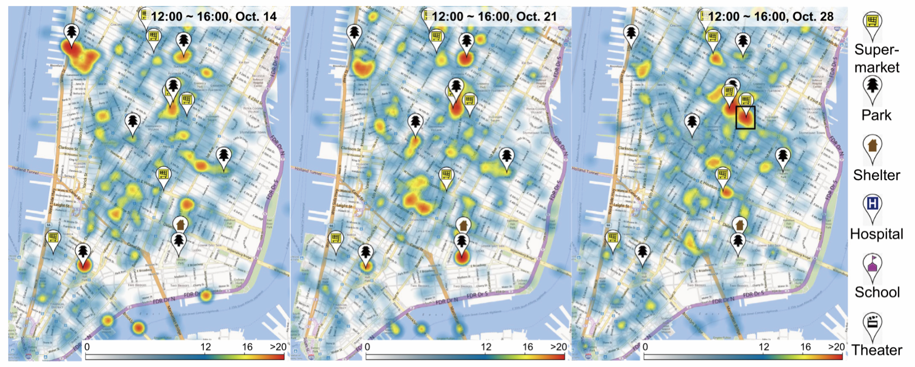
Geographic Information: Spatial Temporal
Event Distribution Visualization
Two sources of geo information
  Where the social media users come from (Relative static)
  Where the social media users post the messages (Dynamic)
A density map design with the aggregation to show the distribution of the social events [CTJ∗14]

Slide 22
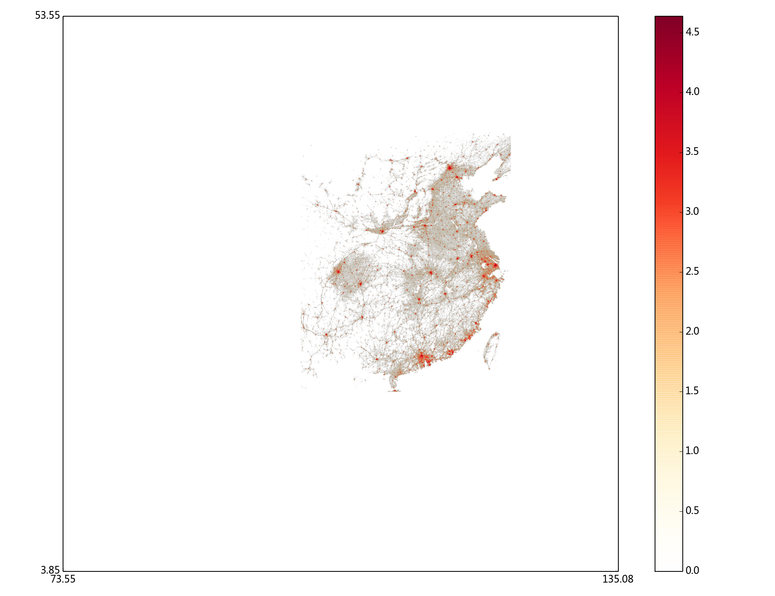
Geographic Information: Spatial Temporal
Event Distribution Visualization

Slide 23
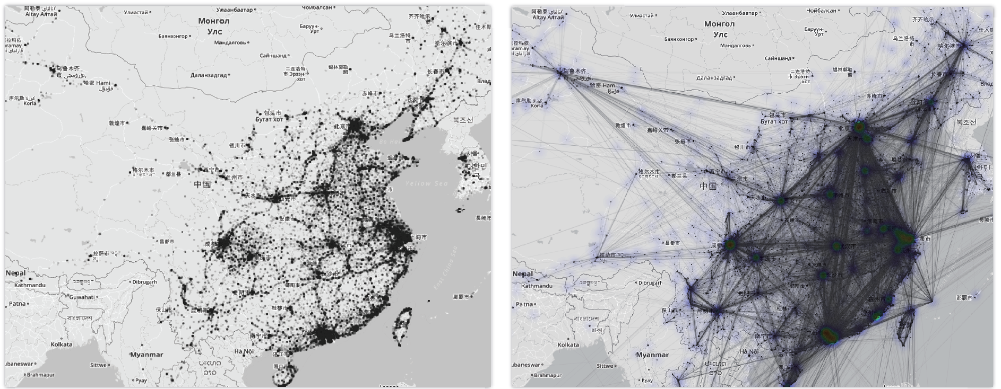
Geographic Information: Movement
Trajectories Visualization
Two weeks Weibo distribution in China and its neighborhood
[CYW∗16]

Slide 24
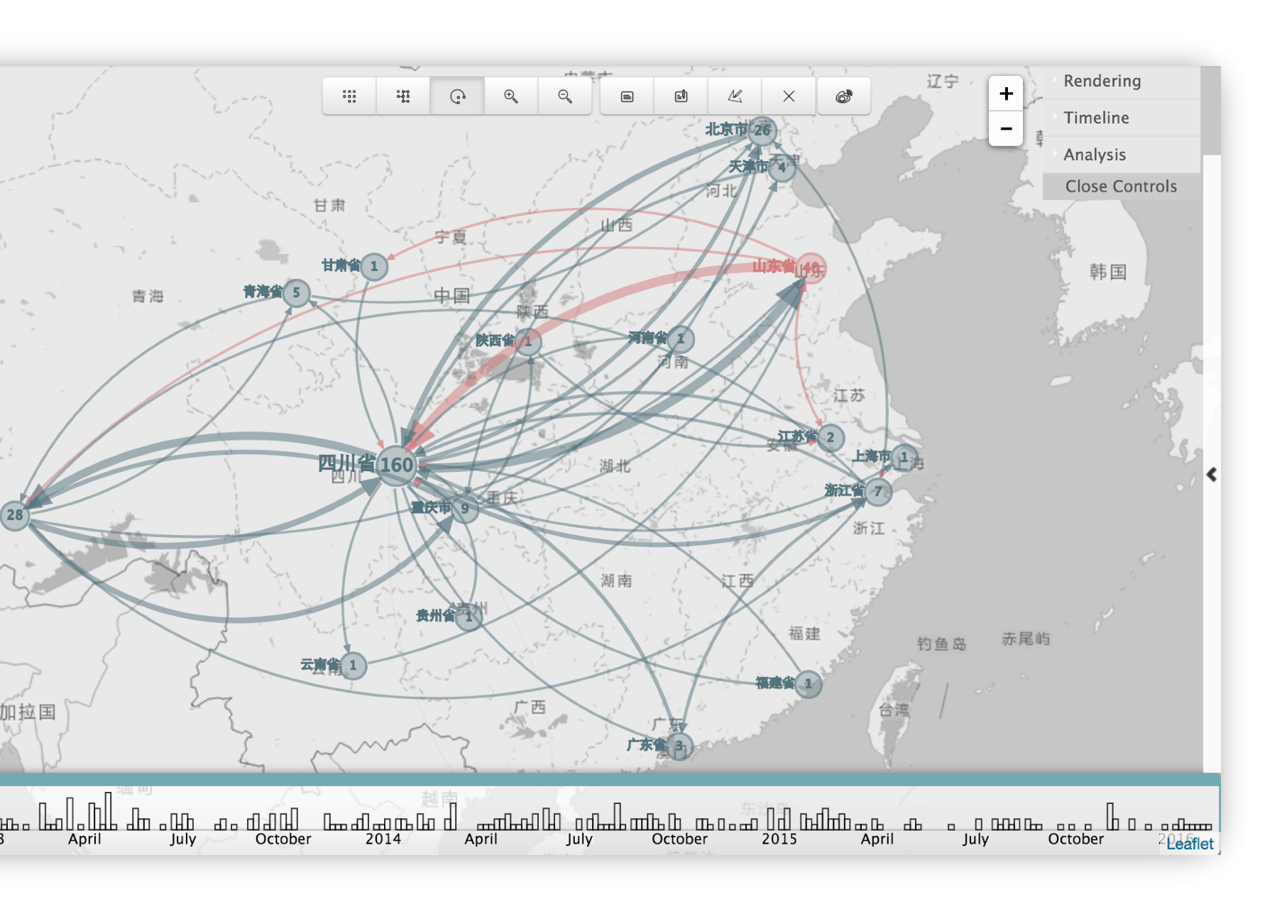
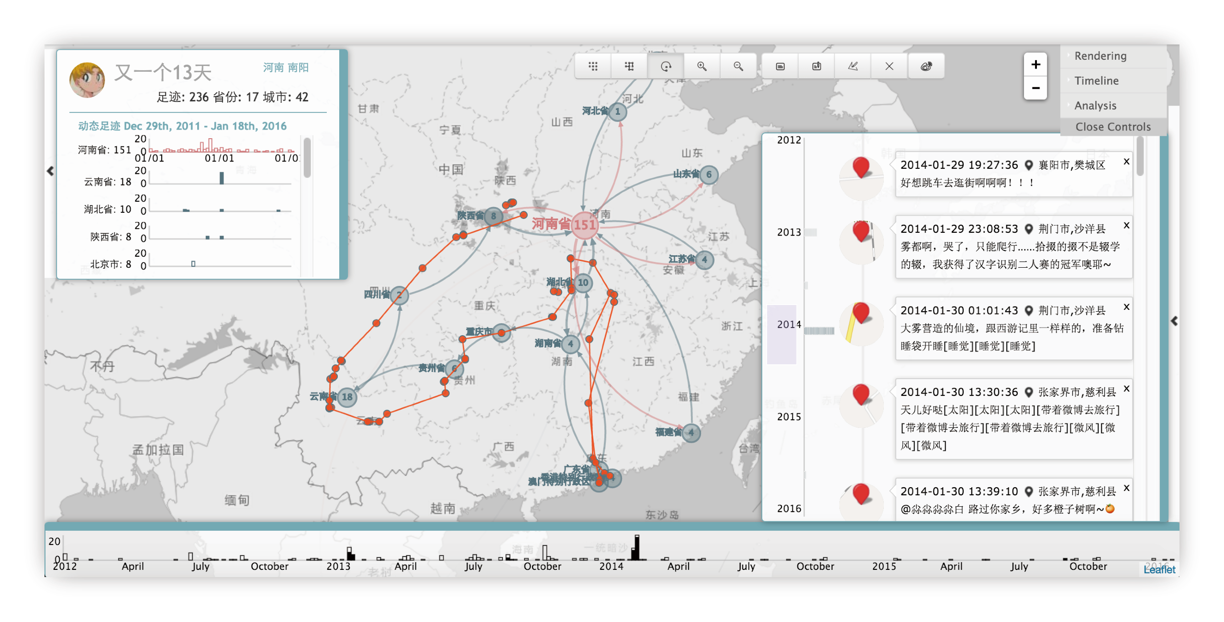
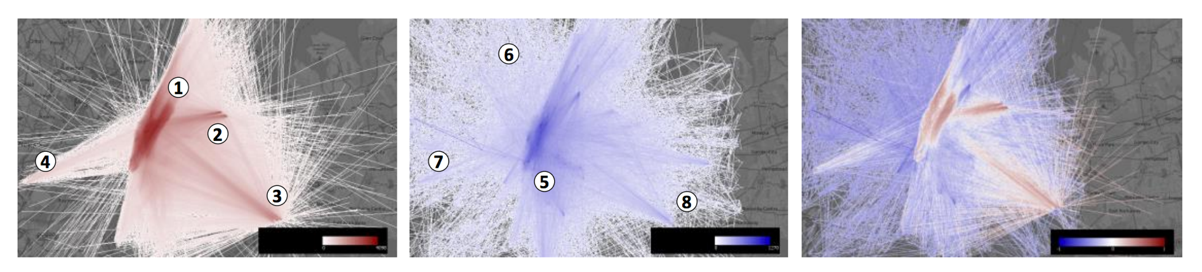
Geographic Information: Movement
Trajectories Visualization
Semantic Movement Patterns
Weibo Footprint [CWLY16]
TravelDiff [KSB∗16]

Slide 25
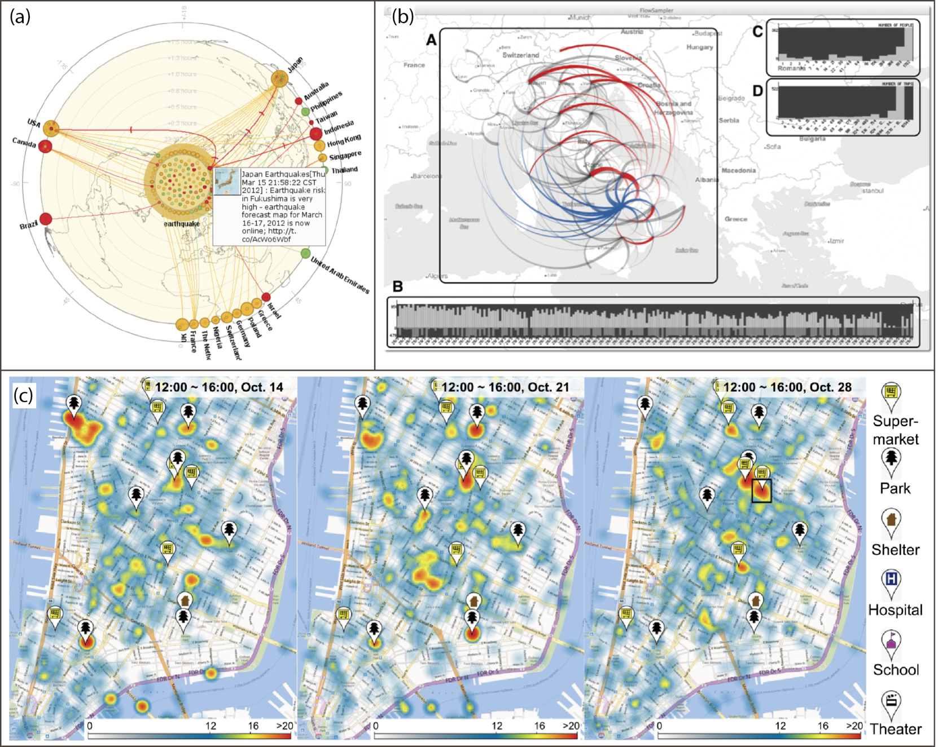
Geographic Information Visualization
Summary: Visualization on the Map
Density-based Visualization
Flow-based Visualization
(a) Whisper [CLS∗12], (b) Flowsampler [CMSVM14], (c) Density Map [CTJ∗14]

Slide 26
Classification of Social Media Entities and Related Visualization Techniques
Notes:
人和机器共存共创的智能社会。
Add additional materials. 1.无处不在。 2. 引领 2 ppt. 1. 家庭＋社会 组织管理 日常生活 机器 ＋ 国家管理决策 －》个人－》网络 智能国防装备，车，无人机，作战指挥系统，物流，智能武器， 图片 大背景／

Slide 27
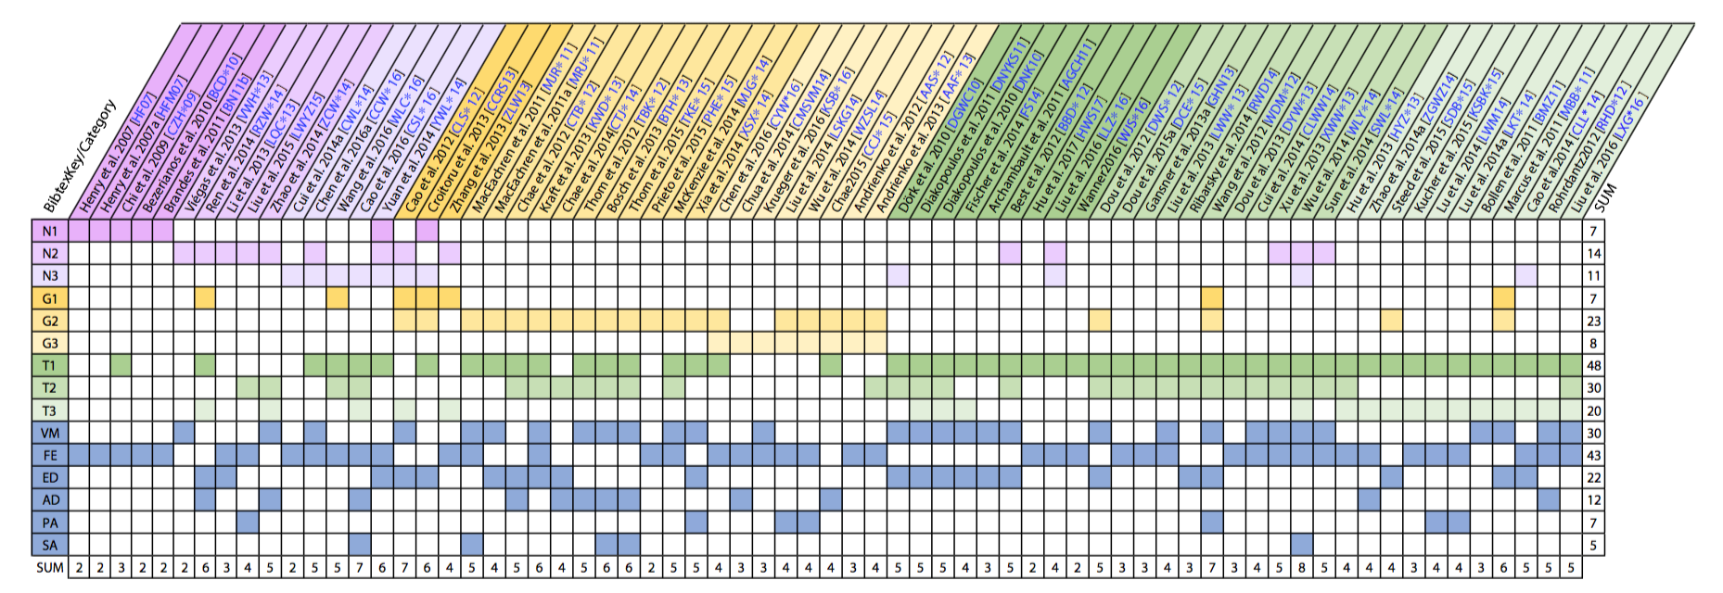
Paper Collections

Slide 28
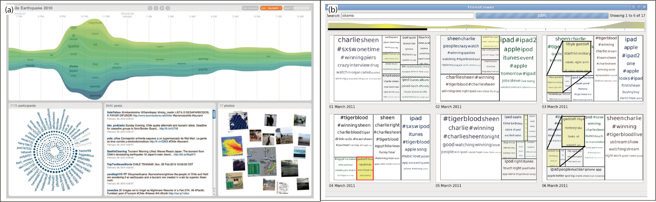
Text and Content: Keywords Visualization
Extracted keywords from content
  Dynamic keywords along the time
  Multi-level aggregation of keywords
(a) Visual BackChannel [DGWC10], (b) ThemeCrowds [AGCH11]

Slide 29
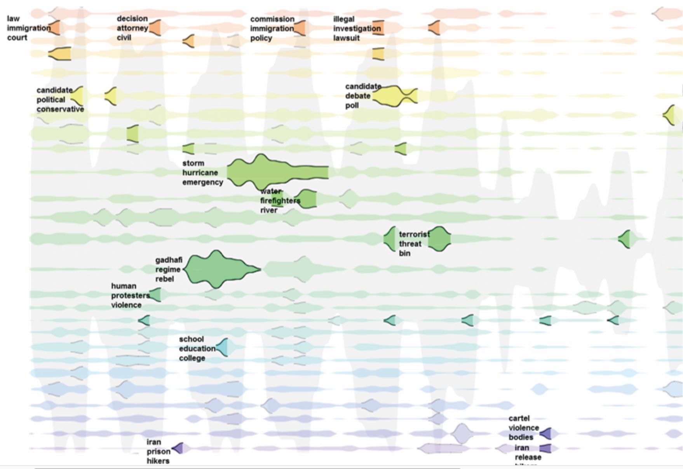
Text and Content: Topic Visualization
Topic Structure
  Dynamic change along the time
LeadLine [DWS∗12]

Slide 30
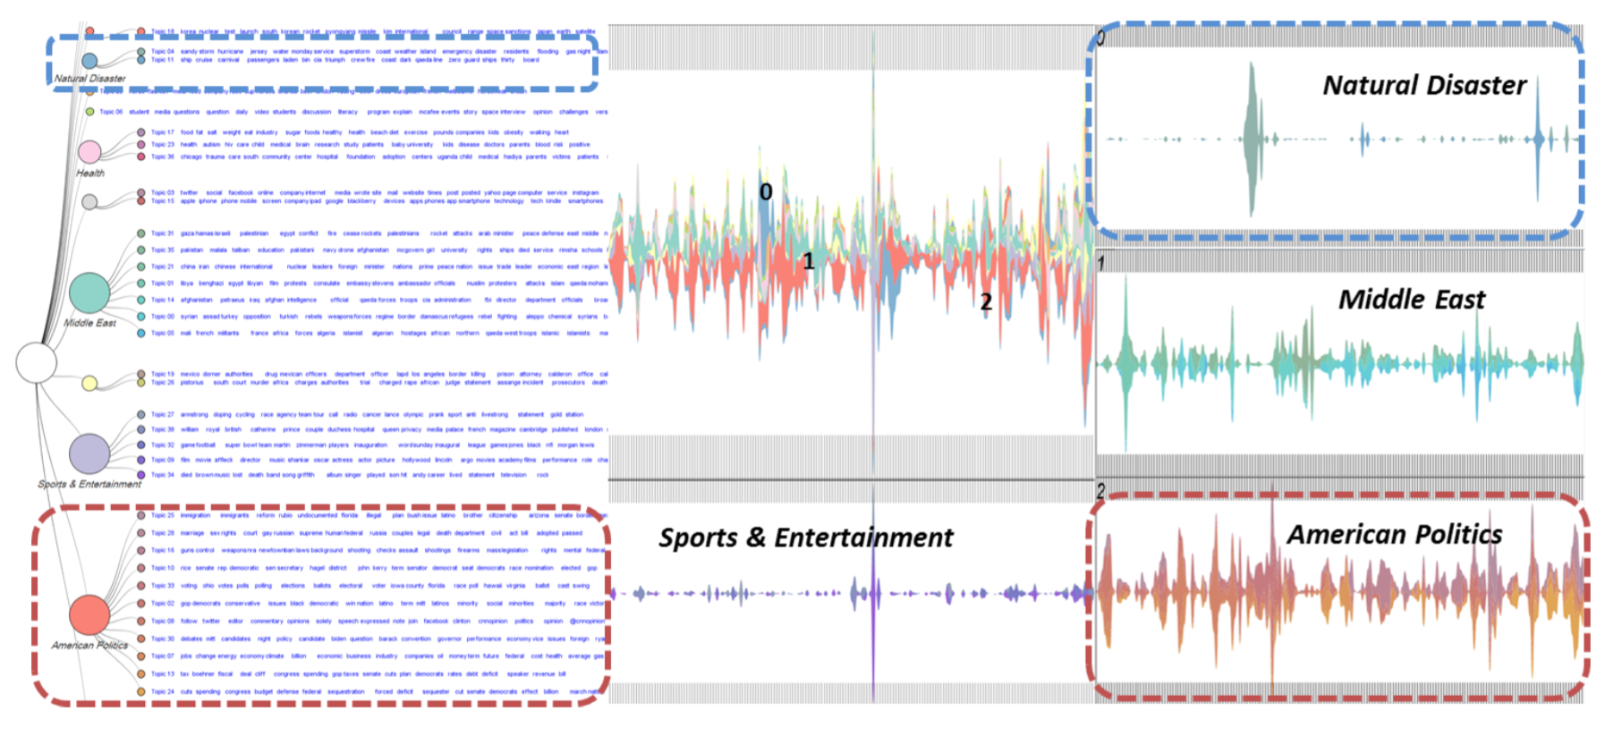
Text and Content: Topic Visualization
Topic Structure
  Dynamic change along the time
  Hierarchical Topics
HierarchicalTopics [DYW*13]

Slide 31
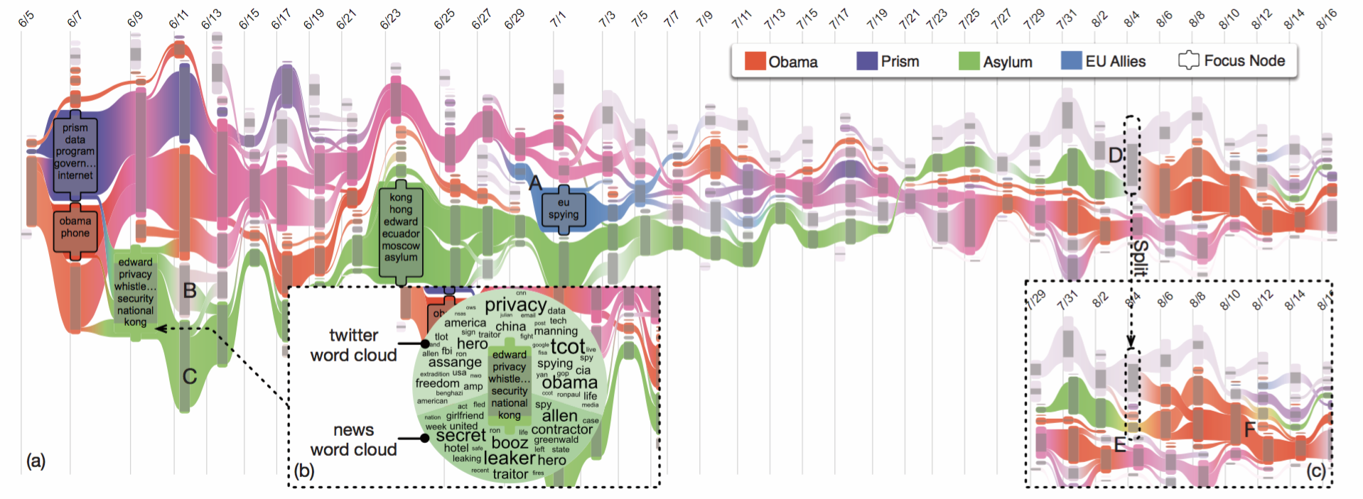
Text and Content: Topic Visualization
Topic Structure
  Dynamic change along the time
  Hierarchical Topics
  Dynamic Hierarchical Topics
RoseRiver [CLWW14]

Slide 32
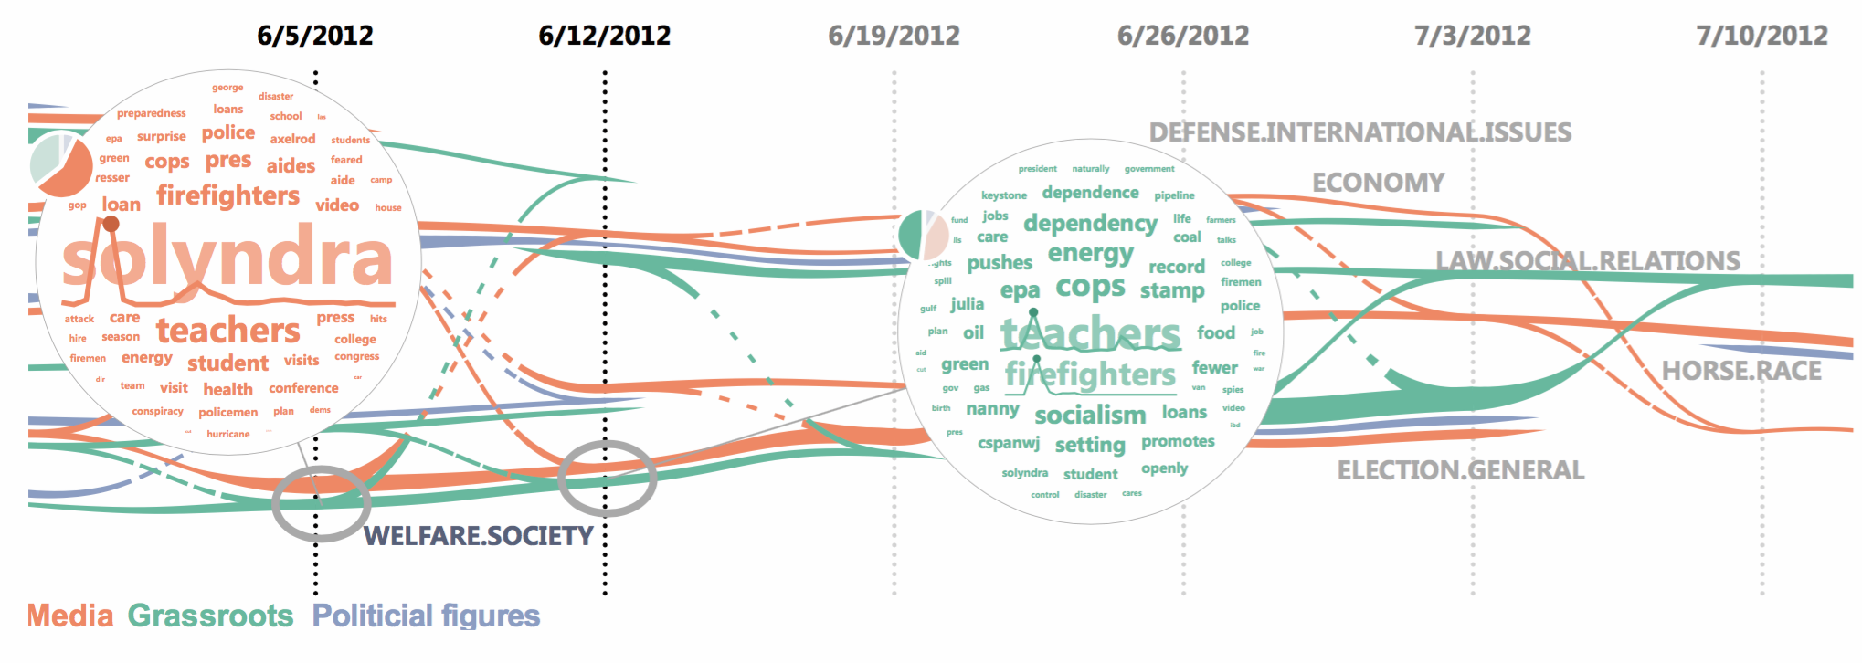
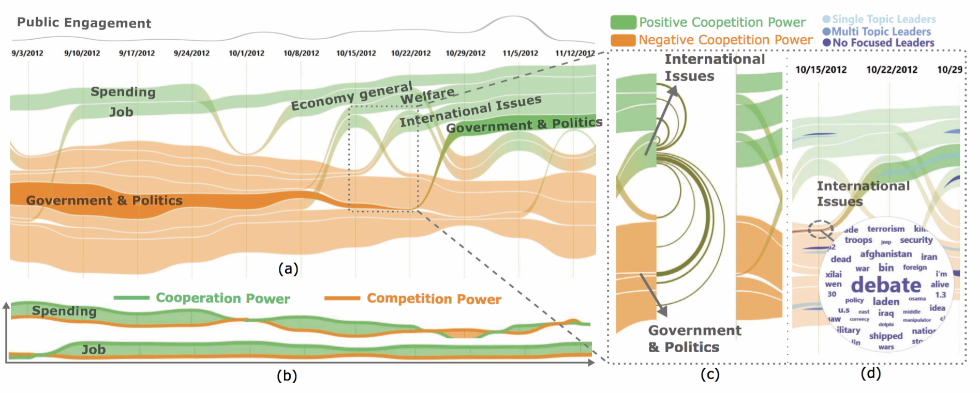
Text and Content: Topic Visualization
Topic Interactions
  Competition
  Collaboration
Topic competition [XWW∗13].
EvoRiver, visualizing the competition and collaboration relationships of topics [SWL∗14].

Slide 33
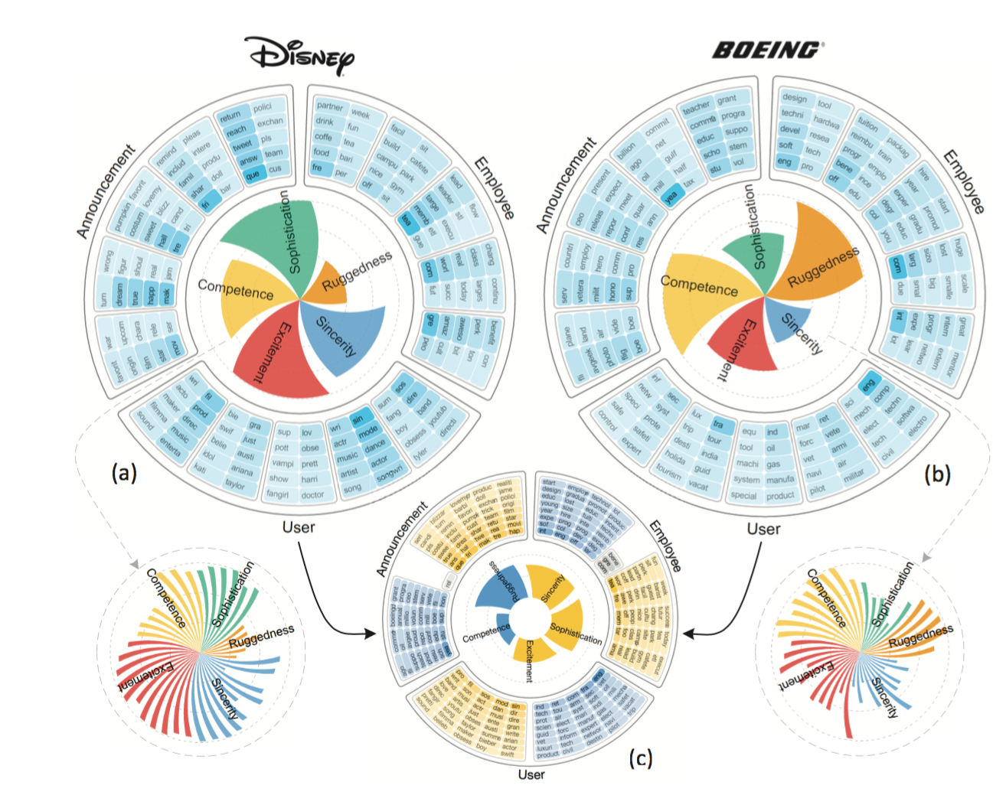
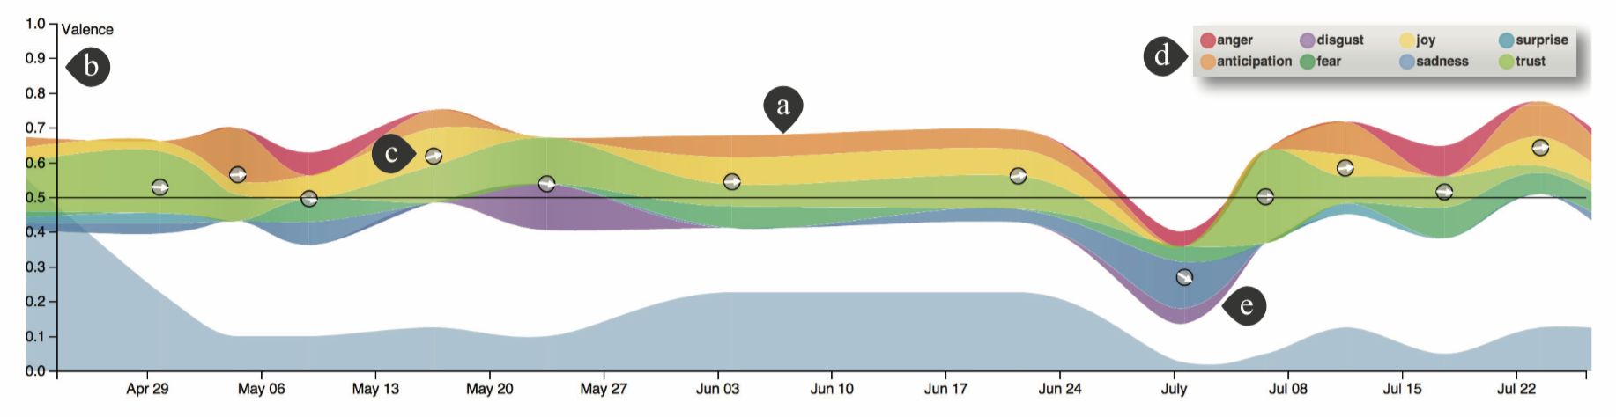
Text and Content: Sentiment Visualization
SocialBrands [LXG*16]
Sentiment
  Attitude Distribution
  Dynamic Sentiment Change
Sentiment visualization [ZGWZ14]

Slide 34
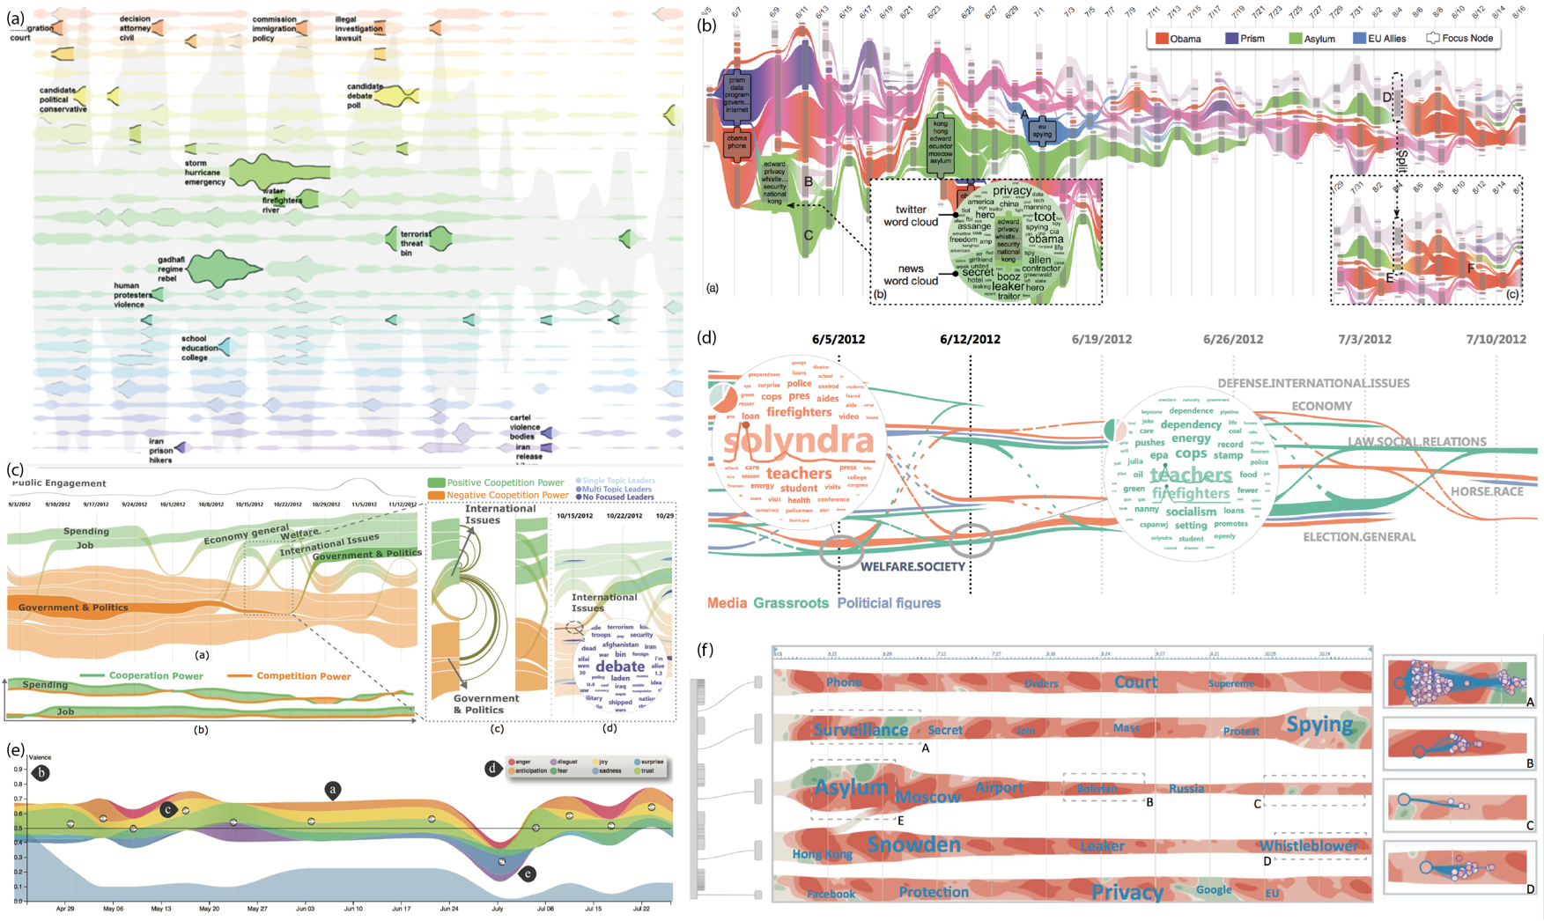
Text and Content Visualization Summary:
River-like Visual Metaphor

Slide 35
Classification of Social Media Entities and Related Visualization Techniques
Notes:
人和机器共存共创的智能社会。
Add additional materials. 1.无处不在。 2. 引领 2 ppt. 1. 家庭＋社会 组织管理 日常生活 机器 ＋ 国家管理决策 －》个人－》网络 智能国防装备，车，无人机，作战指挥系统，物流，智能武器， 图片 大背景／

Slide 36
Technique Relationship
N1-N3: Following Network, Information Diffusion Network and Reposting Network;
G1-G3: Geographic Information Diffusion, Spatial Temporal Event Distribution and Movement Trajectories;
T1-T3: Keywords, Topic and Sentiment

Slide 37
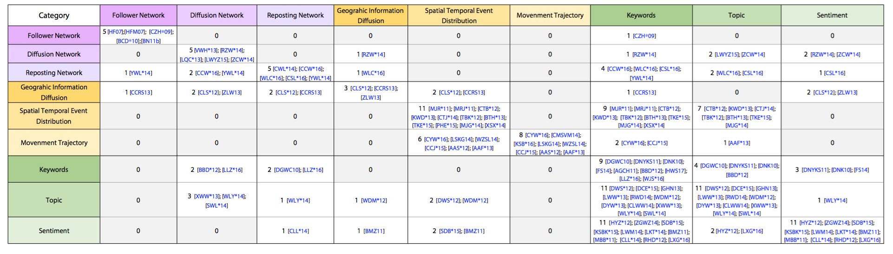
Pair-wised Technique Relationship
Social Network Visualization
  Follower-Followee Relationship
  Reposting / Diffusion Relationship
D-Map [CCW*16]

Slide 38
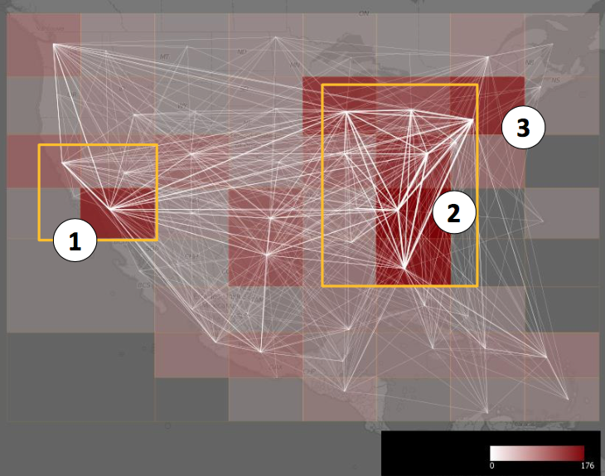
Pair-wised Technique Relationship
Geographic Information in Social Media
  Geographic information diffusion
  Event distribution / trajectories
TravelDiff [KSB∗16]

Slide 39
Pair-wised Technique Relationship
Text and Content
  Keywords are frequently used
  Multiple abstracted level
EvoRiver [SWL∗14].

Slide 40
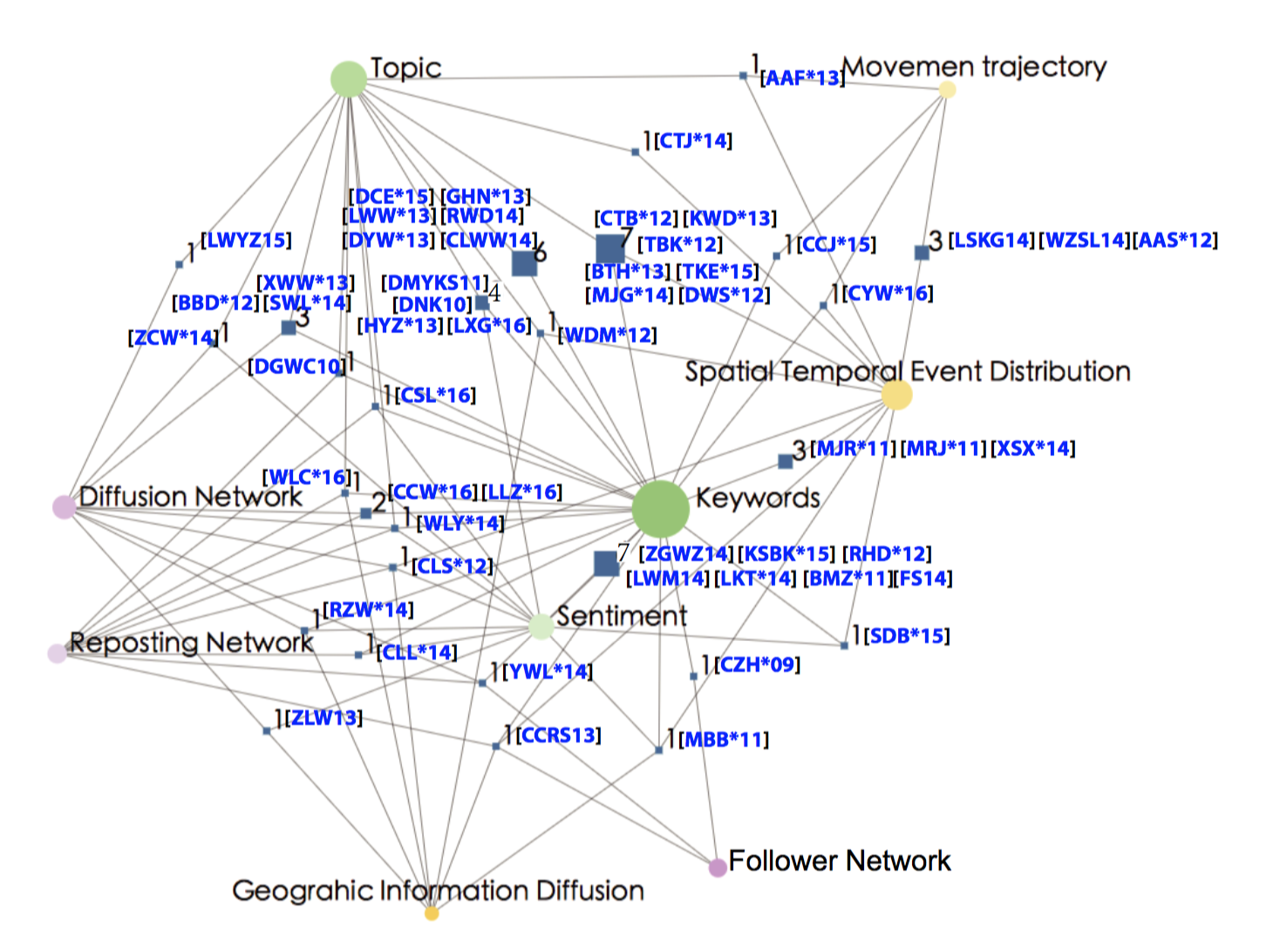
Combination of Multiple Entities and
Techniques – Visual Analytics
Graph-based intersection exploration
  Circle: Category
  Rect: Intersection
Combination Examples
  (+) Spatial temporal event distribution + Keywords + Topics
  (-) Movement + Semantics?
  (-) Social network + Sentiment

Slide 41
Survey Methodology
N1-N3: Following Network, Information Diffusion Network and Reposting Network;
G1-G3: Geographic Information Diffusion, Spatial Temporal Event Distribution and Movement Trajectories;
T1-T3: Keywords, Topic and Sentiment
VM: Visual Monitoring;
FE: Feature Extraction;
ED: Event Detection;
AD: Anomaly Detection;
PA: Predictive Analysis;
SA: Situation Awareness
Notes:
人和机器共存共创的智能社会。
Add additional materials. 1.无处不在。 2. 引领 2 ppt. 1. 家庭＋社会 组织管理 日常生活 机器 ＋ 国家管理决策 －》个人－》网络 智能国防装备，车，无人机，作战指挥系统，物流，智能武器， 图片 大背景／

Slide 42
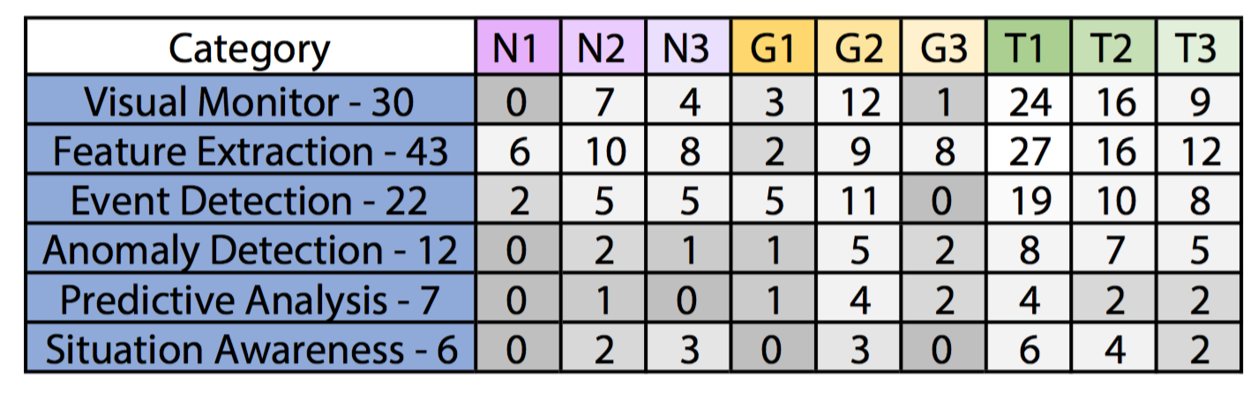
Survey Methodology
VM: Visual Monitoring;
FE: Feature Extraction;
ED: Event Detection;
AD: Anomaly Detection;
PA: Predictive Analysis;
SA: Situation Awareness
Notes:
人和机器共存共创的智能社会。
Add additional materials. 1.无处不在。 2. 引领 2 ppt. 1. 家庭＋社会 组织管理 日常生活 机器 ＋ 国家管理决策 －》个人－》网络 智能国防装备，车，无人机，作战指挥系统，物流，智能武器， 图片 大背景／

Slide 43
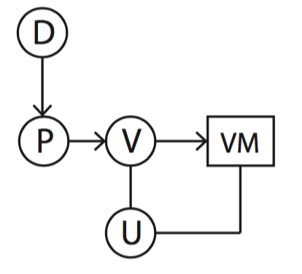
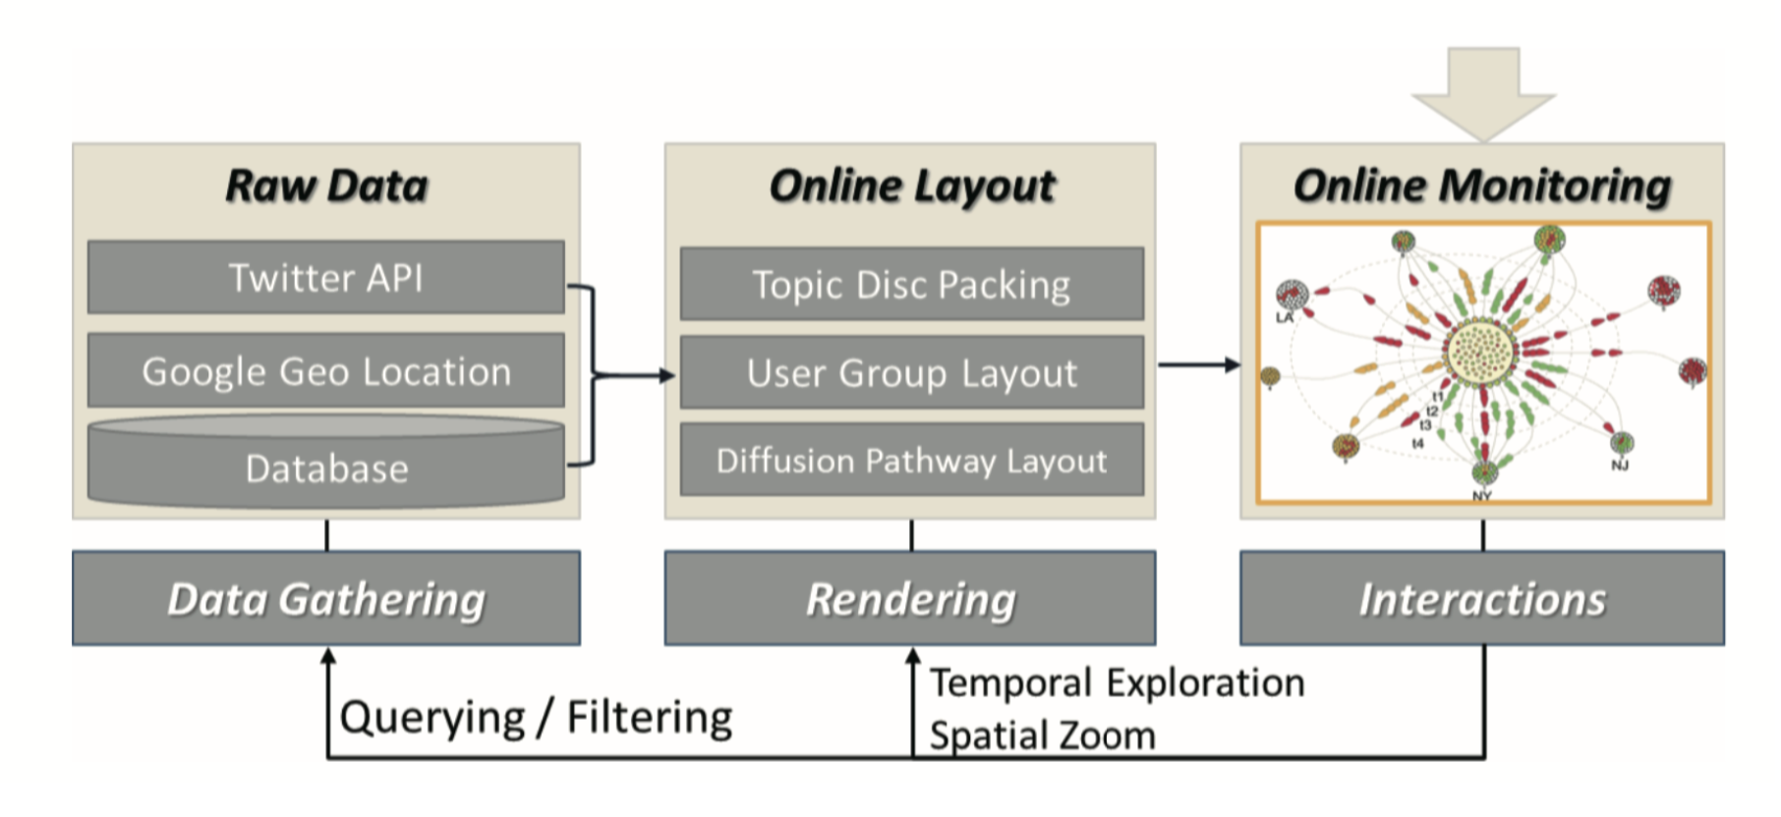
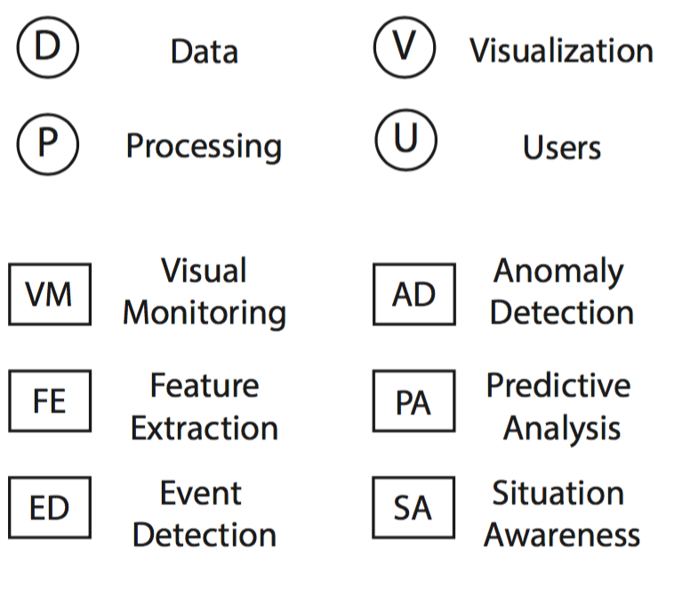
Social Media Visual Analytics (1) – Visual Monitoring
Monitoring (e.g. Information diffusion process, reposting behaviors, moving behaviors etc.)
  Overview design
  Streaming Data
  Animation
Whisper [CLS∗12]

Slide 44
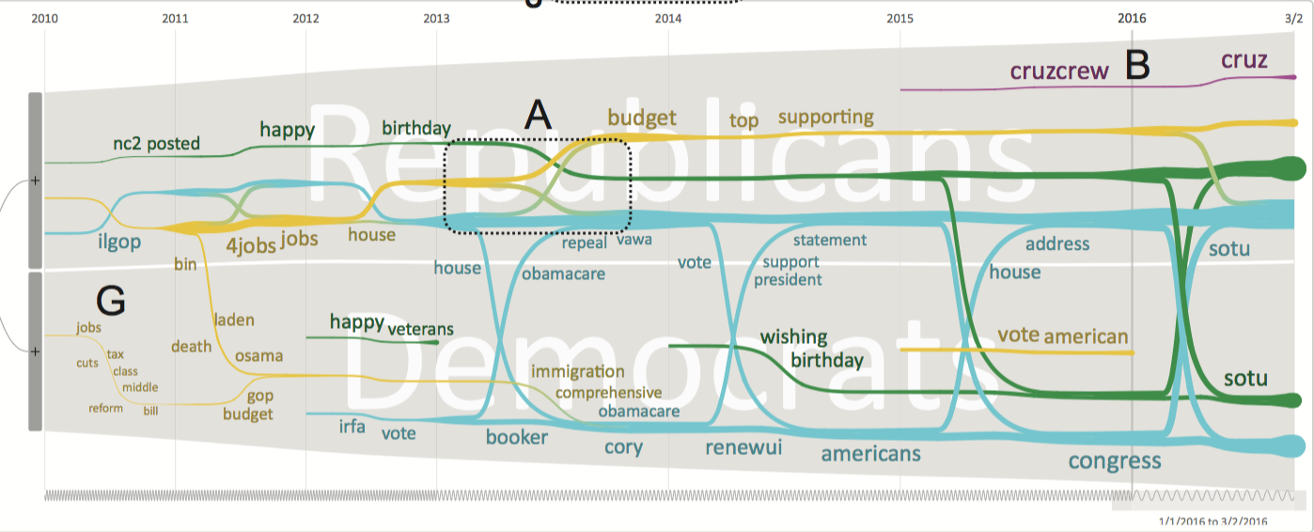
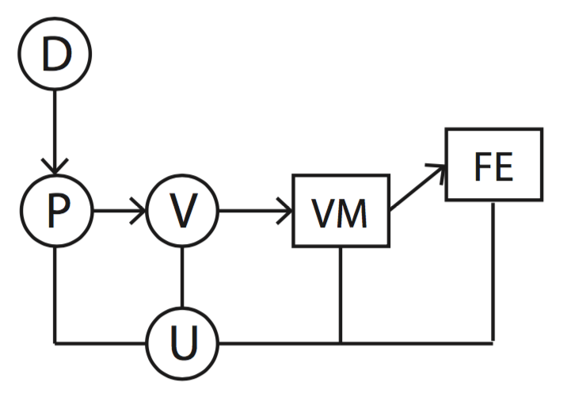
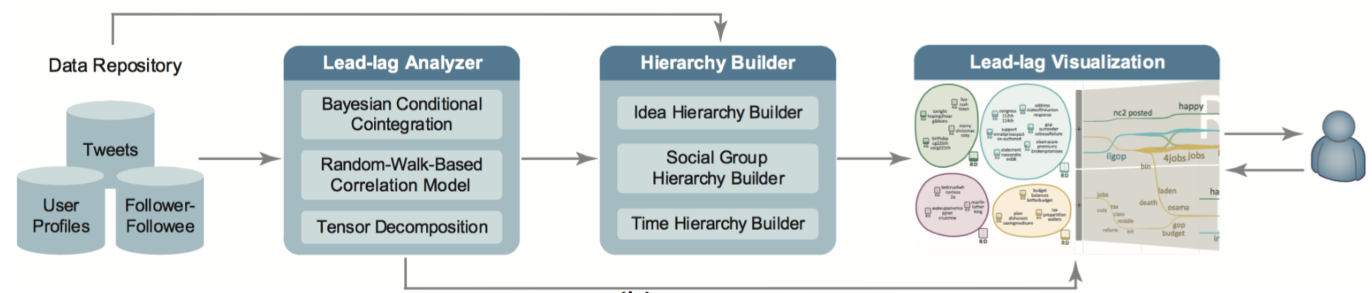
Social Media Visual Analytics (2) – Feature Extraction
Feature Extraction (e.g. summarized diffusion patterns, movement trajectories with semantics, etc.)
  Significant characteristics of specific data attributes
  Combining data mining algorithms
  Preprocessing
IdeaFlow [WLC*16]

Slide 45
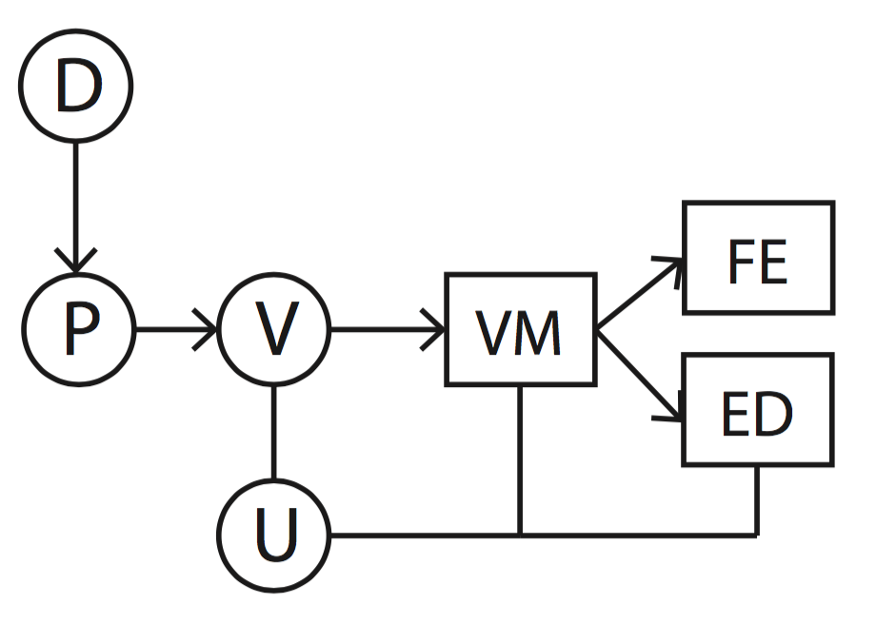
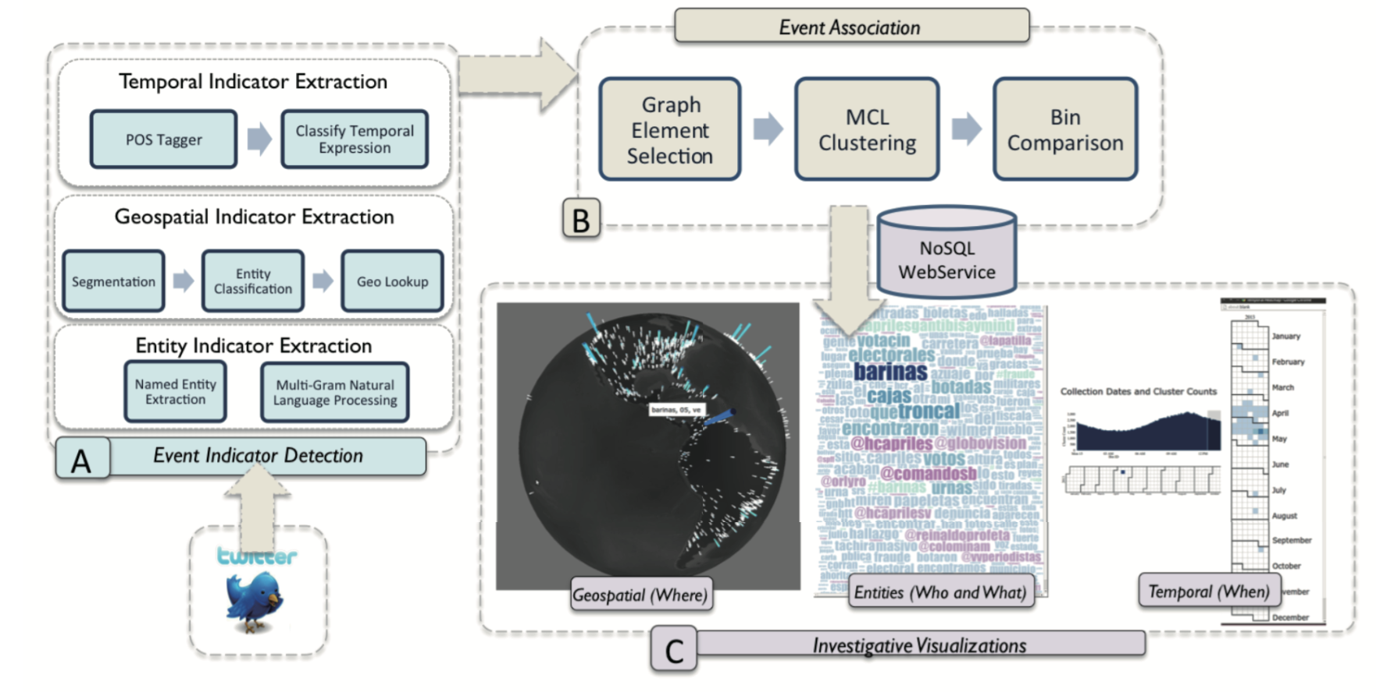
Social Media Visual Analytics (3) – Event Detection
Event: <People, Messages, Time, [Reposting, Location, Themes]>
  Event extraction
  Event visualization
  Event analysis
GCAT [KWD∗13]

Slide 46
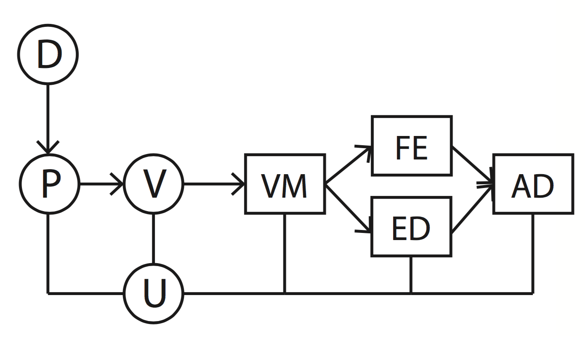

Social Media Visual Analytics (4) - Anomaly Detection
Normal patterns: data is around average / common ranges of its attributes
Abnormal patterns
  Classification model
  Visual query and analysis
Public Response Analysis [CCJ∗15]
Notes:
type

Slide 47



Social Media Visual Analytics (5) – Predictive Analysis
Predictive Analysis (Topic trend, keywords rating, etc.)
  Event detection
  Abnormal event detection
  Similarity analysis
  Prediction and verification
Topic Decomposition [YJ15]

Slide 48


Social Media Visual Analytics (6) – Situation Awareness
Situation Awareness (Combination of spatial temporal events, topic and social networks) – for Decision Making
  Visual monitoring
  Feature extraction / Event detection
  Anomaly detection
ScatterBlogs2 [BTH∗13]

Slide 49

Social Media Visual Analytics (6) – Situation Awareness
Can Twitter Really Save Your Life? A Case Study of Visual Social Media Analytics for Situation Awareness
ScatterBlogs2 [BTH∗13, TKE∗ 15]

Slide 50

Social Media Visual Analytics Pipeline

Slide 51




Applications and Systems
Crisis Management [DTH*13]
Applications and Systems
Social Science Research [CCW*16]
Journalism [DNYKS11]
Politics [SWL*14]
Disaster and Emergency Management [CTH*14]

Slide 52

Application: Social Science Research
Topic Leader Theory
Topic Coopetition – Collaboration and Competition
Social Science and Politics [SWL*14]
Notes:
??

Slide 53

Application: Social Science Research
D-Map [CCW*16]

Slide 54

Application: Social Science Research
Repeating
patterns
Strong
Center
Many communities, Strong Center
Small influences among communities
Representative accounts: Businessman in Social Media
D-Map [CCW*16]
Notes:
??

Slide 55

Application: Social Science Research
Dual Center
Behaviors
Different territories
Many communities, Dual-center Patterns
Large influences among communities
Representative accounts: Accounts reposted by
accounts with larger influence
D-Map [CCW*16]

Slide 56

Journalism Application: WeiboEvents
WeiboEvents [RZW∗14]

Slide 57

Emergency/Disaster/Crisis Management
Gain a general overview
Investigate prominent topics
Analyze message in detailed regions
Examine where the emergency is the most severe
ScatterBlogs2 [BTH∗13, TKE∗ 15]

Slide 58


More applications and commercial systems

Slide 59
Discussion – Challenges and Opportunities
Social Media Data Content
  Content analysis - Extracted keyword/topic analysis
  Multi-media visual analytics
  How to deal with bias / trustiness of sampling
  How to deal with privacy issues

Slide 60
Discussion – Challenges and Opportunities
Social Network Evolution Analysis
  Challenge: both relationship and temporal analysis
  Visualization: river-like and map-like visual metaphor
  Visual analytics approach: pattern analysis
  How to detect (subtle) anomaly? It’s still in the exploration stage
Map-like Visualization [CCW*16]
River-like Visualization [SWL*14]

Slide 61


Discussion – Challenges and Opportunities
Movement and Trajectory Analysis
  Challenge: Understand trajectory patterns with semantics
  Detecting movement patterns considering periodical behaviors / uncertainty
  Comparison with other data sources
Visits [TBC13]
WeiboGeo [CYW*16]
TravelDiff [KSB∗16]

Slide 62
Discussion – Challenges and Opportunities
Heterogeneous visual analytics
  Attribute level – Profiling social media users
  Data level – Enriching behavior understanding with additional data source
  Analysis level: Social Media + other discipline's analytical pipeline
Evaluation of Social Media Visual Analytics
  Target users
  Tasks
  User study
  Expert feedback
Notes:
large

Slide 63

Summary
Social Media Data Category
Social Media Visualization
Social Media Visual Analytics
Application and System
Discussion and Summary

Slide 64
Acknowledgement
Reviewers
Funding
  NSFC No. 61672055
  NSFC Key Project No. 61232012
  The National Program on Key Basic Research Project (973 Program) No.2015CB352503.
PKU-Qihoo Joint Data Visual Analytics Research Center.

Slide 65
Thank you !

