Slide 1
Interactive Visual Discovering of Movement Patterns from Sparsely Sampled Geo-tagged Social Media Data
Siming Chen¹, Xiaoru Yuan¹, Zhenhuang Wang¹, Cong Guo¹, Jie Liang¹, Zuchao Wang¹, Xiaolong (Luke) Zhang², Jiawan Zhang³
¹ Key Laboratory of Machine Perception (Ministry of Education), School of EECS, Peking University
² Pennsylvania State University
³ Tianjin University

Slide 3
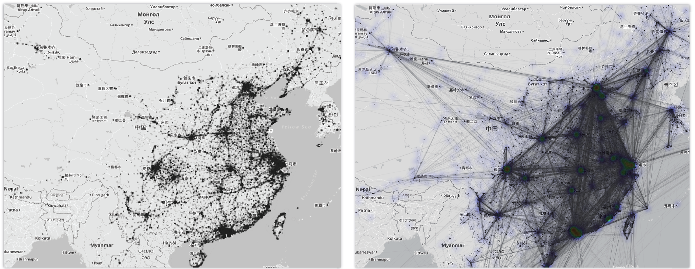
Geo-tagged Weibo Data
Distribution over the country (2 weeks)
Notes:
13.7 m weibos, 5 m users

Slide 4
Large amounts of people and wide geographic coverage
Notes:
1 months, 25 m weibos, 8 m users?

Slide 5
Introduction
Developed an interactive visual analytics procedure to analyze movement patterns with semantics of social media users
Categorized movement
Possible transportation methods
Possible travel type: travelling, business, etc.
Frequent visiting patterns
Keywords and content of the trips
However…
Sparsely and Irregular Sampling leads to high variation and uncertainty

Slide 6
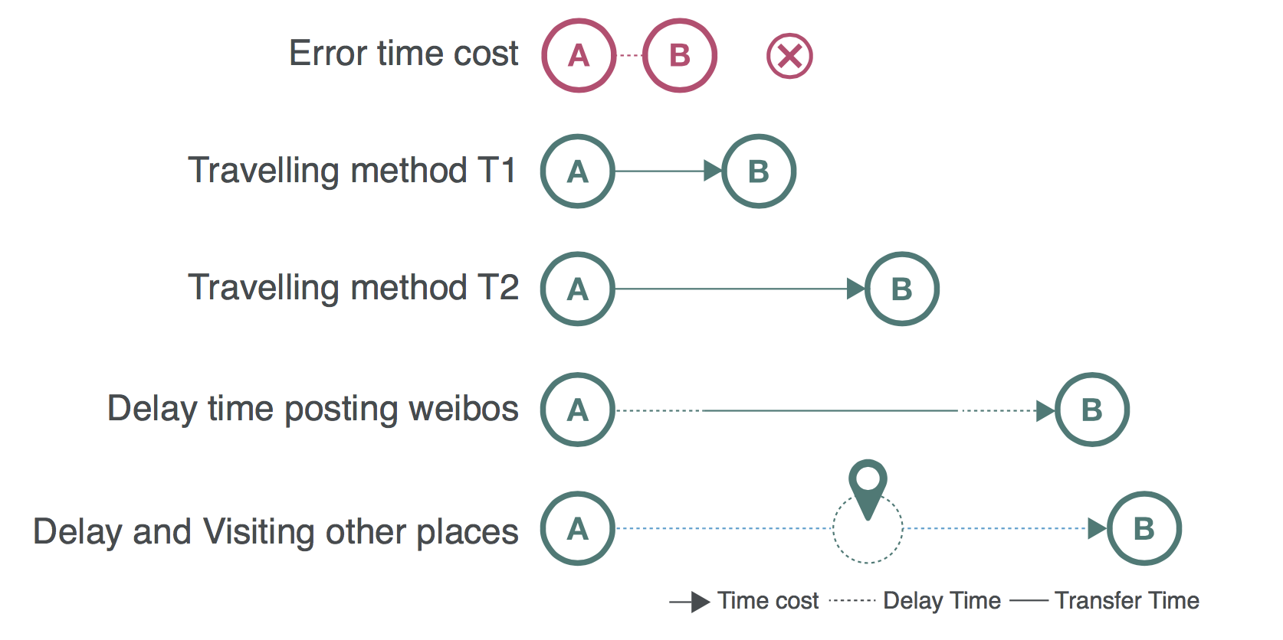
Challenges: Uncertain and Irregular sampling

Slide 7
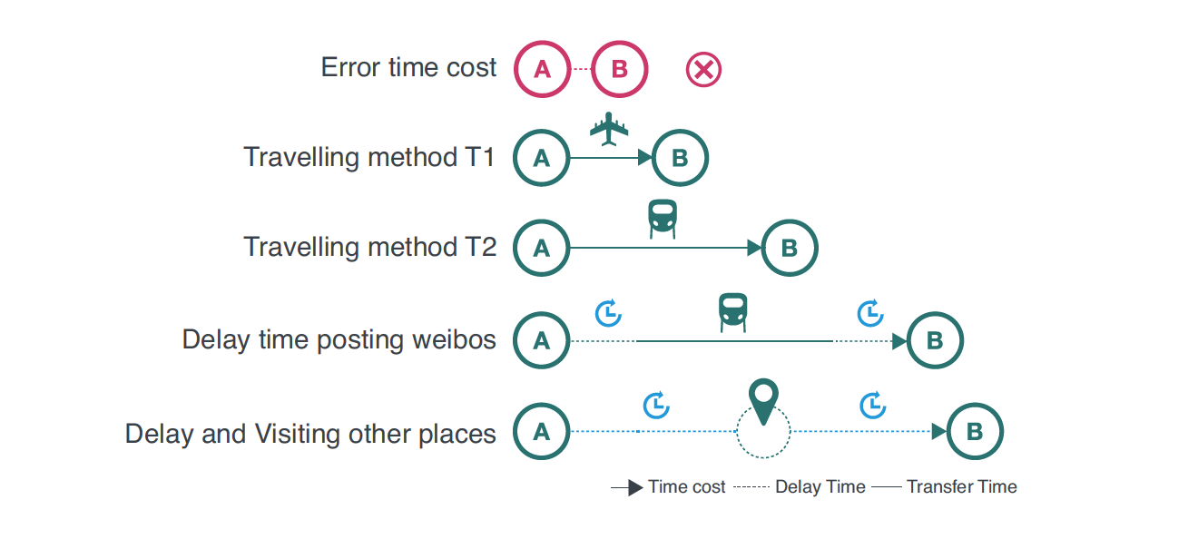
Gaussian Mixture Model based Uncertainty Modeling
So, how to get reliable movements with semantics from such data?
Foundations
Each transportation method corresponds to a time distribution
In traffic modeling field, a general model of the time interval is the Gaussian Distribution
Different transportation methods have different distributions
Input – movement data
Output
Category information within confidence interval of each time interval distribution
Inferred semantics combined with text information
Illustration for transportation derived
from geo-tagged weibos

Slide 8
Uncertainty Model – Case Illustration
Movements between Beijing and Chengdu
1) Original time interval distribution (a)
(a)
Notes:
5,000 weibos, 1,000 users

Slide 9
Uncertainty Model – Case Illustration
Movements between Beijing and Chengdu
1) Original time interval distribution (a)
2) Filter out the trajectories with time interval less than 1 hour and more than 60 hours
(a)
(b)

Slide 10
Uncertainty Model – Case Illustration
Movements between Beijing and Chengdu
1) Original time interval distribution (a)
2) Filter out the trajectories with time interval less than 1 hour and more than 60 hours
3) Get the distribution with modeling with k=3,4
(a)
(b)
(c)
(d)

Slide 11
Uncertainty Model – Case Illustration
Movements between Beijing and Chengdu
1) Original time interval distribution (a)
2) Filter out the trajectories with time interval less than 1 hour and more than 60 hours
3) Get the distribution with modeling with k=3,4
4) Investigate the four peaks in (d)
5) Using external data sources for investigation ( air plan, train time table, etc.)
P1：By plane
P2：Plane delay
P3：Train
P4：large delay time, no specific transportation methods
(a)
(b)
(c)
(d)
Top 30 Keywords distributions in each peak of (d)

Slide 12
Visual Analytics System
(a) Time line view, (b) Spatial temporal view, (c) ST matrix view, (d) ST detail view, (e) ST model view, (f) Parameter control bar

Slide 13
Visual Analytics Pipeline - Augmenting Statistics Model with Visual Analytics
1) Data reprocessing – remove the advertisement account, robots, jumping points, etc.

Slide 14
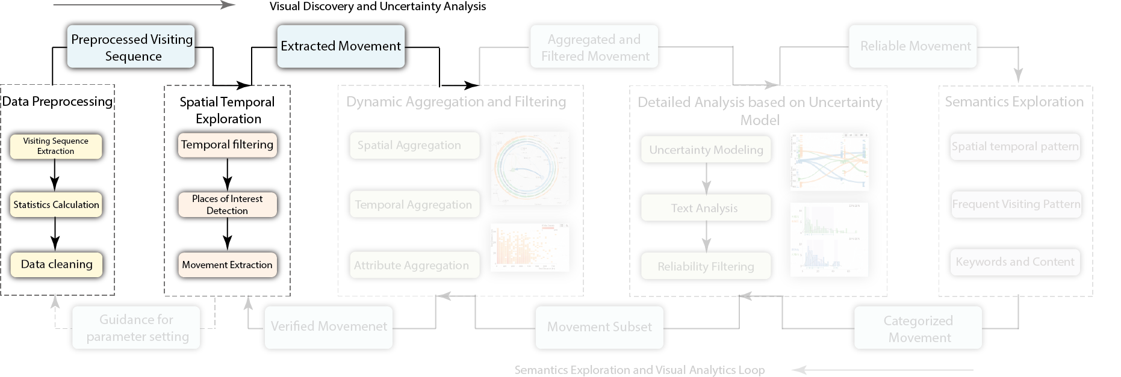
Visual Analytics Pipeline - Augmenting Statistics Model with Visual Analytics
2) Spatial temporal exploration – interactive POI selection and temporal filtering.

Slide 15
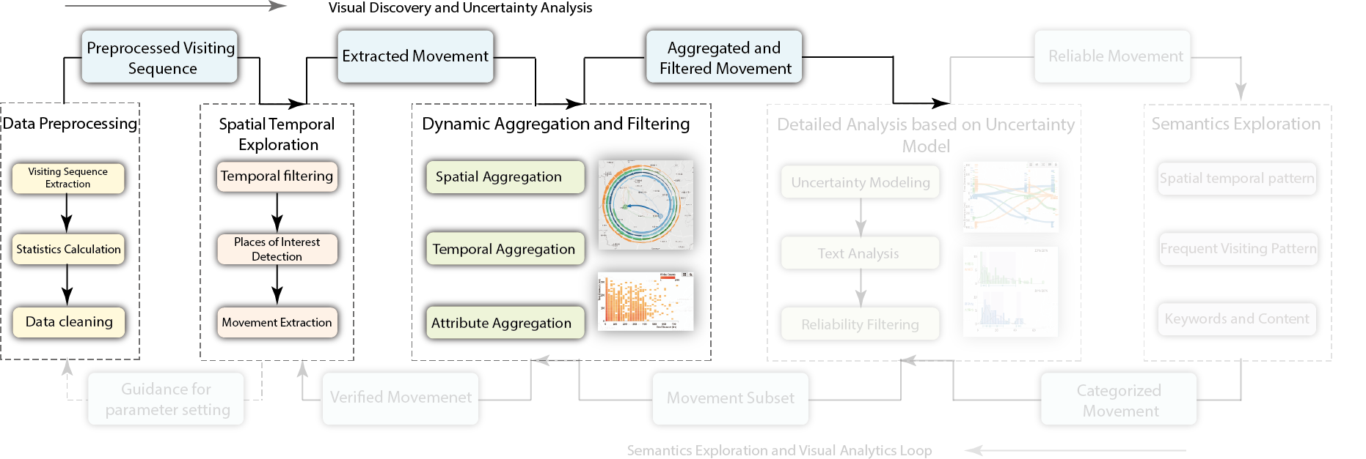
Visual Analytics Pipeline - Augmenting Statistics Model with Visual Analytics
3) Dynamic aggregation and filtering – filter spatial and non-spatial attributes (time interval / geo distance) distribution

Slide 16
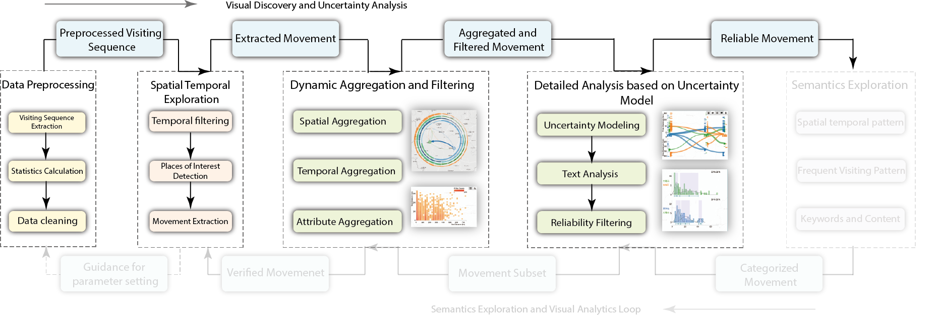
Visual Analytics Pipeline - Augmenting Statistics Model with Visual Analytics
4) Detailed analysis – adjust the parameters of uncertainty modeling, iteratively adjust the output of the model with text analysis and spatial temporal filtering

Slide 17
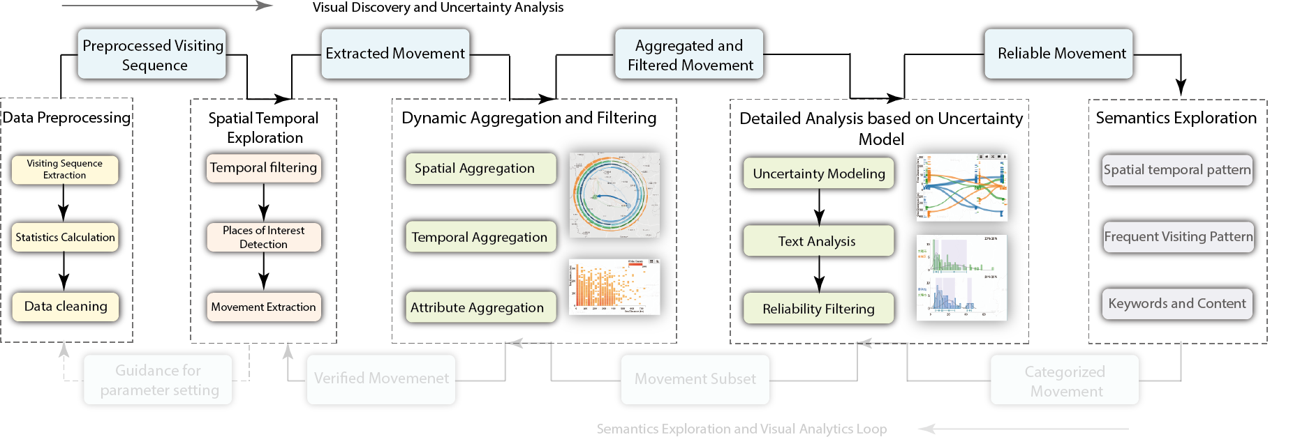
Visual Analytics Pipeline - Augmenting Statistics Model with Visual Analytics
5) Semantics Exploration – with customized POI, temporal ranges and reliable movement data within specific categories

Slide 18
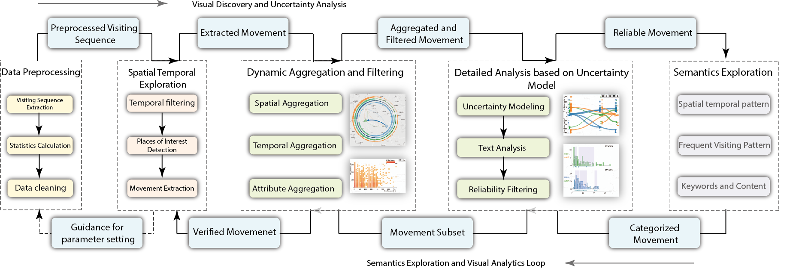
Visual Analytics Pipeline - Augmenting Statistics Model with Visual Analytics
6) Iterative analysis with the loop: Drill down to details and explore hypotheses

Slide 19
Visual Analytics Process（0）-- Data Preprocess
Calculate the statistics of the data
Filter out unrelated data
Robot account / Service account
Obviously jumping data
Users with low frequencies of posting activities

Slide 20
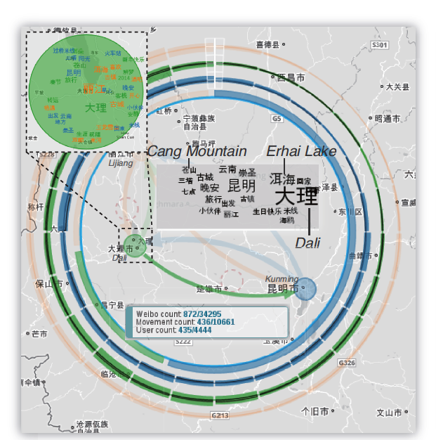
Visual Analytics Process（1）-- Spatial Temporal Exploration
Spatial temporal view
Detect Position of Interest (POI) based on density-based clustering method (DB-Scan)
Temporal and Periodical distribution of each POI in the outer ring
Position of Interest (POI)

Slide 21
Visual Analytics Process（1）-- Spatial Temporal Exploration

Slide 22
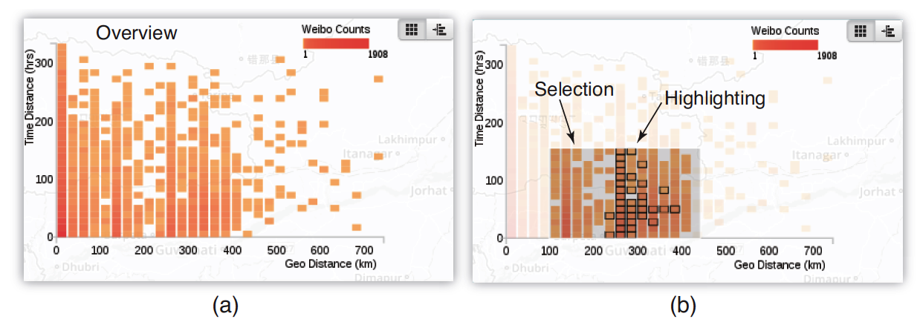
Visual Analytics Process（2）-- Attribute Exploration
Analysis based on attribute space
The relationship between time interval and geo distance
Provide brushing, multi-brushing, highlighting to support the interactive exploration
ST-Matrix, visualizing the time interval and geo distance with 2D histograms

Slide 23
Visual Analytics Process（3）-- Detailed Analysis based on Uncertainty Modeling
Visual Design
X-Axis: 1D Location
Y-Axis (up): time interval
Y-Axis (down): geo distance
Curve from source (Y=0) to destination (two fold)
Detailed Analysis
Provide aggregation, individual and density map view, with brushing and keywords retrieving
Input for modeling process
ST Detail View – showing the relationship between location, time interval and geo distance of the filtered movements

Slide 24
Visual Analytics Process（3）-- Detailed Analysis based on Uncertainty Modeling

Slide 25
Visual Analytics Process（3）-- Detailed Analysis based on Uncertainty Modeling
Filtering based on Uncertainty Model
Time interval distributions of each pair of movements between two POIs
Calculate the different distributions and the confidence intervals
Further adjusting by the users
(a) ST Detail View - aggregation mode，(b) Keywords brushing (c) ST Model View – Filtering based on confidence interval

Slide 26
Visual Analytics Process（4）-- Semantic Exploration

Slide 27
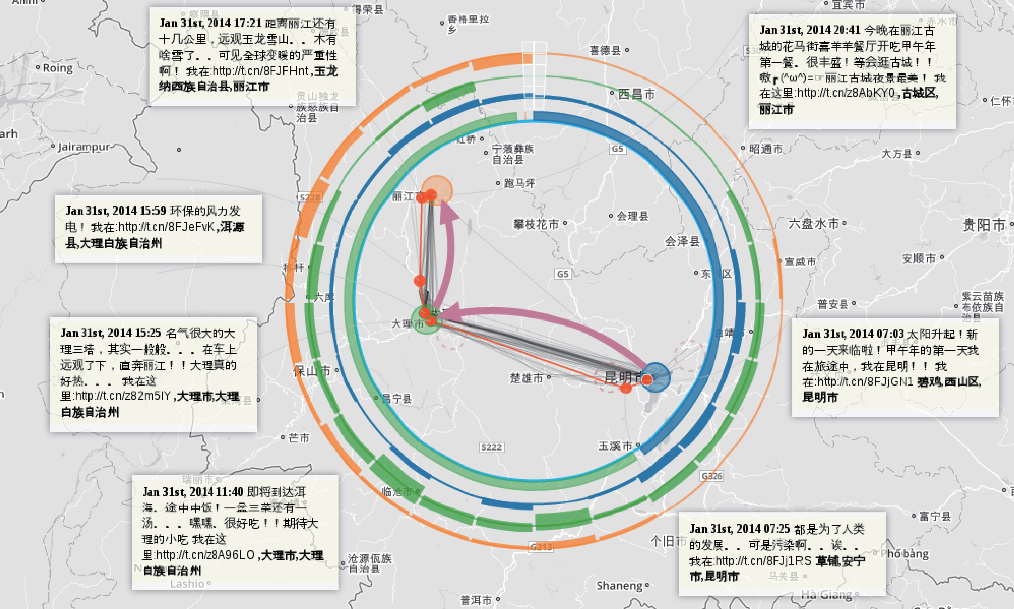

Slide 28
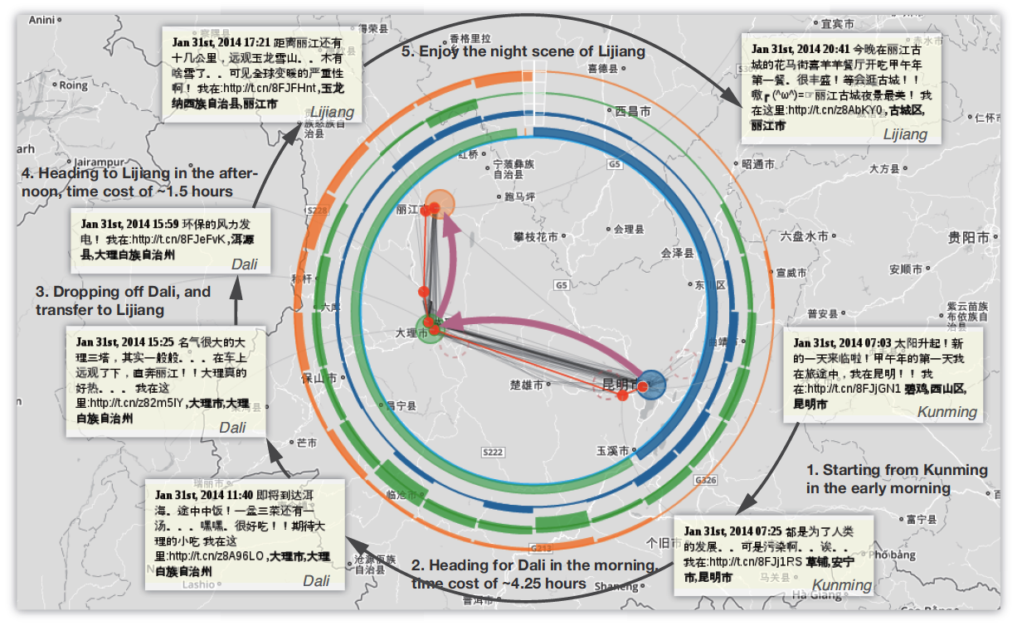
Visual Analytics Process Summary-- Semantics Exploration
Interactive exploration for sparsely sampled geo-tagged social media
Visual feedback
Analytics loop

Slide 29
Case Study – Travelling in Taiwan (1)
Exploration results
Going to Taiwan from the opening cities in mainland, e.g. Beijing, Shanghai, Xiamen and Guangzhou, etc. (a)
Visitors are interested in Taipei, Hualien, Kaohsiung, Kenting etc. (b,c)
Anti-clock visiting sequence in traveling in Taiwan (d)
Many travelers enjoyed the night markets in Taiwan (d)
People from mainland going to Taiwan, and its density map, trajectories and keywords in Taiwan (b,c,d)

Slide 30
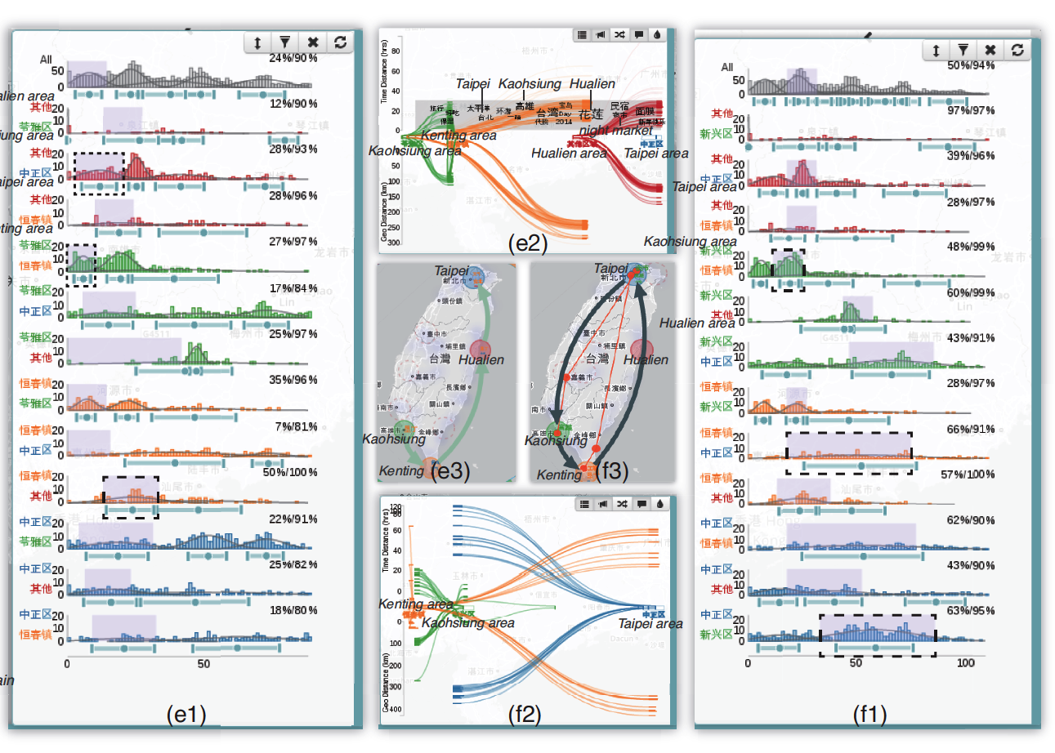
Case Study – Travelling in Taiwan (2)
Characters of the movements (e1)
Relatively reliable movements from Kaohsiung to Kenting, averagely in 4-8 hours
High uncertainty in the movements from Kenting to Hualien, with the average time of 24 hours, indicating the stay or travel in other cities in the middle
Travelling time (including stay time) hypotheses (f2)
Kaohsiung -> Kenting (1 day)
Kenting -> Taipei (2 days)
Taipei -> Kaohsiung (3 days)
(e)(f) The attributes in travelling in Taiwan:
(1) Time interval distribution (2) Attribute parameter space analysis (3) Geographic distribution

Slide 31
Summary and Possible Extensions
Dealing with uncertainty
Interactive visual analytics system with uncertainty modeling, providing the visual feedback and interactive guide
Extend the uncertainty model
Considering people habits and detail location information
More specific model than GMM in some situation
Combined with topic modeling

Slide 32
Acknowledgements
The authors wish to thank Ziteng Wang and Siqi Tu for the discussions and evaluations, and the anonymous reviewers for their valuable comments.
This work is supported by
NSFC No. 61170204, and
partially funded by NSFC Key Project No. 61232012 and the National Program on Key Basic Research Project (973 Program) No. 2015CB352500.
by PKU-Qihu Joint Data Visual Analytics Research Center

Slide 33
Thank you

