Slide 1
D-Map: Visual Analysis of Ego-centric Information Diffusion Patterns in Social Media
Siming Chen¹, Shuai Chen¹, Zhenhuang Wang¹, Jie Liang^{1, 2}, Xiaoru Yuan¹,
Nan Cao³, Yadong Wu⁴
¹ Key Laboratory of Machine Perception (Ministry of Education), School of EECS, Peking University
² Faculty of Engineer and Information Technology, The University of Technology, Sydney, Australia
³ New York University, Shanghai, China
⁴ Southwest University of Science and Technology, China

Slide 2
Social Media
Entity
  Users
  Messages
User behaviors
  Posting messages (Tweet)
  Commenting and Re-posting (Re-tweet)

Slide 3
Information Diffusion Network of Social Media

Slide 4
Ego-centric Analysis
Motivation
  Understanding the individual users, especially the high-impact users is important – how their messages spread and affect different people
Analyzing ego-centric information diffusion is a complex task
  Social connection analysis
  Information diffusion analysis

Slide 5
Ego-centric Analysis – Social Connection Analysis
What are his/her social connections?

Slide 6
Ego-centric Analysis – Social Connection Analysis
What are his/her social connections?
Whether there
are communities?
What are their roles
and characteristics?

Slide 7
Ego-centric Analysis – Information Diffusion
How information diffuse across the network?
What are the
diffusion patterns?
Diffusion Path

Slide 8
Data for Ego-centric Information Diffusion Analysis
For the centric user
  All the original posts (source weibos/Twitter)
  All the re-postings from these original posts
    Users
    Reposting messages

Slide 9
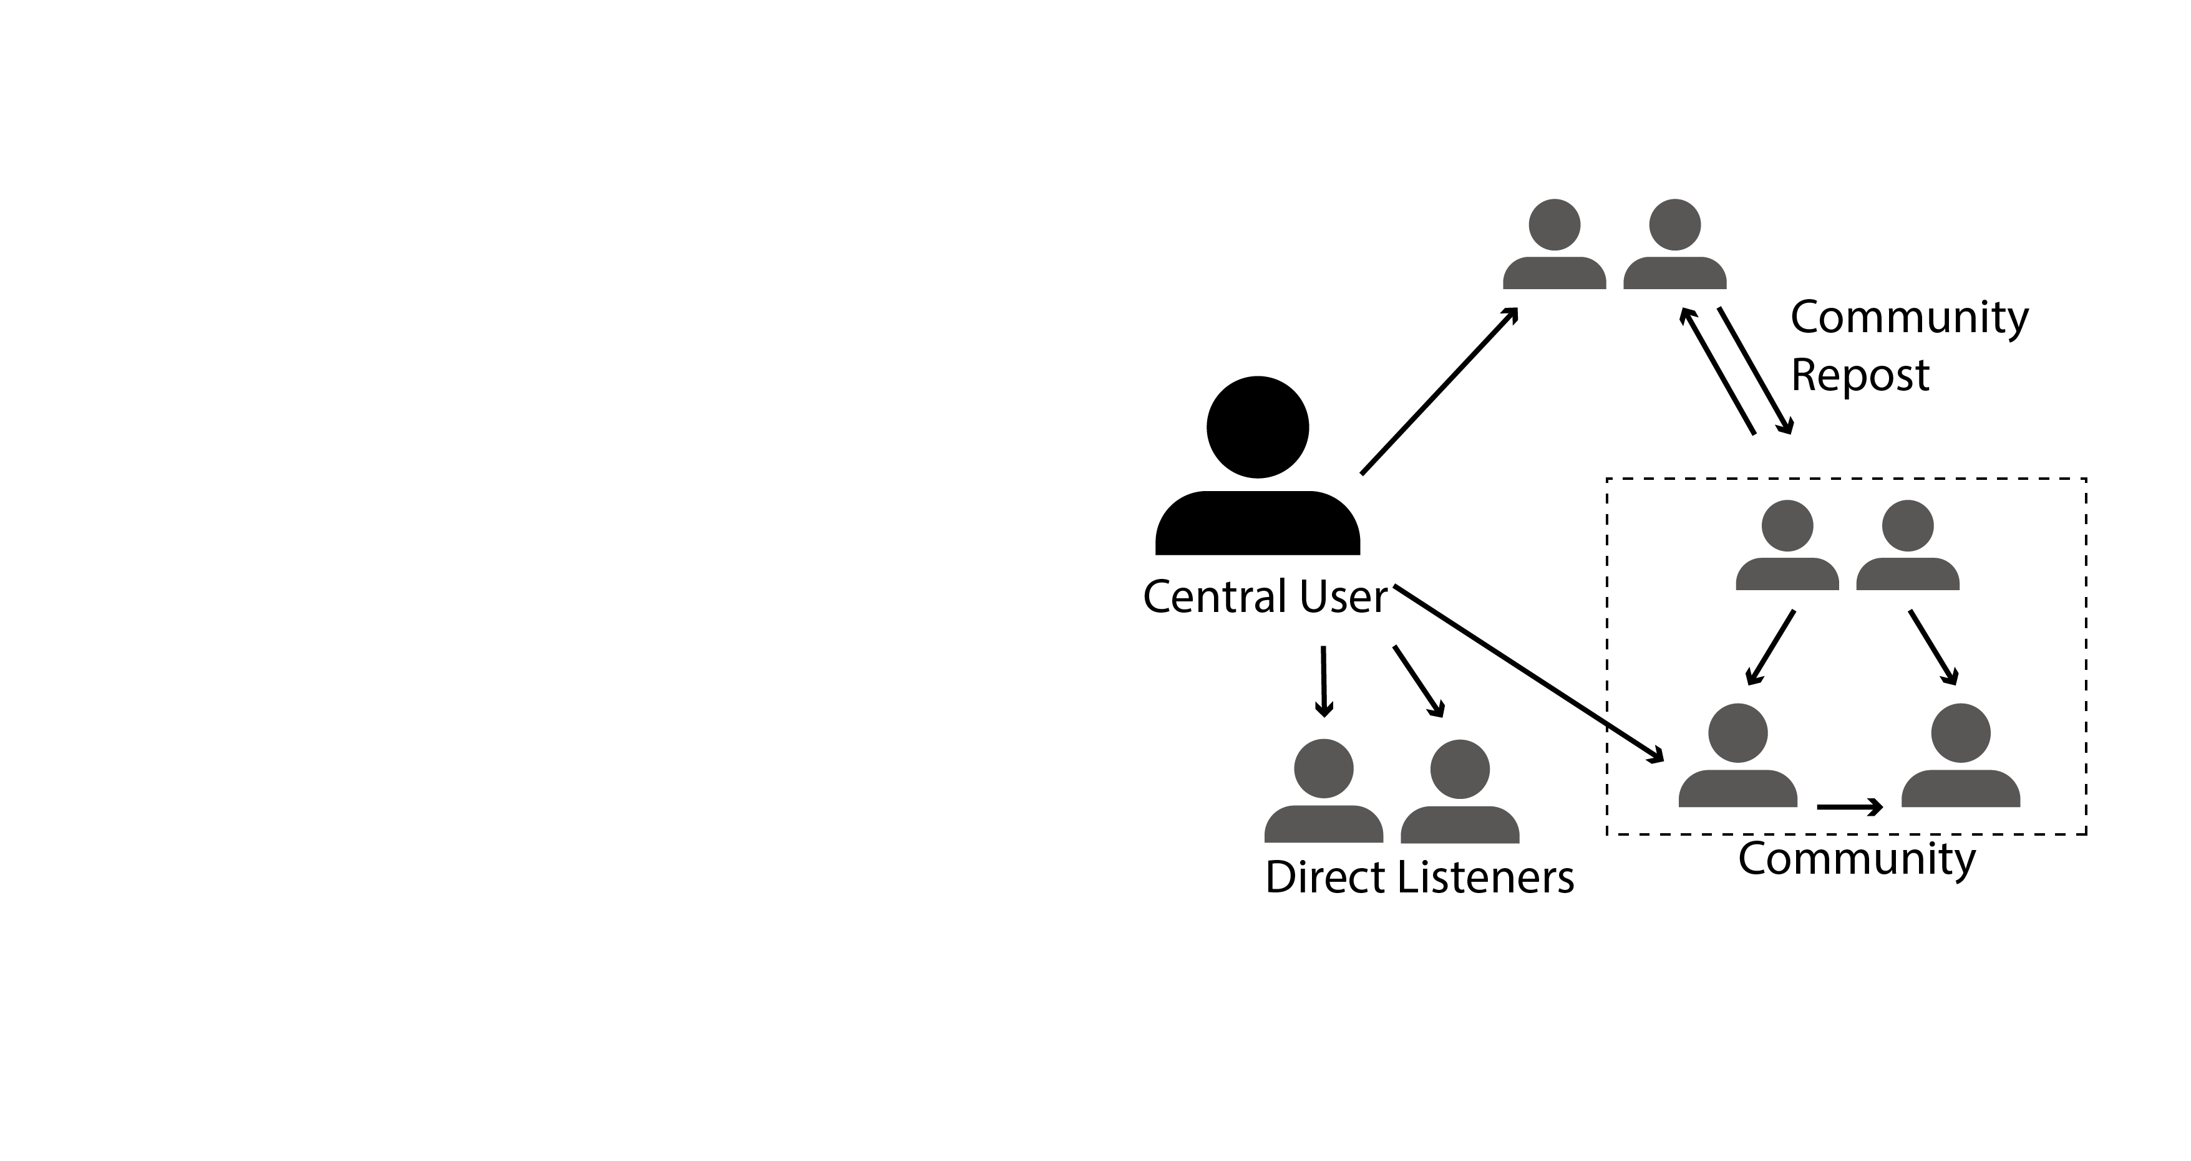
Data Characteristics
Participating Features
  Community / Number / Activeness
Influence of the Participants
  Direct / Multi-level diffusion
Key Player Distribution
  Key player (lead to large reposts)
  Impact on other people
Dynamic Diffusion
  Life periods
  Latency/ frequency

Slide 10
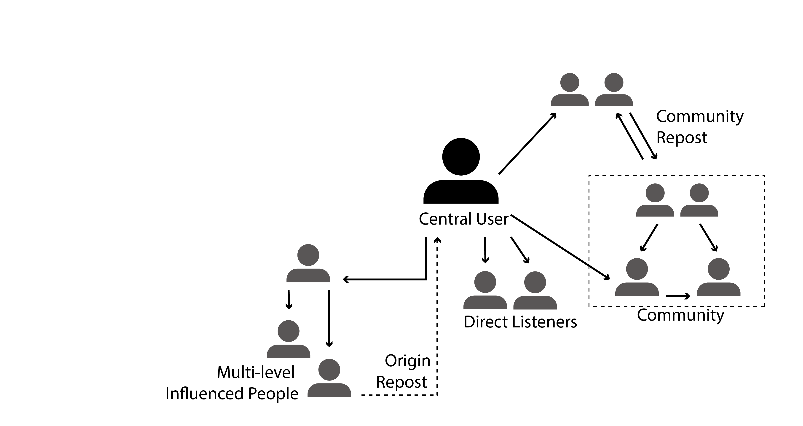
Data Characteristics
Participating Features
  Community / Number / Activeness
Influence of the Participants
  Direct / Multi-level diffusion
Key Player Distribution
  Key player (lead to large reposts)
  Impact on other people
Dynamic Diffusion
  Life periods
  Latency/ frequency

Slide 11
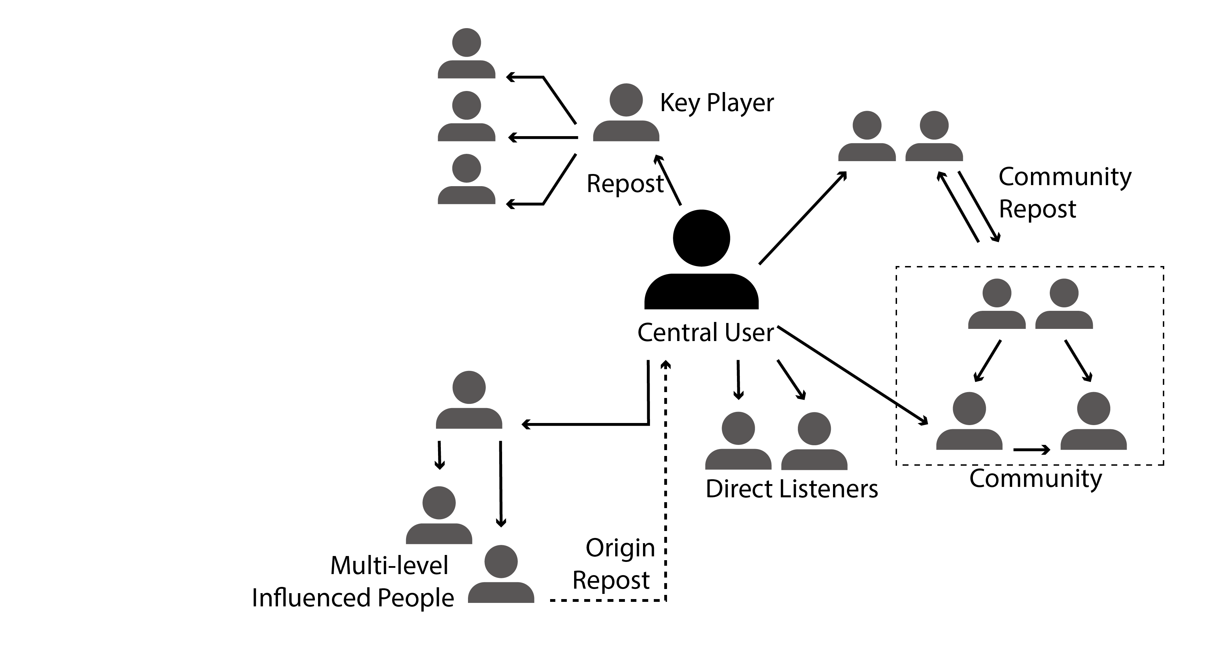
Data Characteristics
Participating Features
  Community / Number / Activeness
Influence of the Participants
  Direct / Multi-level diffusion
Key Player Distribution
  Key player (lead to large reposts)
  Impact on other people
Dynamic Diffusion
  Life periods
  Latency/ frequency

Slide 12
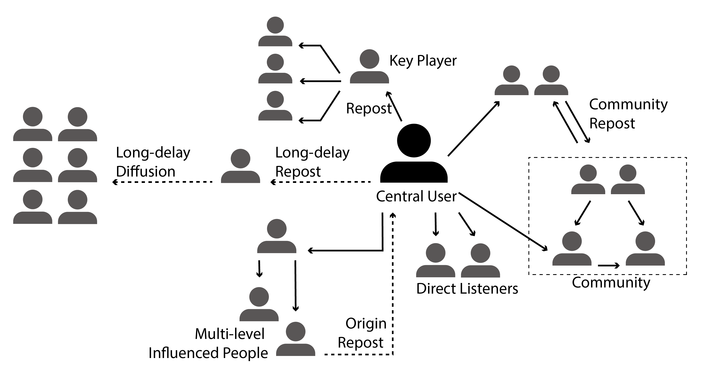
Data Characteristics
Participating Features
  Community / Number / Activeness
Influence of the Participants
  Direct / Multi-level diffusion
Key Player Distribution
  Key player (lead to large reposts)
  Impact on other people
Dynamic Diffusion
  Life periods
  Latency/ frequency

Slide 13
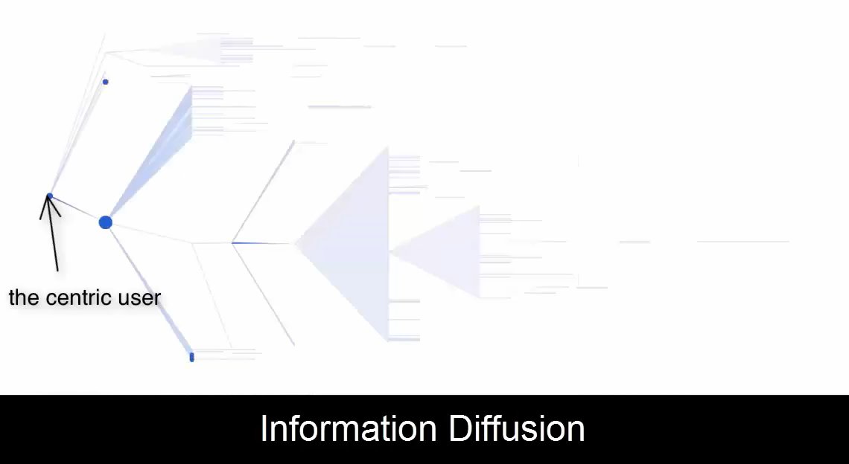

Slide 14
Inspiration
Users’ relationship build up their territories
Information diffusion process
  “People travelling across multiple countries”

Slide 15
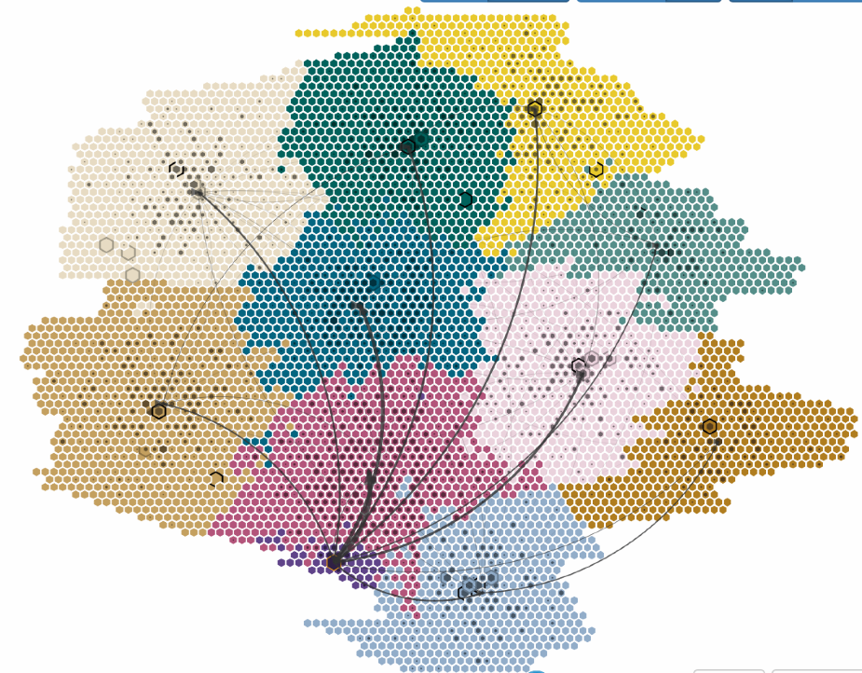
D-Map Design
Map-based metaphor
  Constructing the map for the ego-centric social network
  Mosaic cartograms
  Minimize wasted space among items and maximize the area inside them.
Notes:
they communicate data with countable in- teger units, which is easy for visual comparison

Slide 16
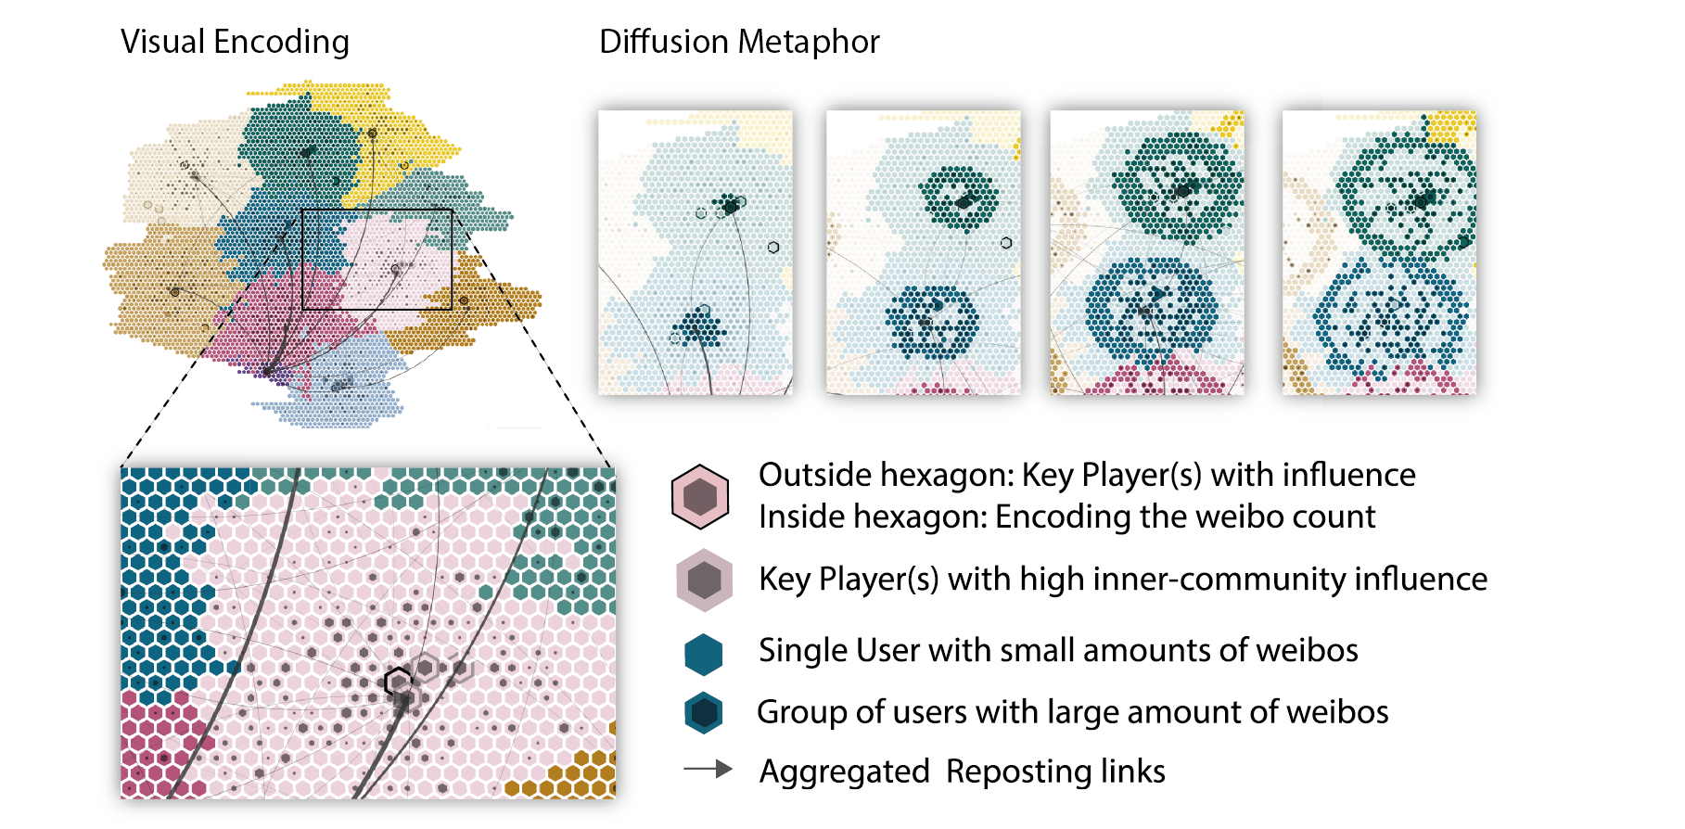

Slide 17
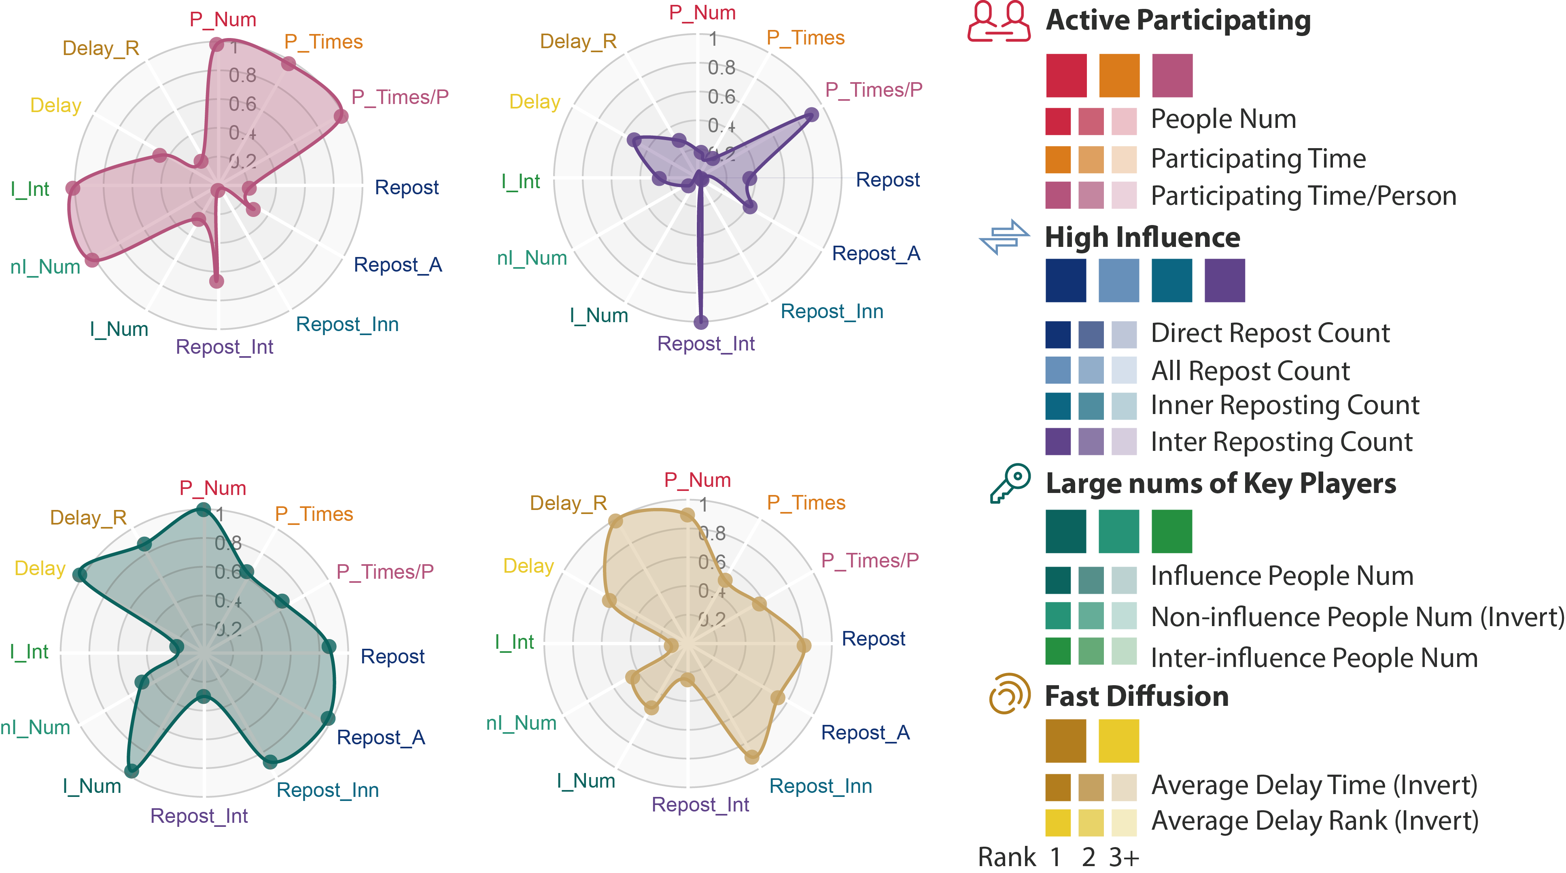
D-Map Design

Slide 18
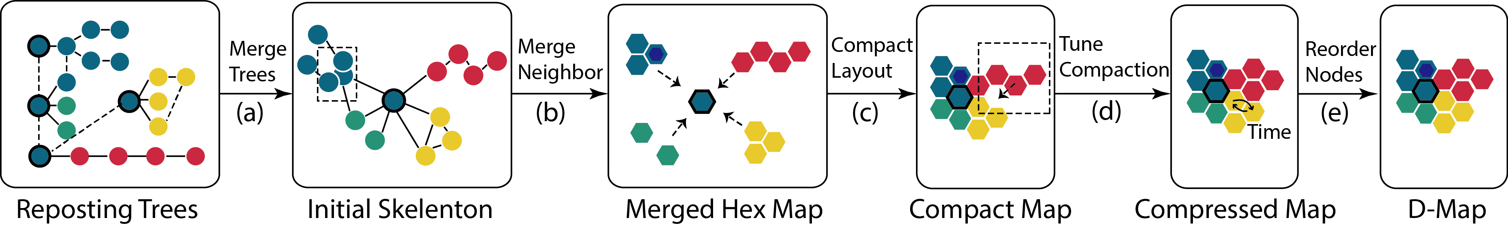
D-Map Constructing Process

Slide 19
D-Map Constructing Process – Step 1
Input: reposting trees of each source weibos
Process:
  Merge nodes based on the same identity
  Run the force directed layout
Output: Initial skeleton of the ego-centric network
Dash: the
Same user
Centric
User
(a)
Merge
Trees
Centric User

Slide 20
D-Map Constructing Process – Step 2
Input: initial skeleton of the ego-centric network
Process:
  Users set up the estimated hexagons number
  It merges the near hexagons to reduce the size
Output: merged discrete map
Near
nodes
Merged
node
(b)
Merge
Neighbors

Slide 21
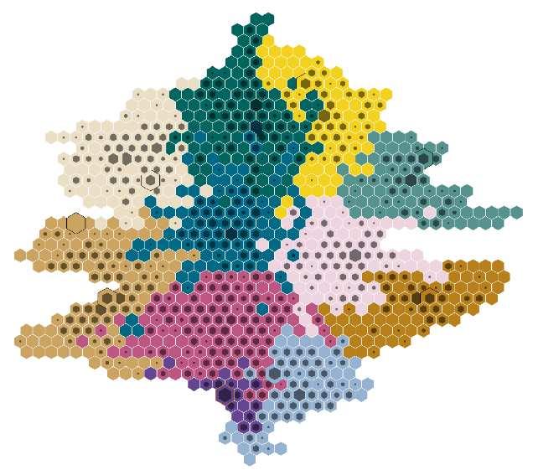
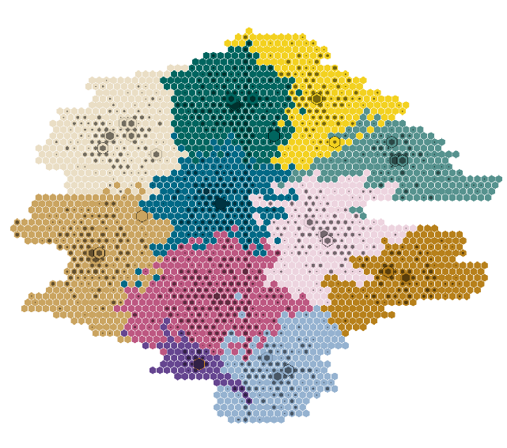
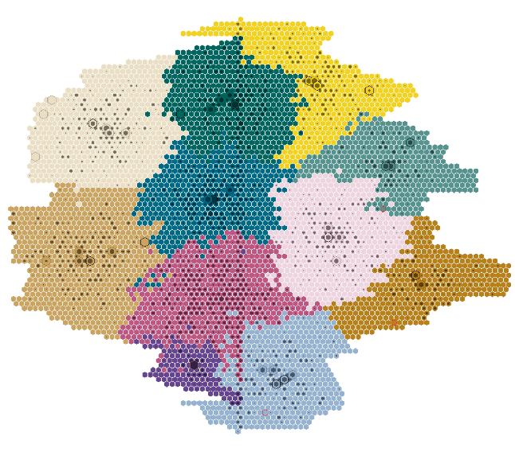
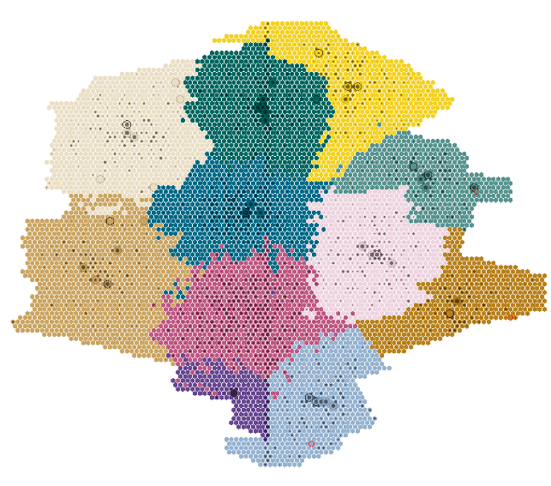
D-Map Constructing Process – Step 2
Resize different numbers of the hexagons
N = 1000
N = 3000
N = 6000
N = 9000

Slide 22
D-Map Constructing Process – Step 3
Input: merged discrete map
Process:
  Flatten towards the central nodes in different directions
  Filter out the ‘bubble’ of the map
Output: compact map
(c)
Compact
Layout

Slide 23
D-Map Constructing Process – Step 4
Input: compact map
Process:
  Tune the layout
  Flatten towards the central nodes with four directions
Output: compressed map
(d)
Tune
Compaction

Slide 24
D-Map Constructing Process – Step 5
Input: compressed map
Process:
  Reorder the nodes in each community, based on the temporal information
Output: D-Map
(e)
Reorder
Nodes
Time
Order

Slide 25
D-Map Visual Design
Represent the ego-centric information diffusion
  Identify the communities of ego-centric social network
  Trace the information diffusion among multiple communities
To enhance the in-depth exploration, we provide a visual analytics system

Slide 26
D-Map Visual Analytics System

Slide 27
D-Map Visual Analytics System
Source weibos
projection
Source weibos list
Keywords
  Provide the source weibos as analysis entrances

Slide 28
D-Map Visual Analytics System
Small Multiple
Animation and
snapshots
Timeline
  Enable the temporal exploration and animations

Slide 29
D-Map Visual Analytics System
Hierarchical reposting
Information
Multiple features
Statistics information
  Explore the community behaviors with hierarchical and multi-dimensional information.

Slide 30
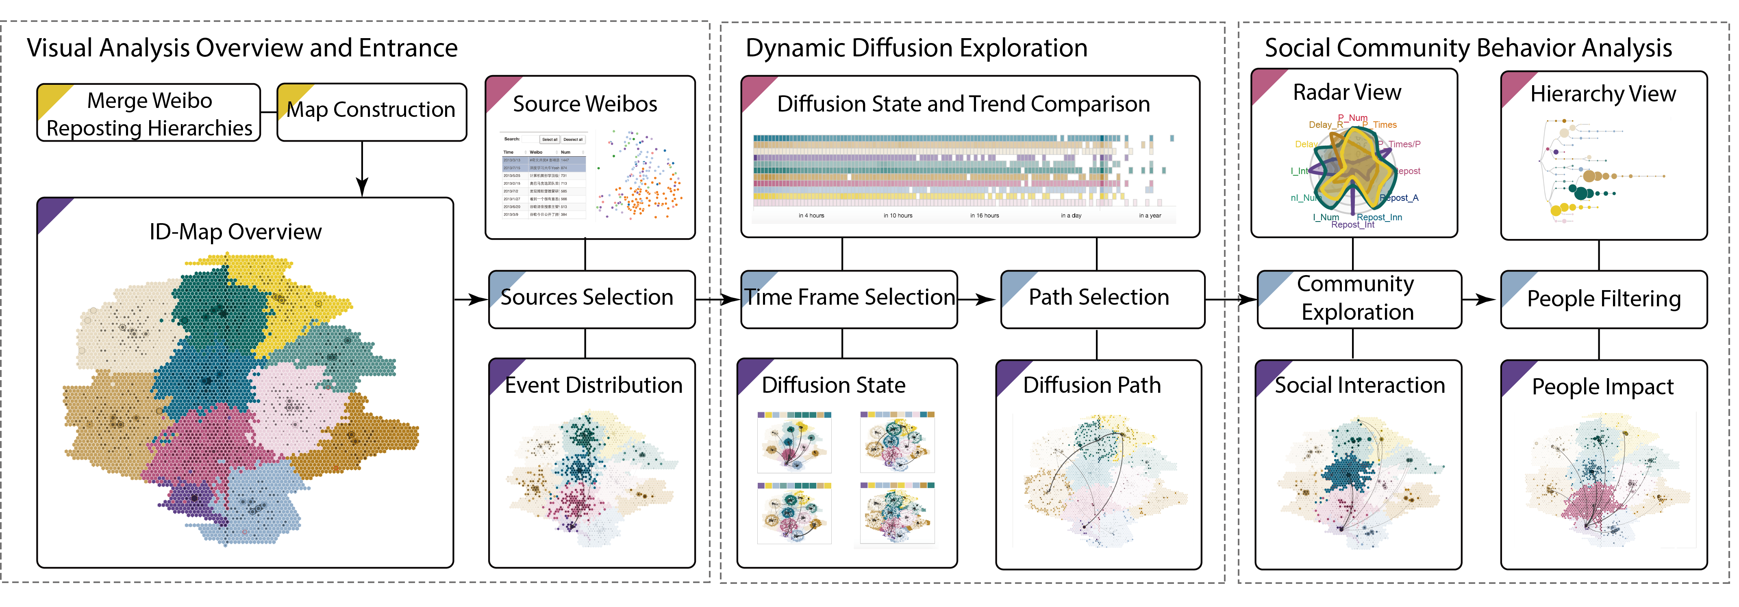
Visual Analytics Pipeline

Slide 31
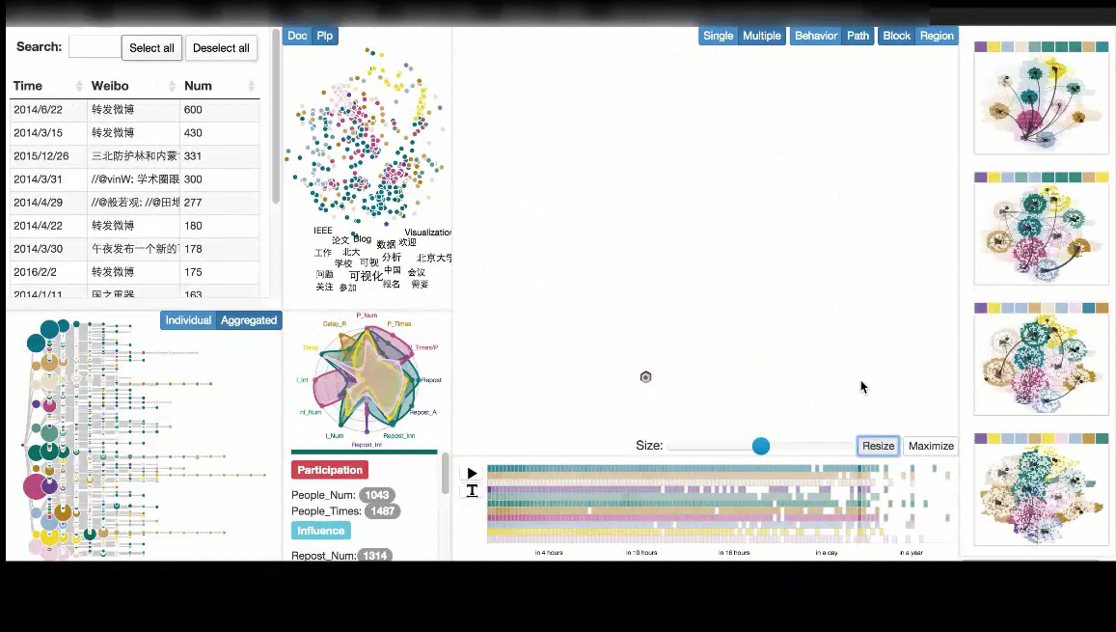

Slide 32
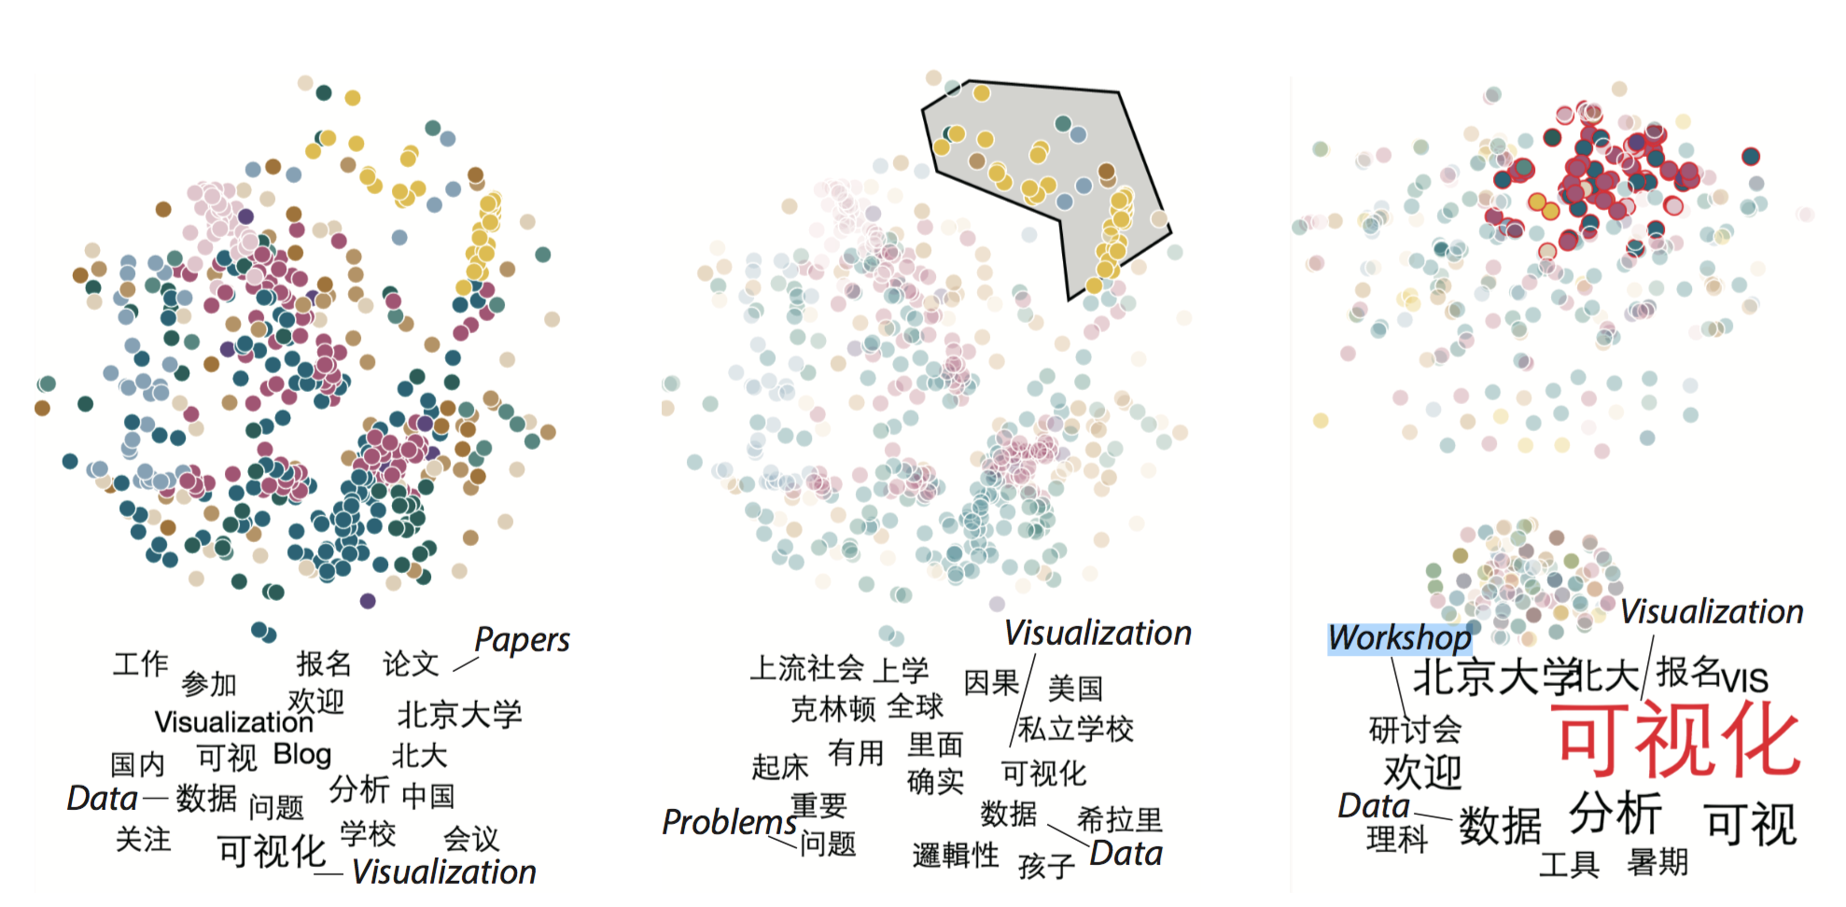
Source weibo projection
Distance considering
reposting people
TF-IDF and cosine distance
of the document

Slide 33
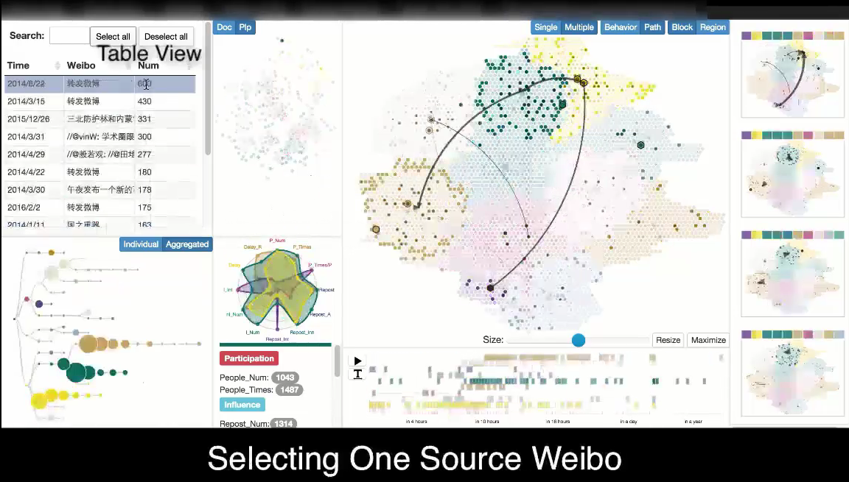

Slide 34
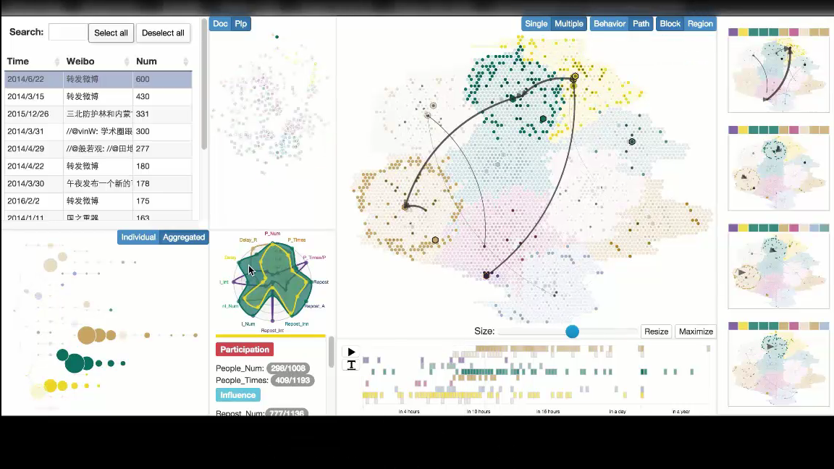

Slide 35
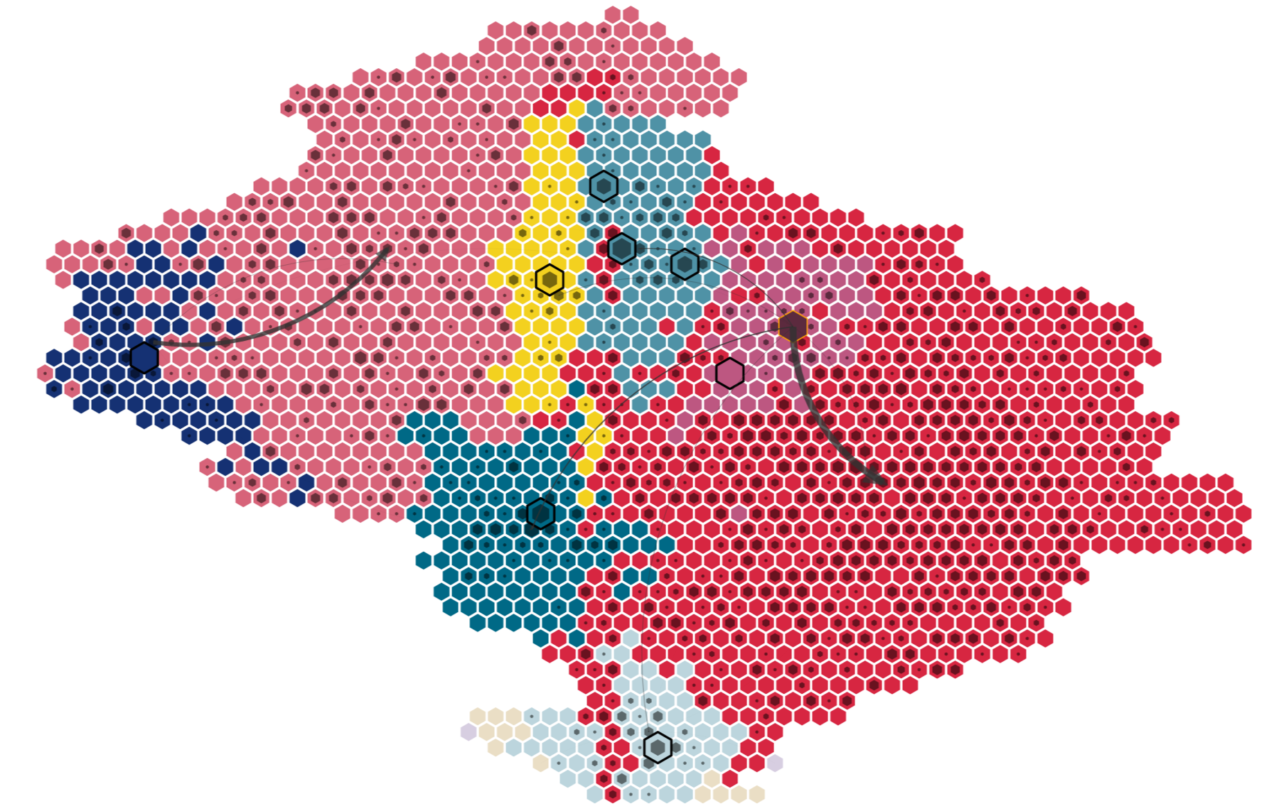
Case Study: Diffusion Pattern and Community Behaviors
Dataset
  300 weibos of one influential person
  7,694 reposting weibos from 5,917 unique users
There were two largest groups, with 2,986 (C1) and 1,811 people (C4), shown in red color.
(C4)
Central
User
(C1)

Slide 36
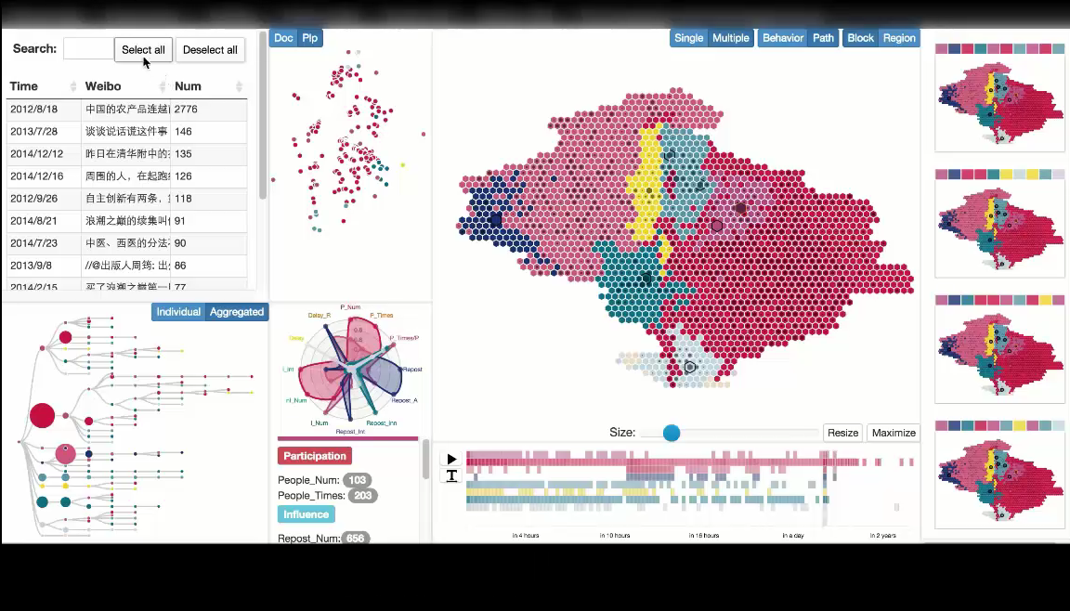

Slide 37
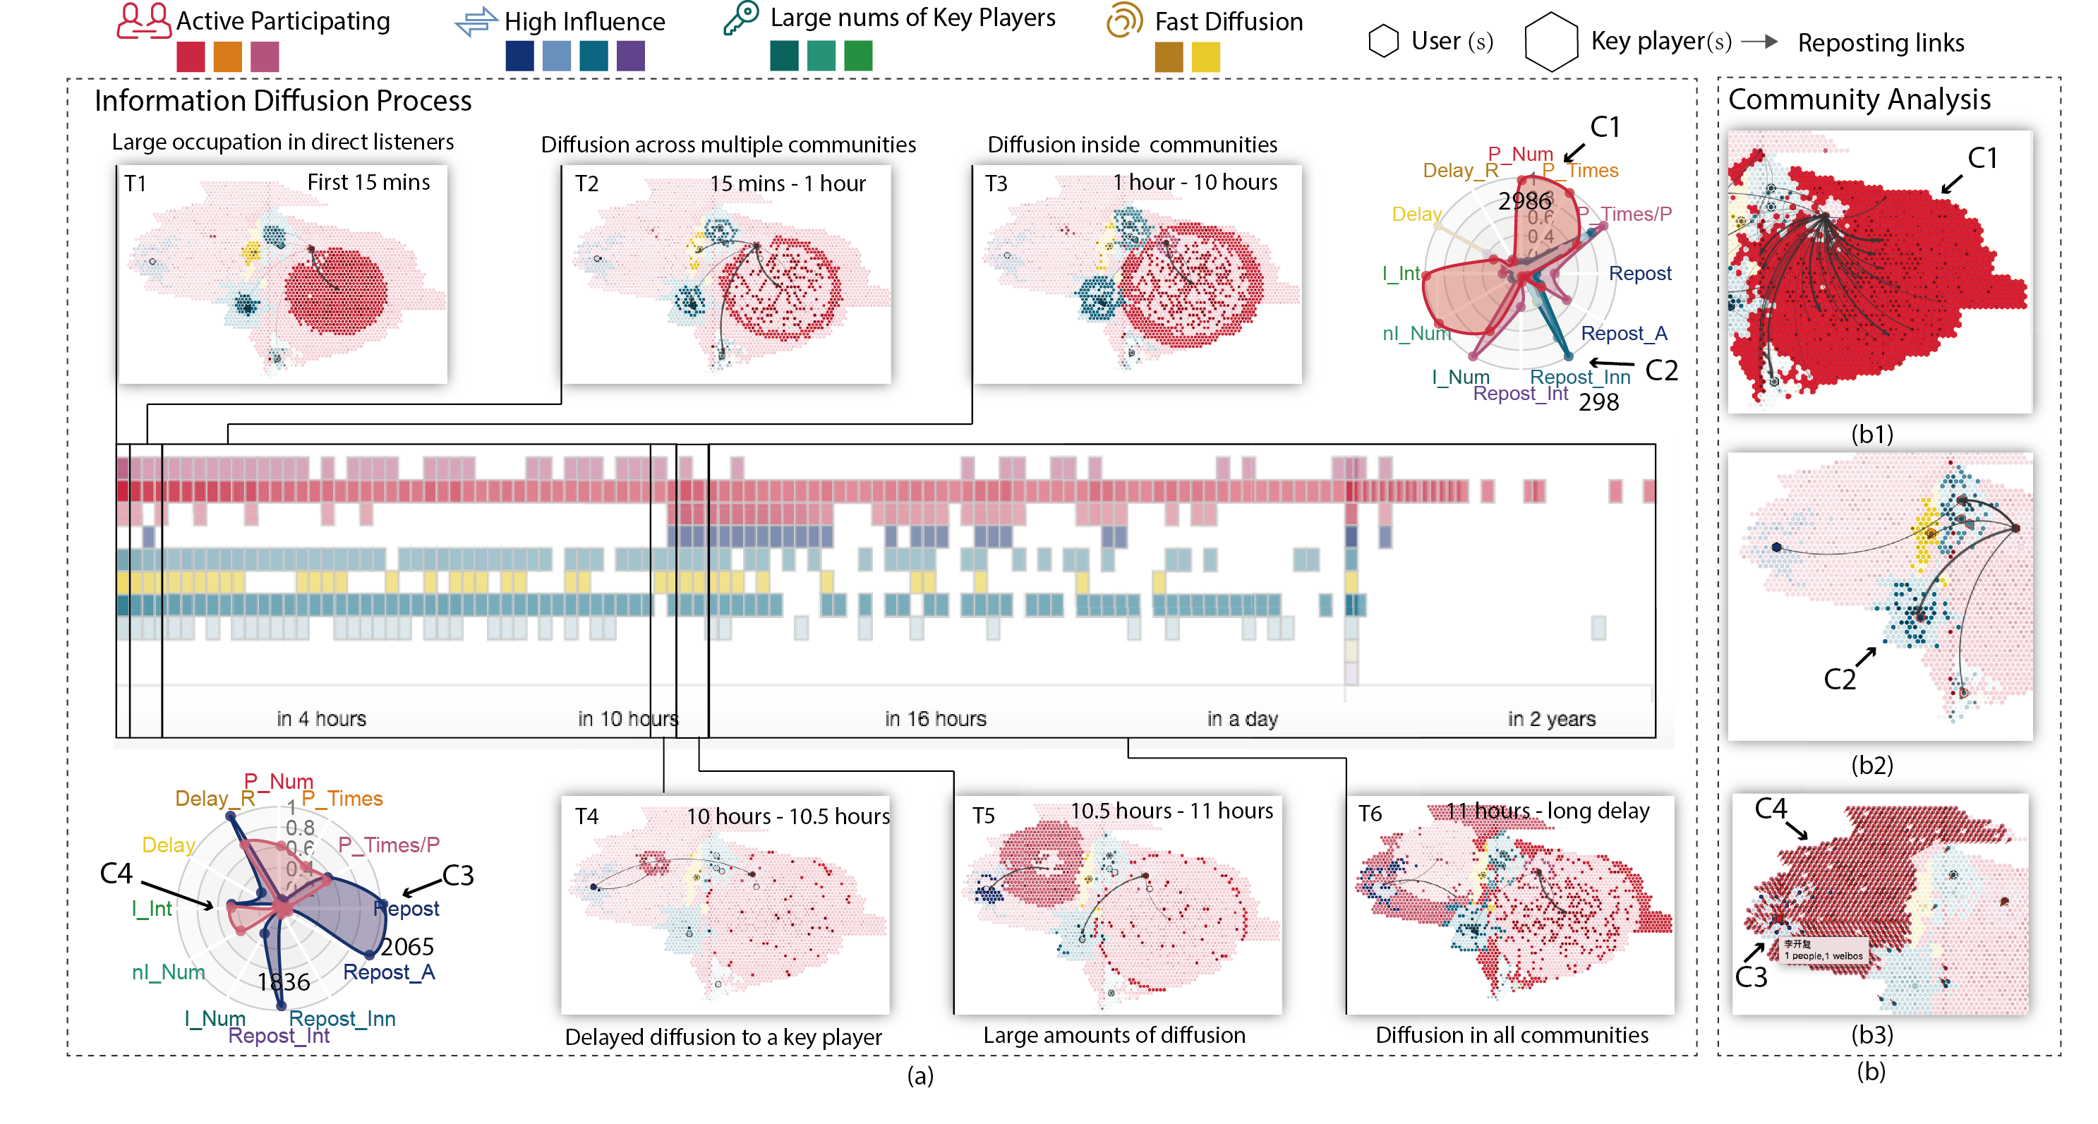
Case 1: Summary
Two main diffusion stages
  C3 leads to a second round diffusion
Community characteristics
  C1 – Large number
  C3 – High impacts

Slide 38
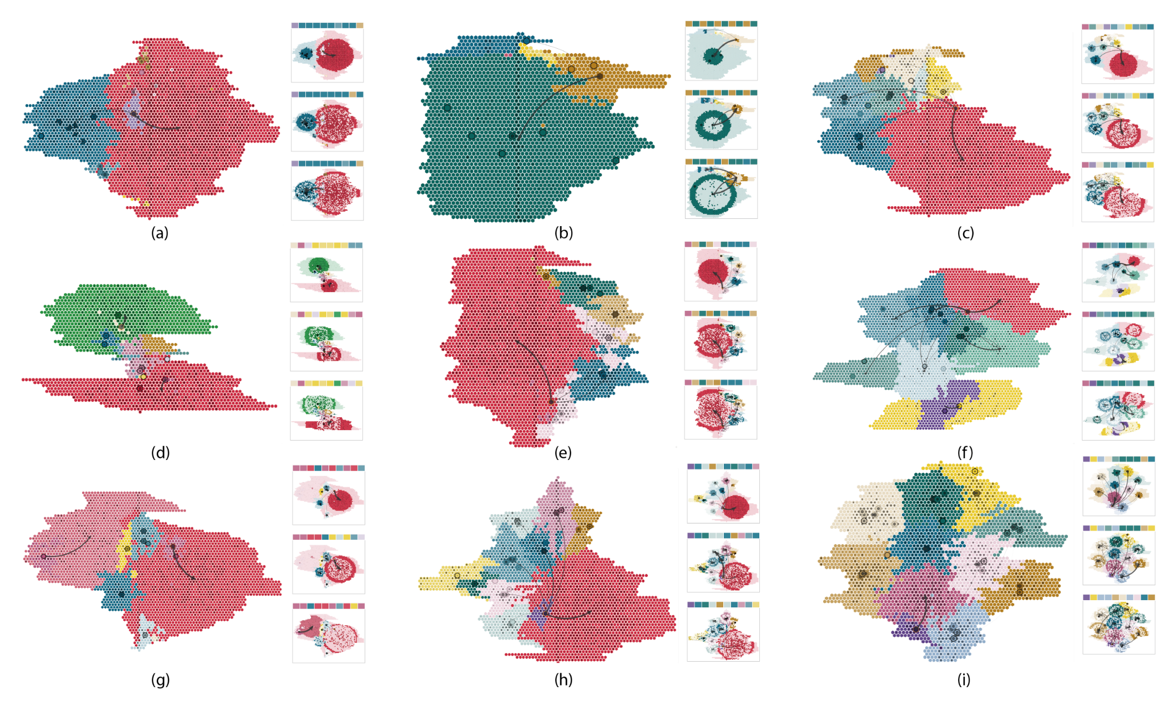
Case 2: People Portrait
Comparison through 34 influential people from Sina Weibo
  Select 500 source weibos and the repostings of each
  Find several representative patterns
Layout
  X-axis: community number
  Y-axis: influences among communities

Slide 39
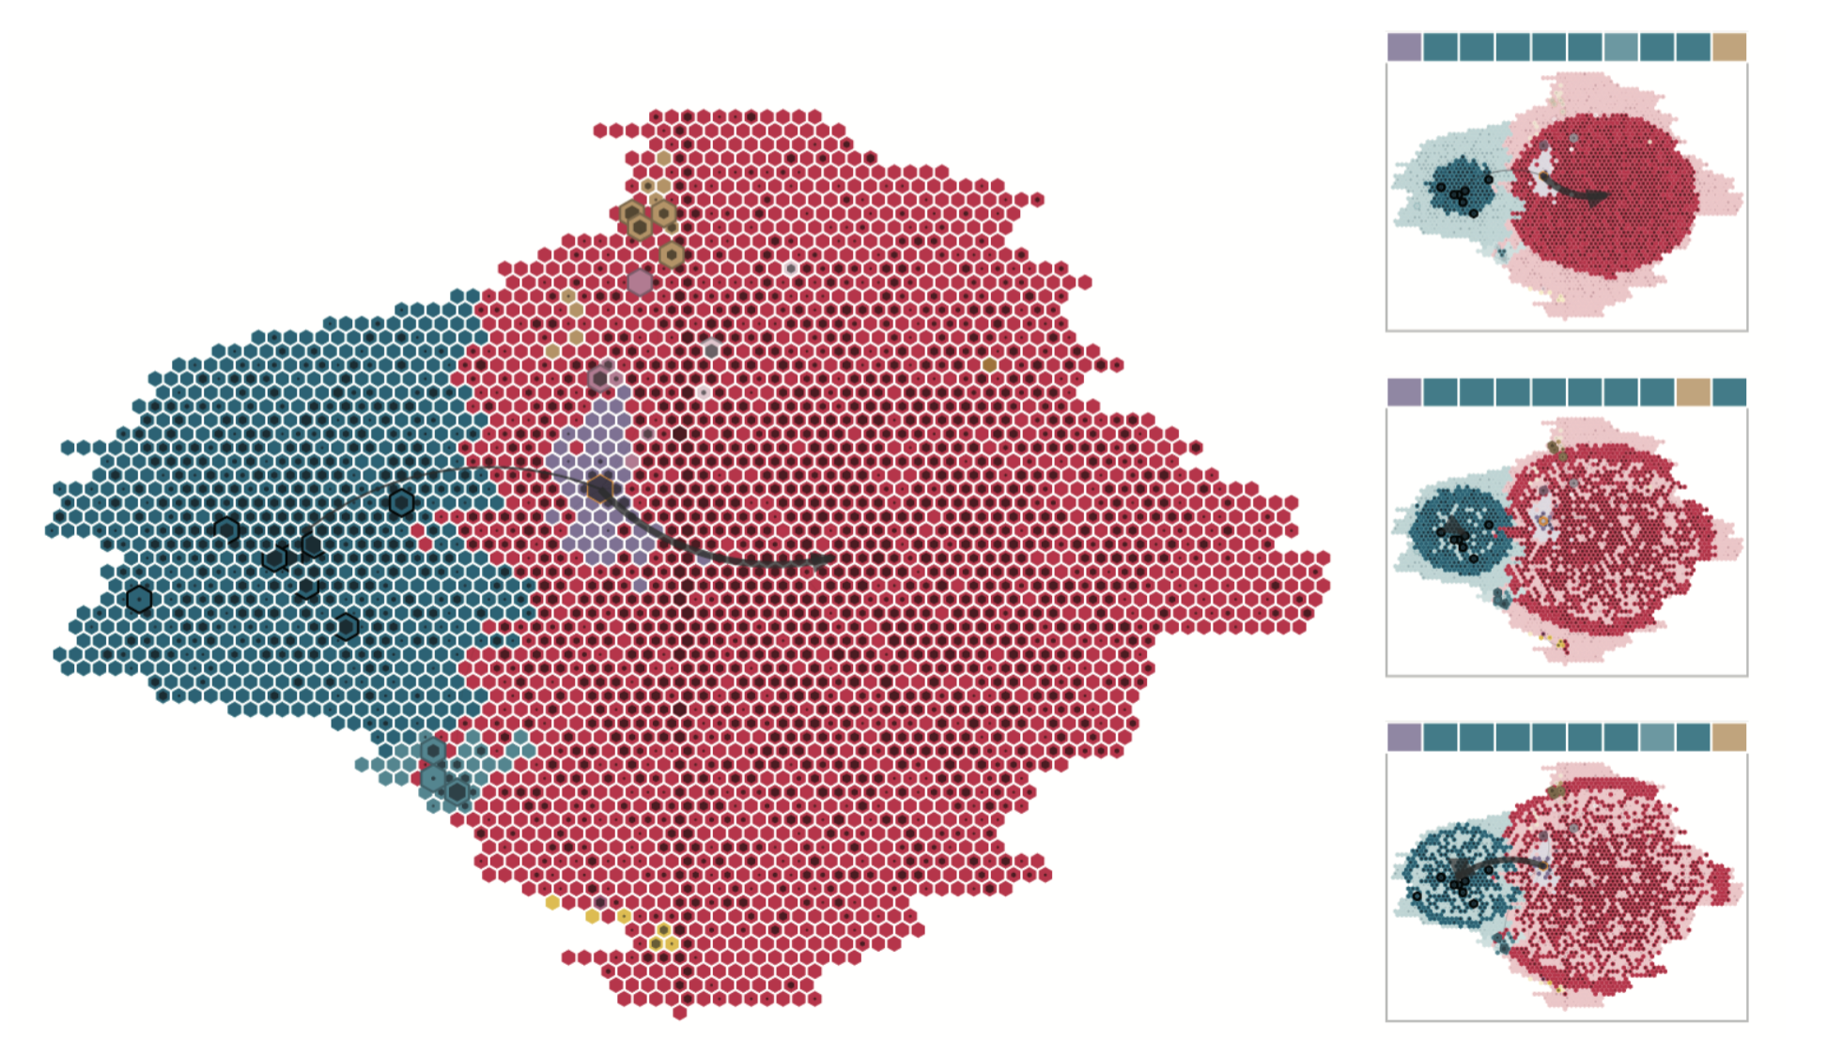
Case 2: People Portrait
Few communities,
Small influences among communities
Representative accounts: Service accounts

Slide 40
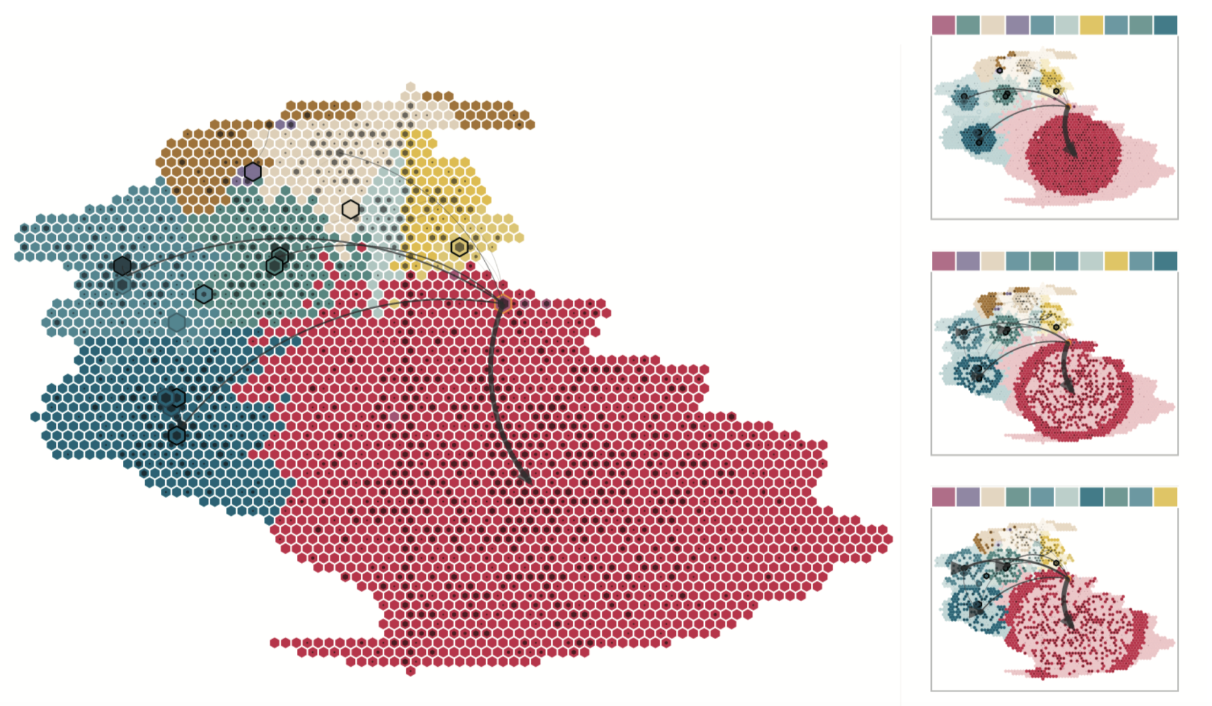
Case 2: People Portrait
Repeating
patterns
Strong
Center
Many communities, Strong Center
Small influences among communities
Representative accounts: Businessman in Social Media

Slide 41
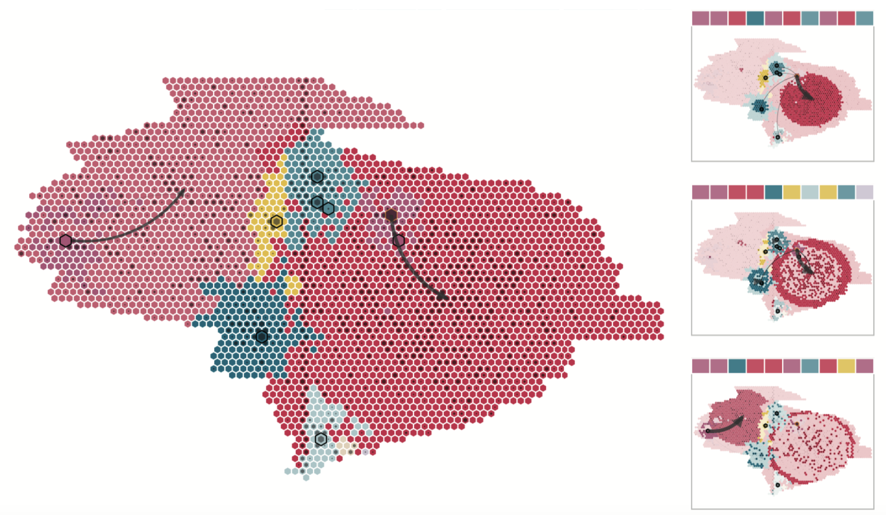
Case 2: People Portrait
Dual Center
Behaviors
Different territories
Many communities, Dual-center Patterns
Large influences among communities
Representative accounts: Accounts reposted by
accounts with larger influence

Slide 42
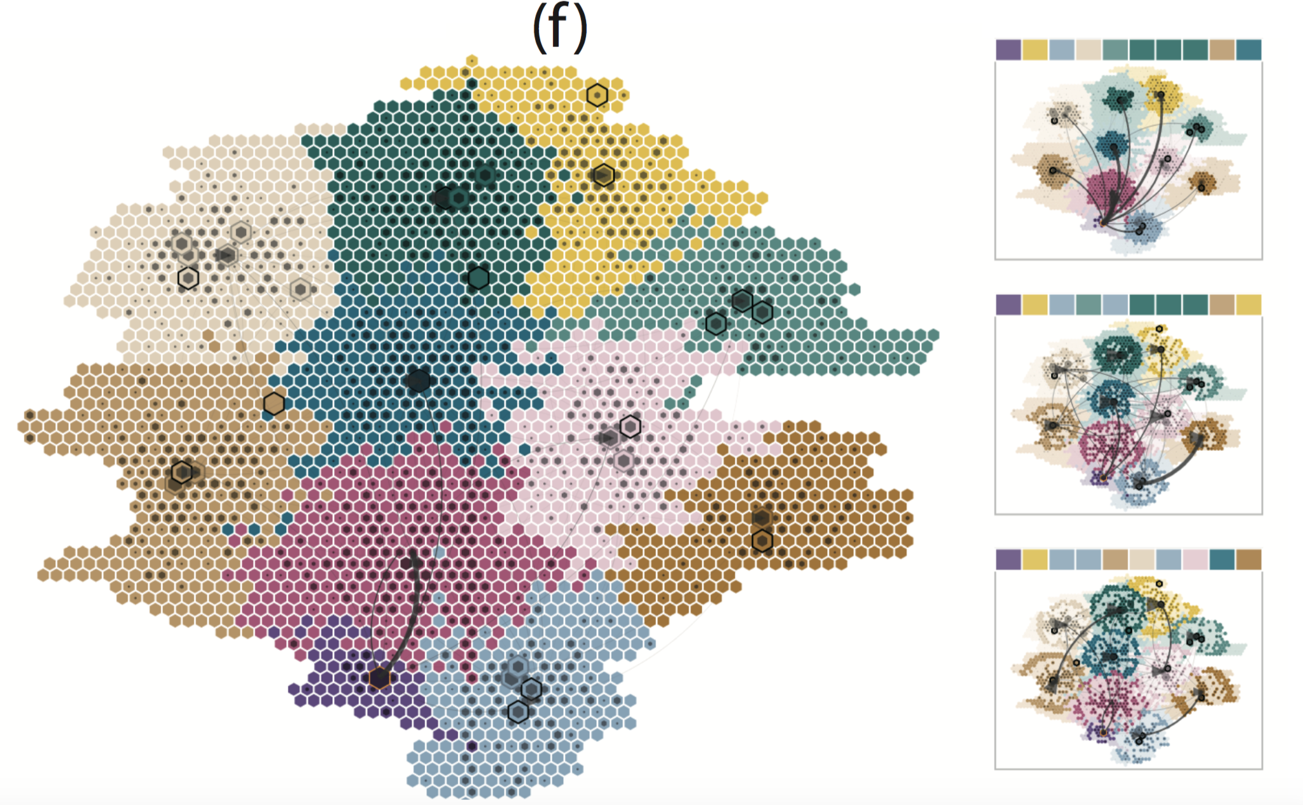
Case 2: People Portrait
Key players
Strong
influences
Many evenly distributed communities
High influences among communities
Representative accounts: Opinion leader in specific topics

Slide 43
Summary
Conclusions
  We propose a map-based visual metaphor for analyzing the information diffusion patterns in ego-centric social network
    Dynamic diffusion patterns
    Community behaviors and correlations
  We investigate interesting patterns from real world social media data

Slide 44
Acknowledgements
This work is supported by
  NSFC No. 61170204, and
  partially funded by NSFC Key Project No. 61232012 and the National Program on Key Basic Research Project (973 Program) No. 2015CB352500.
  by PKU-Qihu Joint Data Visual Analytics Research Center

Slide 45

Thank you!

