Slide 1
E-Map: A Visual Analytics Approach for Exploring Significant Event Evolutions in Social Media
Siming Chen¹ Shuai Chen¹ Lijing Lin¹ Xiaoru Yuan^{1*} Jie Liang² Xiaolong Zhang³
1) Peking University, China
2) The University of Technology, Sydney, Australia
3) Pennsylvania State University, USA

Slide 2
Social Media
Entity
  Users
  Messages
User behaviors
  Posting messages (Tweet)
  Commenting and Re-posting (Re-tweet)

Slide 3



Significant Events in Social Media
Amount of Tweets
Time
Key Players

Slide 4
What are people talking about?
How does the information spread?
How event evolution happens?

Slide 5
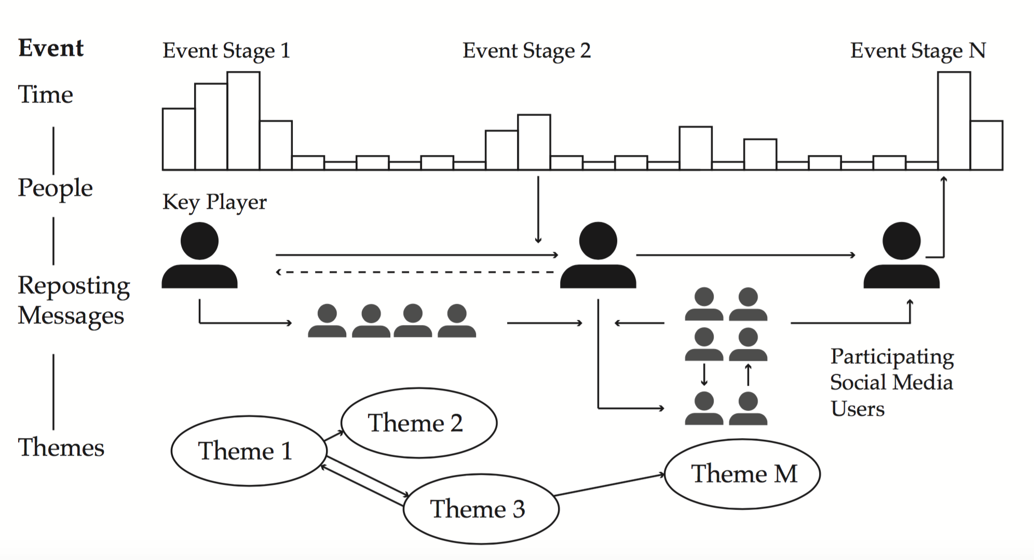
Event Definition
^{Analytics Tasks}
^{D1: Multiple event stages}
^{D2: Influence of Users}
D3: Information diffusion led by the reposting behaviors
D4: Dynamic changes of different themes

Slide 6
Challenges
Complex dynamic evolution patterns of events
Dynamic user behaviors
How to reason the relationship between event evolution and user behaviors

Slide 7
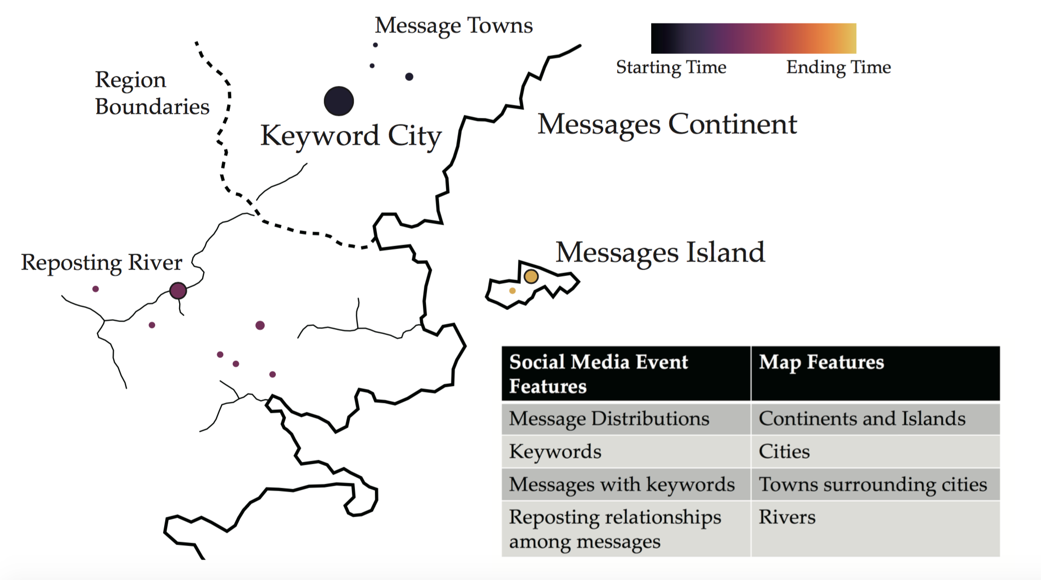
E-Map Design
^{Design Requirement}
R1: Providing a view for event summary with semantics and temporal trends
R2: Grouping messages based on their similarity in discussion themes and reposting relationships
R3: Detecting and presenting themes in different time periods
R4: Identifying behavior patterns of social media users in posting and reposting messages

Slide 8
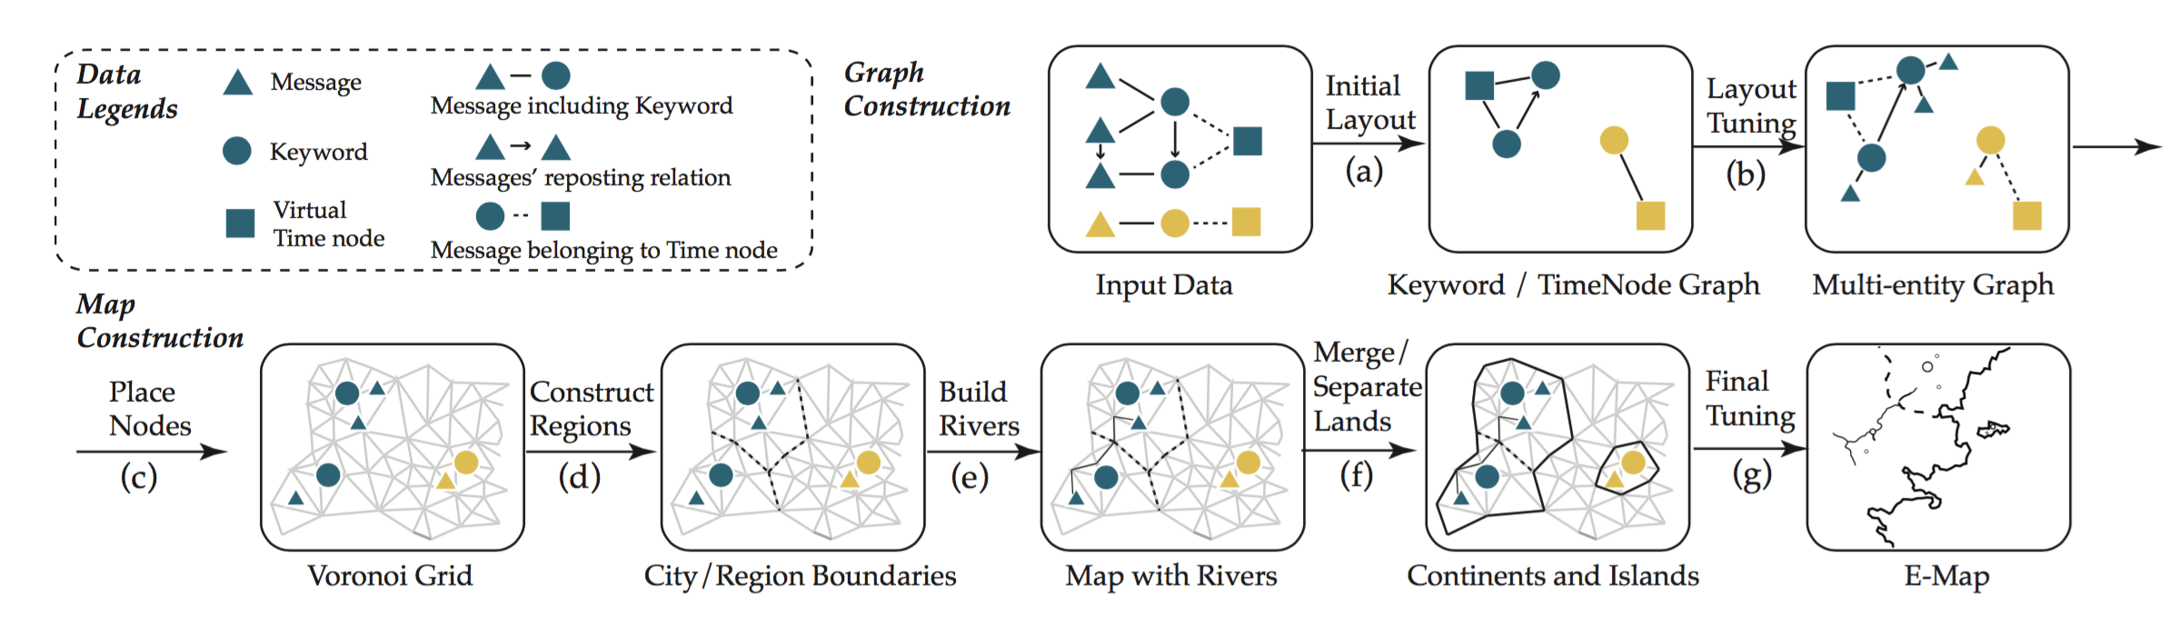
E-Map Construction
Two steps Map Construction
  Multi-entities Graph Construction and Layout
  Map Generation based on Voronoi Grid

Slide 9
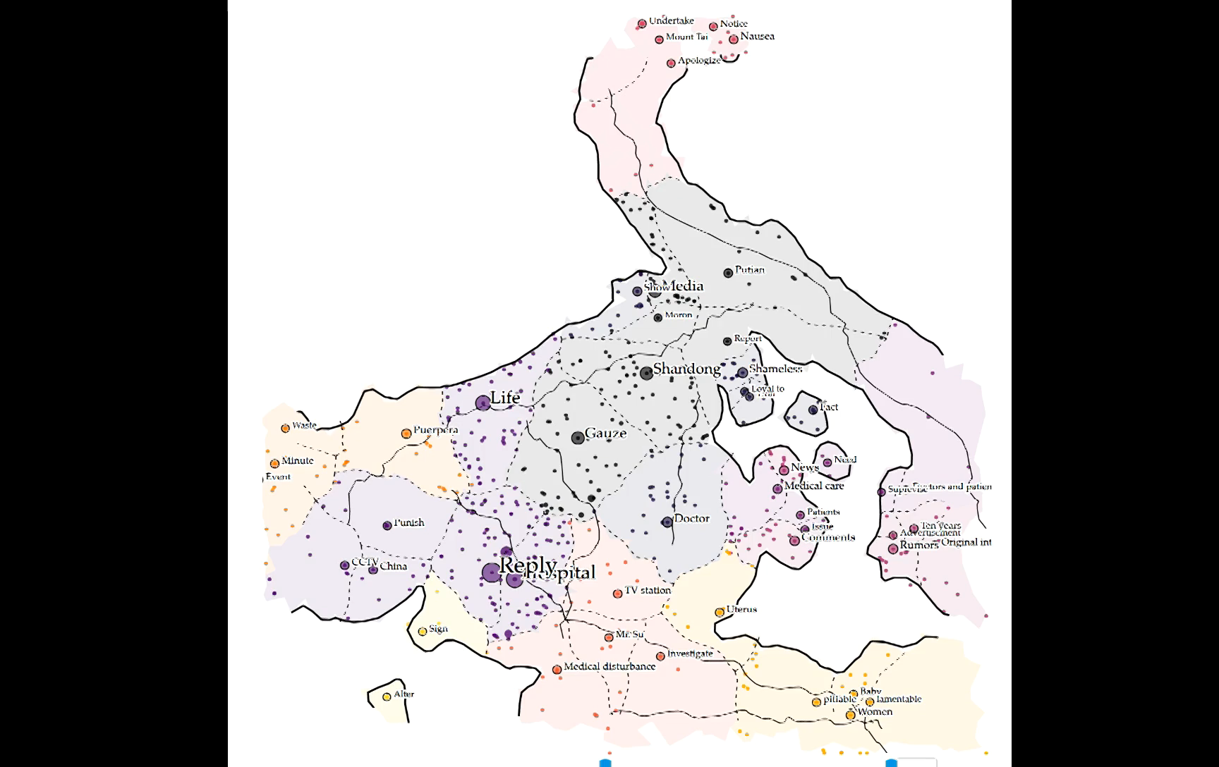
E-Map

Slide 10
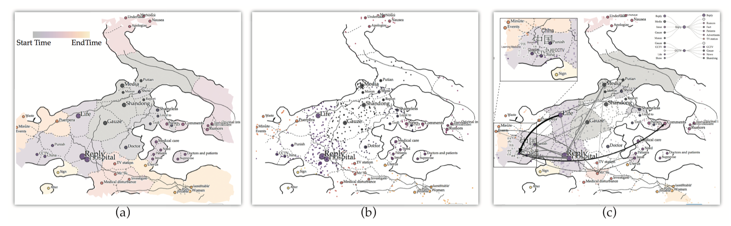
E-Map
Complex and unstructured messages -> Structured and Explorable Map with Semantics
User behaviors and relationship -> People’s trajectories and connections
Support spatial temporal visual analytics

Slide 11
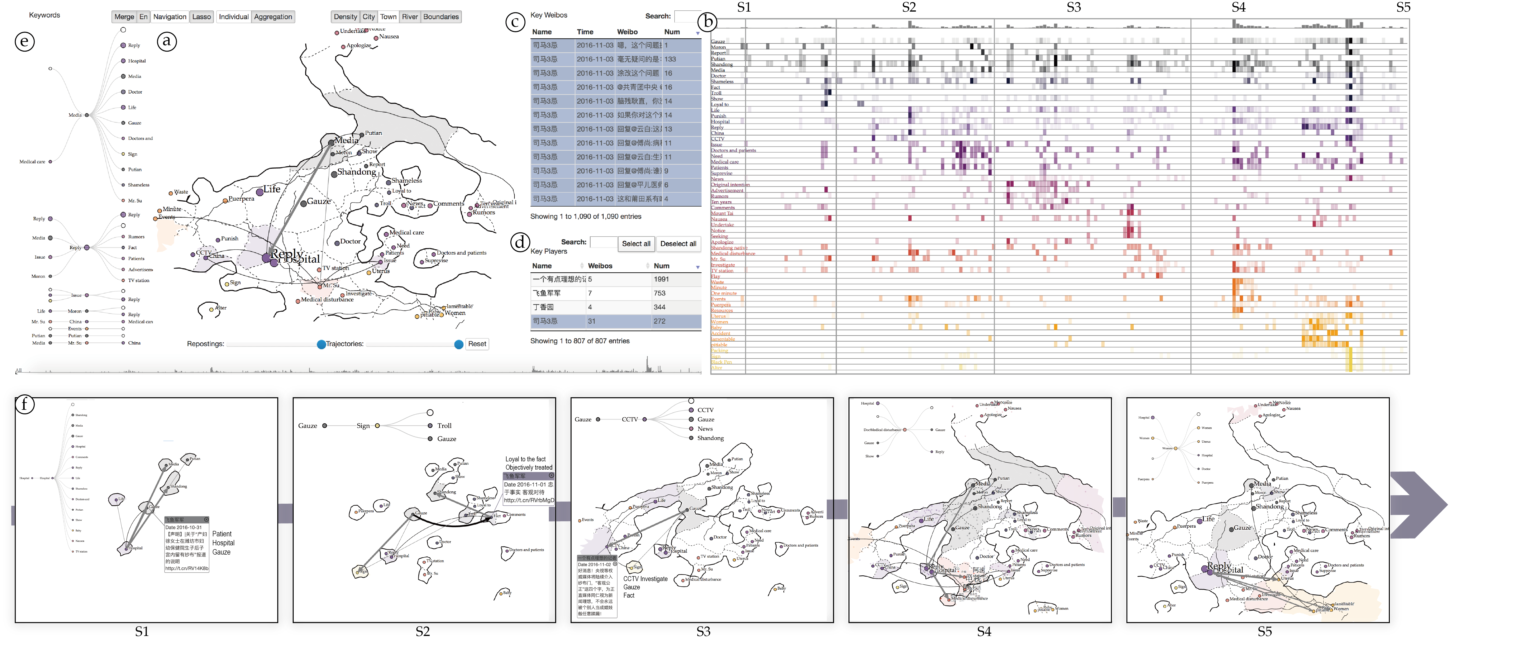
E-Map Visual Analytics System

Slide 12
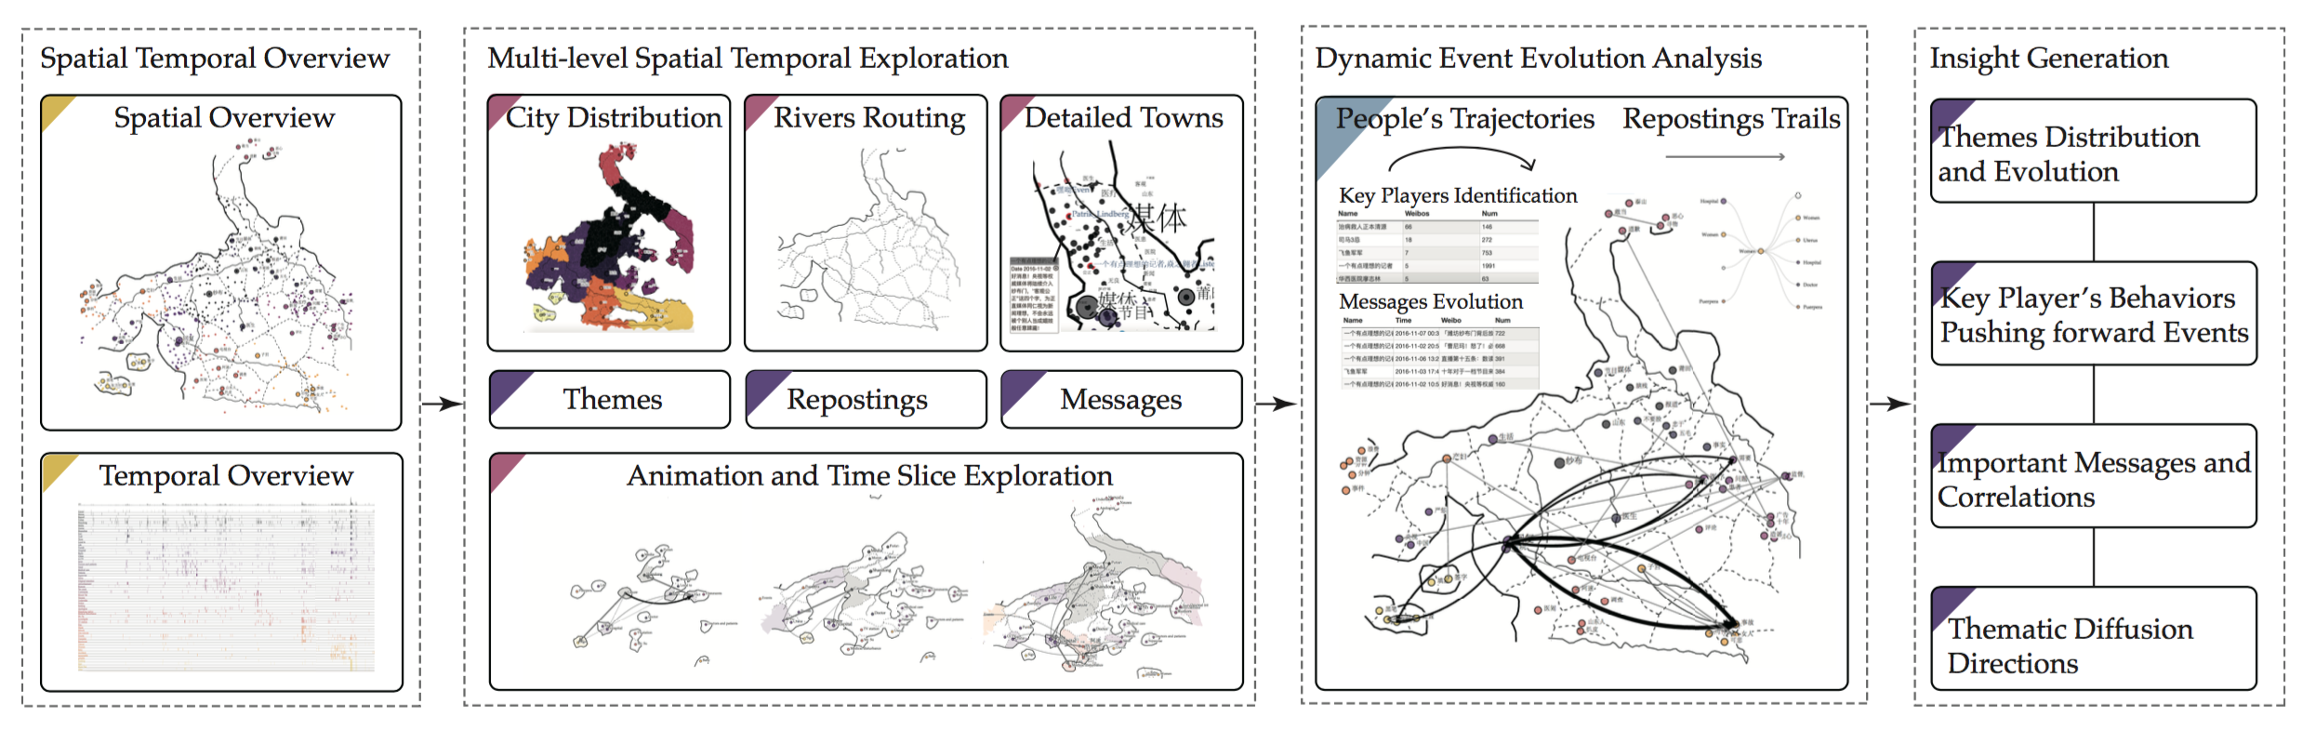
E-Map Visual Analytics Pipeline

Slide 13
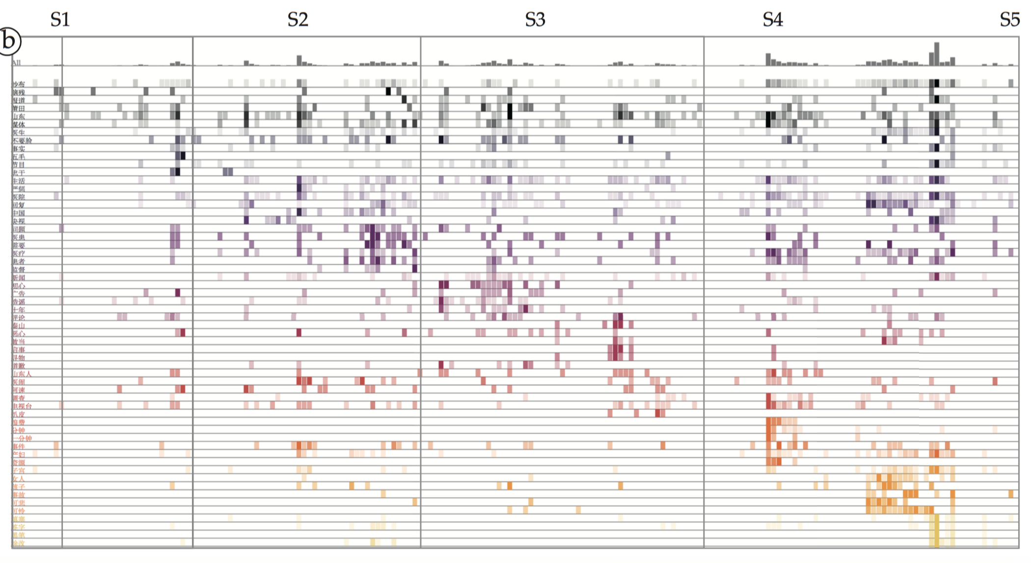
E-Map Visual Analytics（1） – Spatial Temporal Overview
Temporal patterns of keywords
Color encoding the bursting time of the specified keywords cities

Slide 14
E-Map Visual Analytics（2） – Multi-level Spatial Temporal Exploration
Brushing and navigation on timeline时间轴的刷选与导航
Free exploration of the map (navigation, zooming and panning, etc.)
Details on demand (Wordle on the map)

Slide 15
E-Map Visual Analytics（3） – Event Evolution Analysis
User Behaviors Pattern Exploration
  User Trajectories
    Continuous posting messages of people (evolution of themes)
  User Connections
    Reposting relationship of messages
Aggregated model / individual model (City level / town level)

Slide 16

Case Study 1 – Gauze Event

Slide 17
Gauze Event Evolution

Slide 18
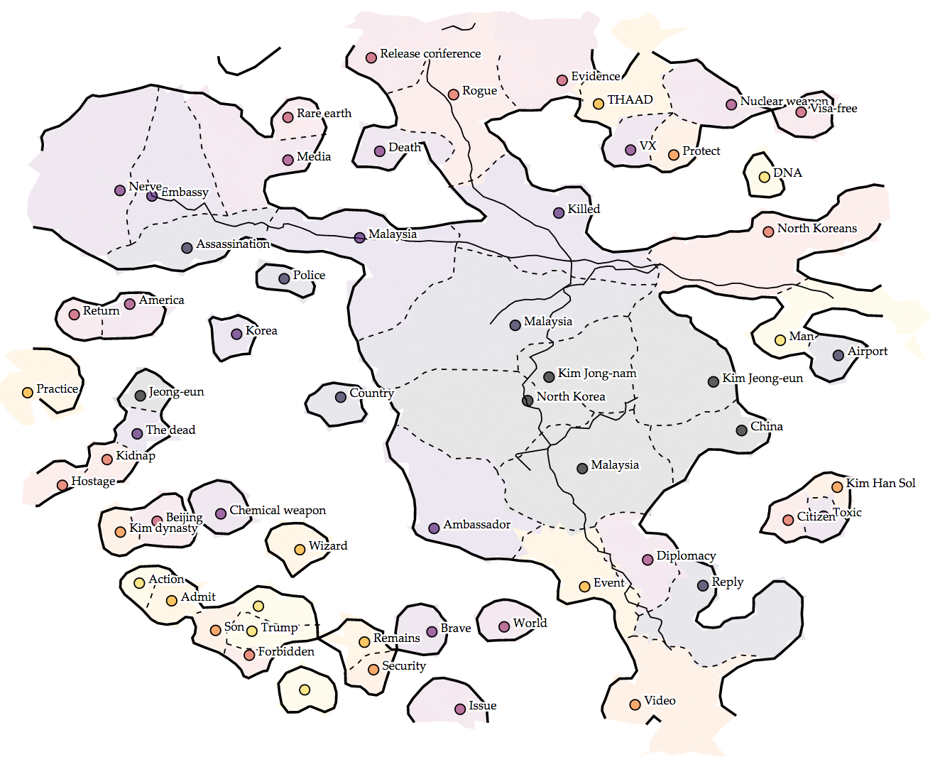
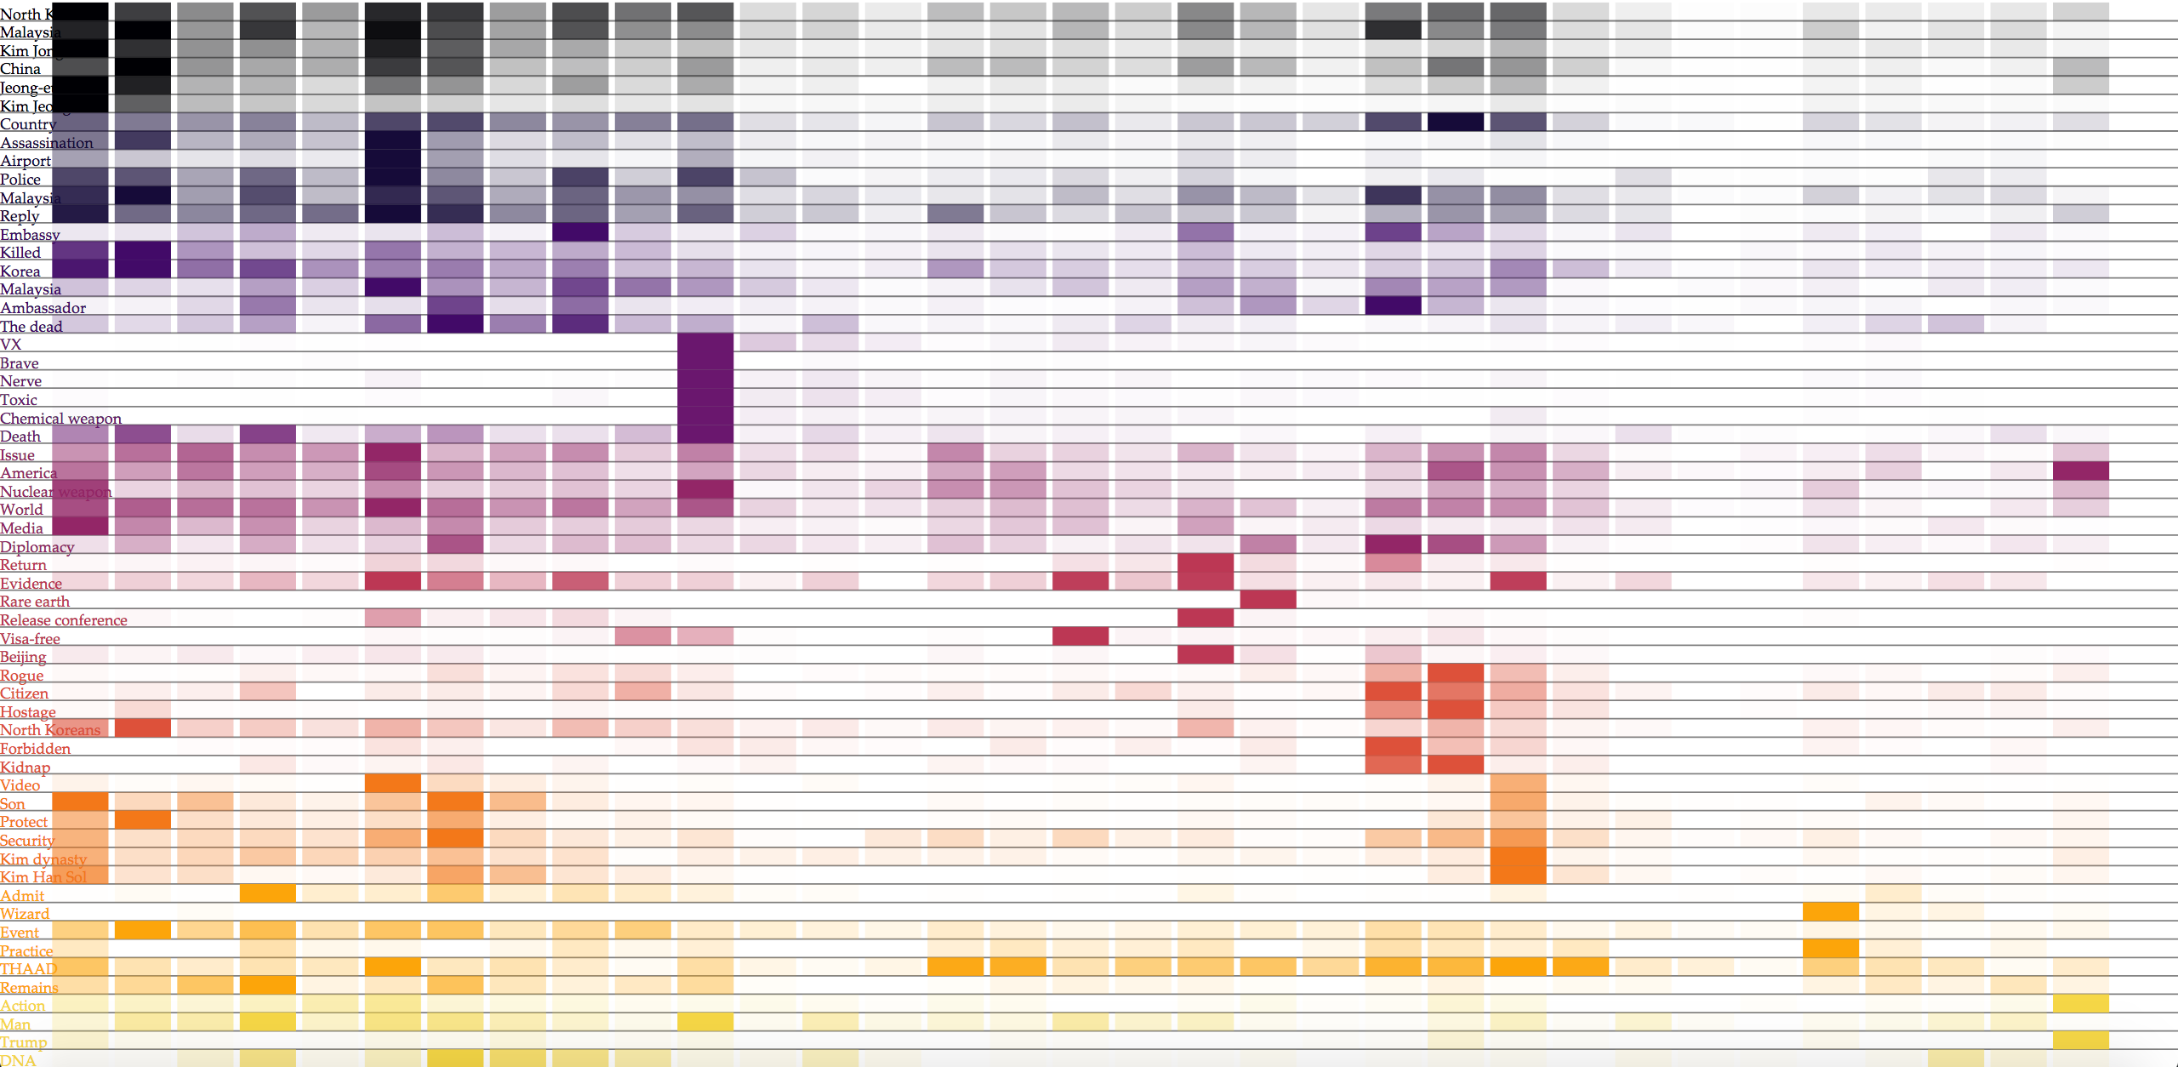
Case Study 2 – Death of Kim Jong-nam

Slide 19
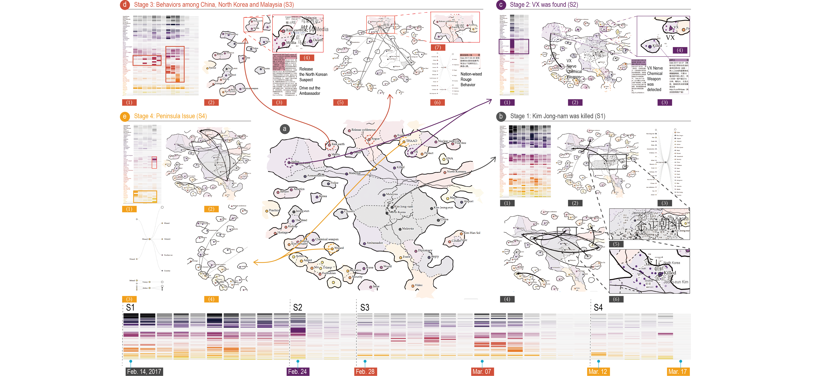
案例分析2 – 金正男遇刺事件动态细节分析

Slide 20
E-Map Summary
A novel event summary visual design based on social media data
  Natural map
  Flexible interactions
A new visual analytics method for exploring user behaviors of social media users
  Dynamic time slicing and animation
  People trajectory and connection analysis
Real-world significant event case study

