Slide 1
LDA Ensembles for Interactive Exploration and Categorization of Behaviors
Siming Chen^{1,2}, Nathalia Andrienko^{1,3},Gennady Andrienko^{1,3}, Linara Adilova¹, Jeremie Barlet⁴, Joerg Kindermann¹, Phong.H Nguyen³, Olivier Thonnard⁴, Cagatay Turkay³
1) Fraunhofer IAIS, Germany
2) Bonn University, Germany
3) City University, London, UK
4) Amadeus, France
Notes:
journalism
ethitic --
issues
long camp ????? nice
care long camp??
brexit
controversy --- thing ????
anymously

Slide 2
Problem Statement
Behaviors: a set of actions performed by some agent during a period of time
Analyzing a large collection of behaviors by multiple agents
Identifying typical behaviors
Spotting behavior anomalies.
Identifying behavior types is challenging
A variety of actions with different frequency
It’s not easy to define ‘behavior patterns’

Slide 3
Approach – LDA Ensembles
We propose an approach leveraging topic modeling techniques -- LDA (Latent Dirichlet Allocation)
Representing categories of typical behaviors by topics obtained through applying topic modeling to behaviors.

Slide 4
Approach – LDA Ensembles
Ensembles of topic models
Topic modeling requires setting the number of topics
Directly setting an ‘appropriate’ number of topic is challenging
Many topic modeling algorithms are non-deterministic and produce slightly different results in each run even if the number of topics is the same
With ensembles, users can decide about the target number based on topics distribution after multiple LDA runs

Slide 5
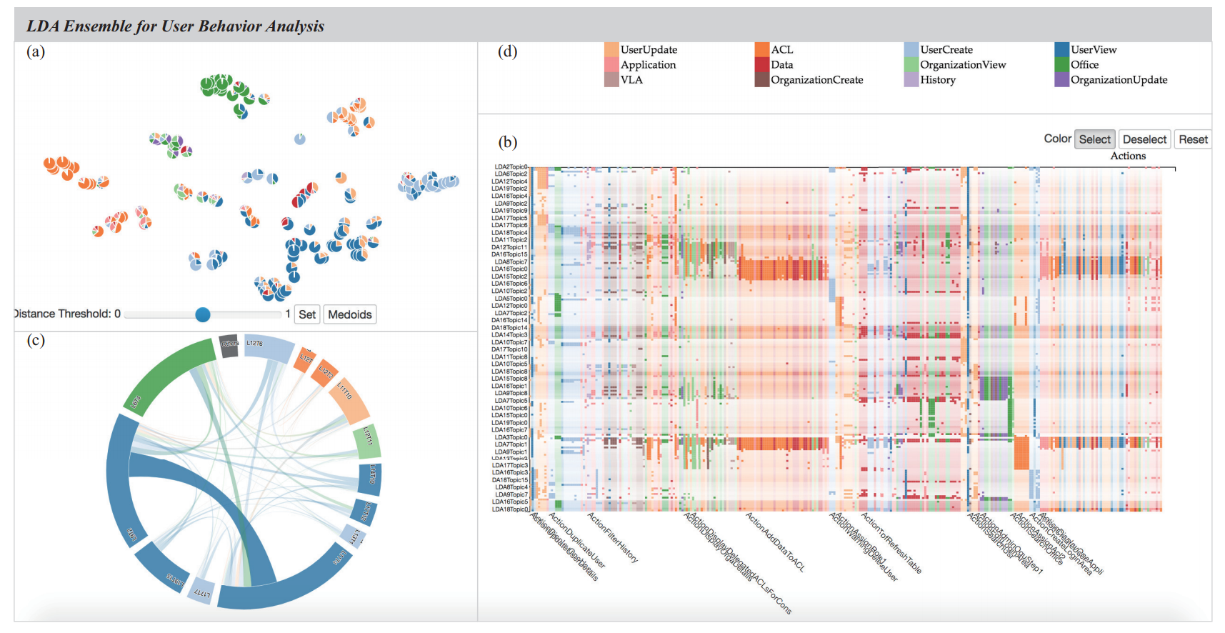
Topics Distribution
Actions Class
Selected Topics Overlapping View
Topic-Action Matrix

Slide 6
Visual Analytics Interface
Topic Projection
Showing similarity and distribution
Enabling interactive selection
Topic-Action Matrix
Showing the Relationship of topic and actions
Supporting Ranking and sorting
Selected Topic Chord View
Showing the overlapping based on the similarity of belonging sessions

Slide 7
Visual Analytics Workflow
We run multiple rounds of LDA, and generate all the topics as input for visual analytics
Users can interactively select representative topics and modify the selection after understanding the topic features, their capabilities to differentiate behaviors, and the coverage of the behavior set.

Slide 8
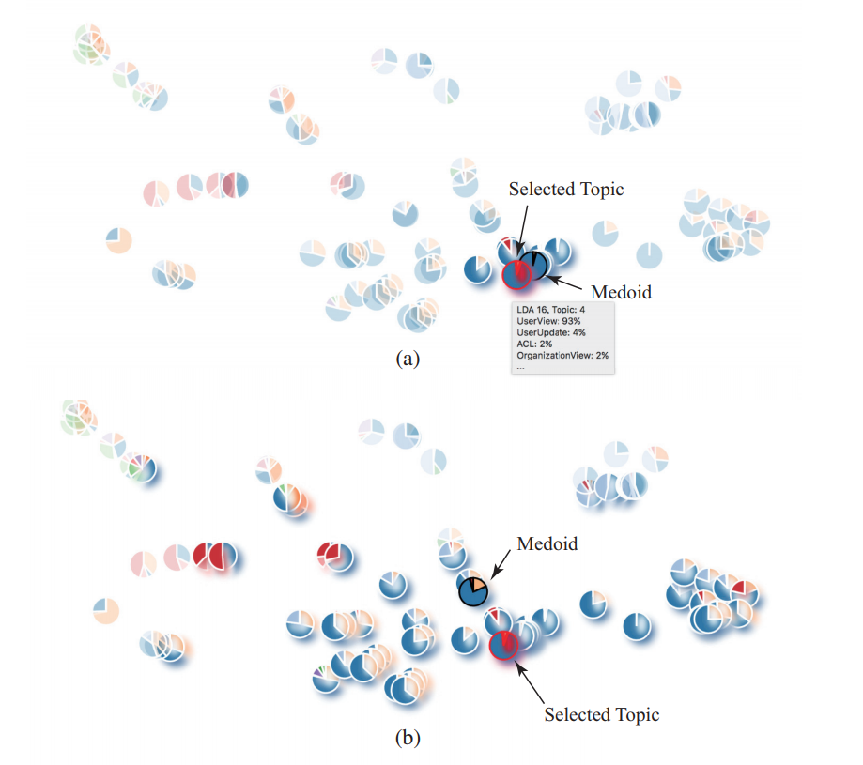
Analytic Process (1): Topic Selection
Glyph encoding
Percentage of action classes
Defining topic groups
Brushing the regions
Click and add similar candidates
Selecting the representative
The Medoid of the group

Slide 9
Analytic Process (2): Topic editing / updating/ removing
(a) Original selected topic groups, (b) Updated topic group, (c) Matrix visualization, (d) Detailed matrix by interactive zooming

Slide 10
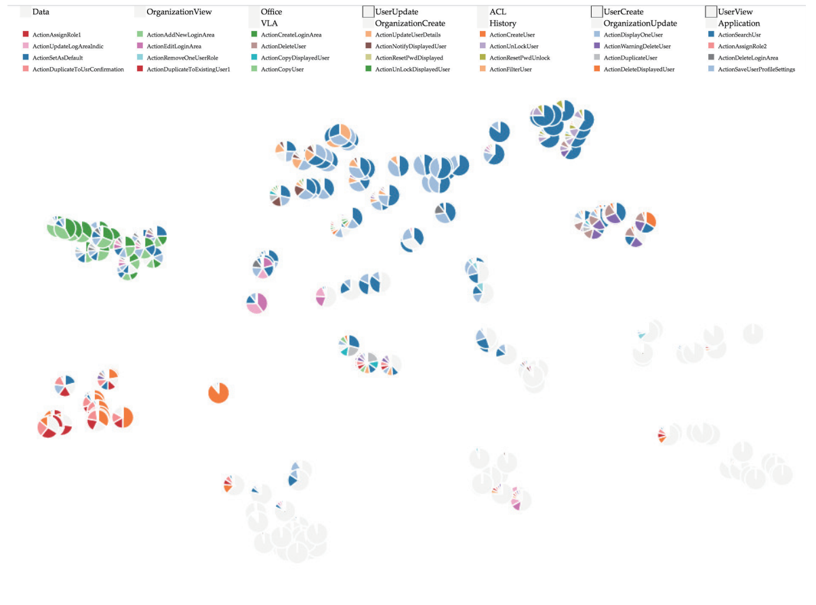
Analytic Process (3): Multiple-level of Exploration
Multiple level of exploration
Drilling down to specific action classes
Showing the details of the action distributions

Slide 11
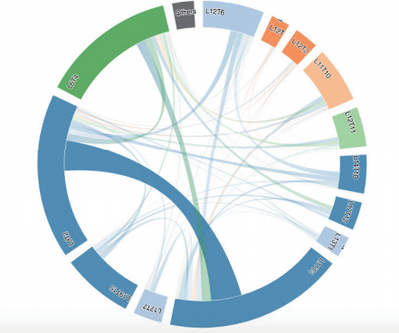
Analytic Process (4): Iterative Exploration
Refinement by examining the duplication of representatives of topics
Distinctiveness
Coverage of behaviors
Patterns of action probability distributions

Slide 13
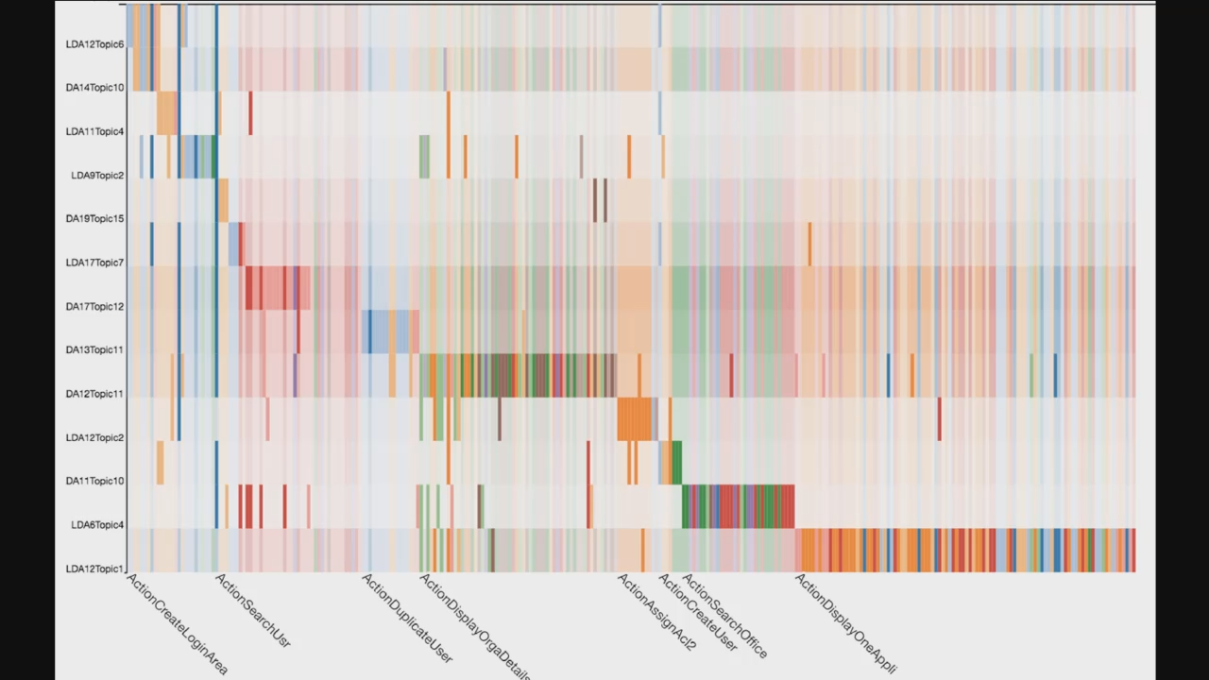
Expert Evaluation
The software is open sourced and deployed in Collaborators’ platform
Their feedbacks of the interviews are positive
Selected topics represent behaviors of interest well
Typical behaviors can be identified as ‘normal’
Atypical behaviors can be identified as ‘anomaly’

Slide 14
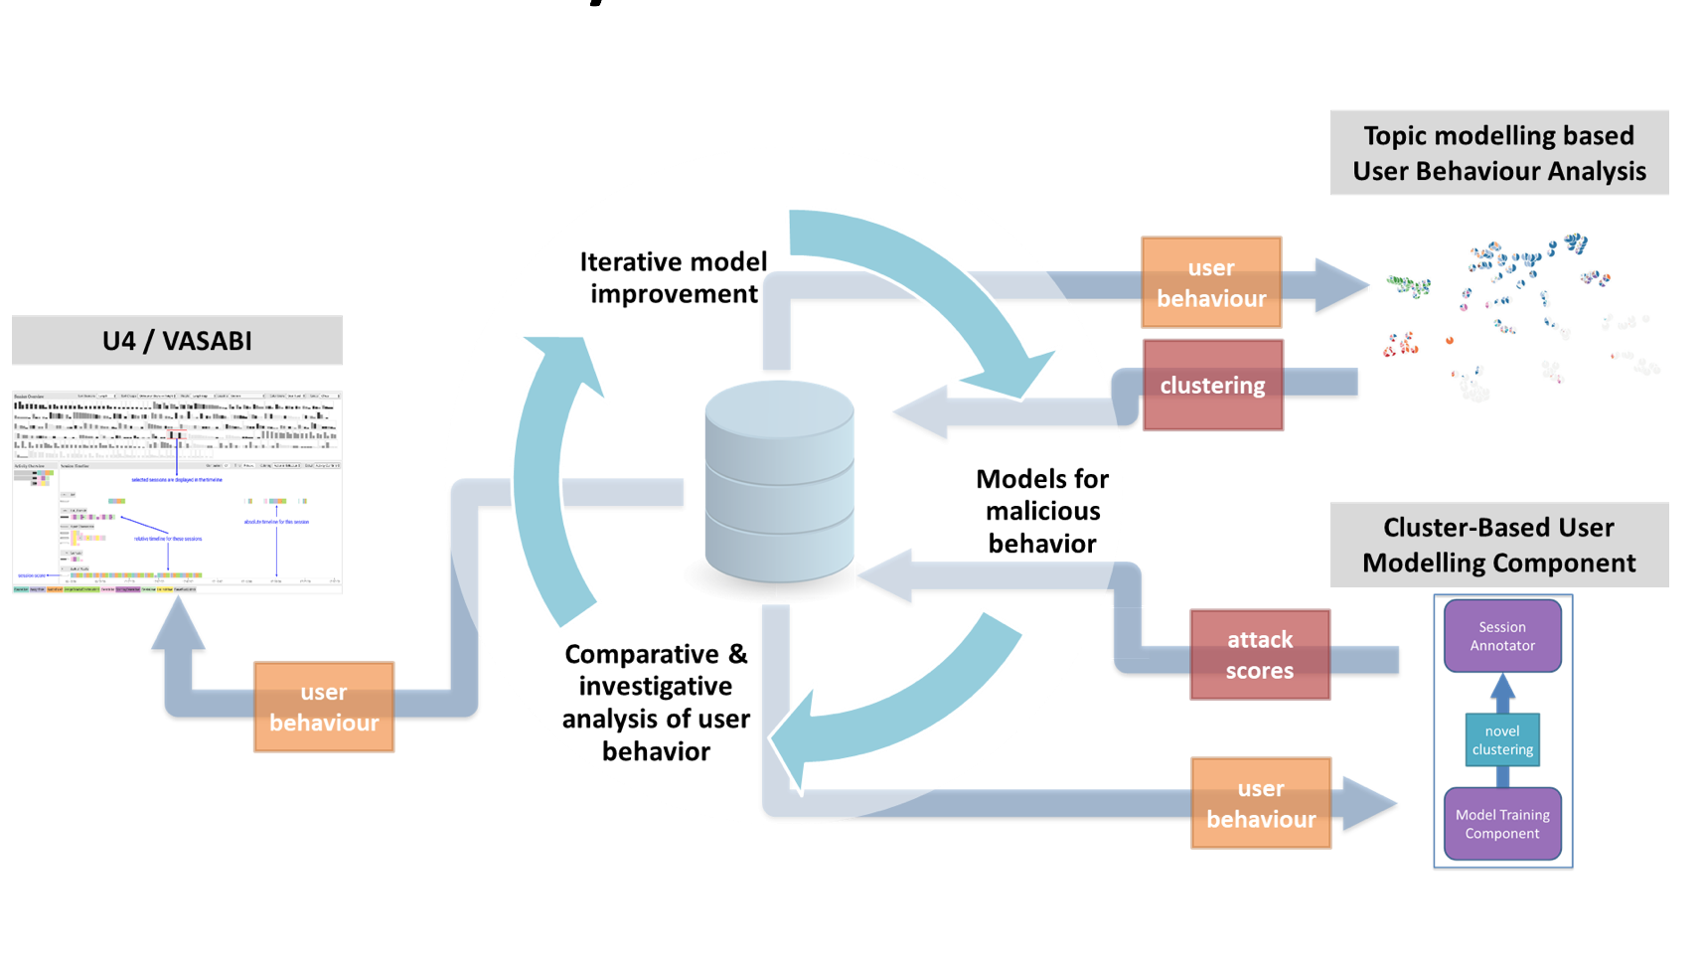
Further Collaborations and Future Work
VASABI: Doing User Behaviour Analytics through Interactive Visual Hierarchical User Profiles (J) Authors: Phong H. Nguyen, Rafael Henkin, Siming Chen, Natalia Andrienko, Gennady Andrienko, Olivier Thonnard, Cagatay Turkay

Slide 15
Thank you
http://simingchen.me
http://geoanalytics.net/and/

