Slide 1
Supporting Story Synthesis: Bridging the Gap between Visual Analytics and Storytelling
Siming Chen^{1,2}, Jie Li³, Gennady Andrienko^{1,4}, Nathalia Andrienko^{1,4}, Yun Wang⁵, Phong. H. Nguyen⁴, Cagatay Turkay⁴
1) Fraunhofer IAIS, Germany
2) Bonn University, Germany
3) Tianjin University, China
4) City University, London, UK
5) Microsoft Research Asia, China
Notes:
journalism
ethitic --
issues
long camp ????? nice
care long camp??
brexit
controversy --- thing ????
anymously

Slide 2
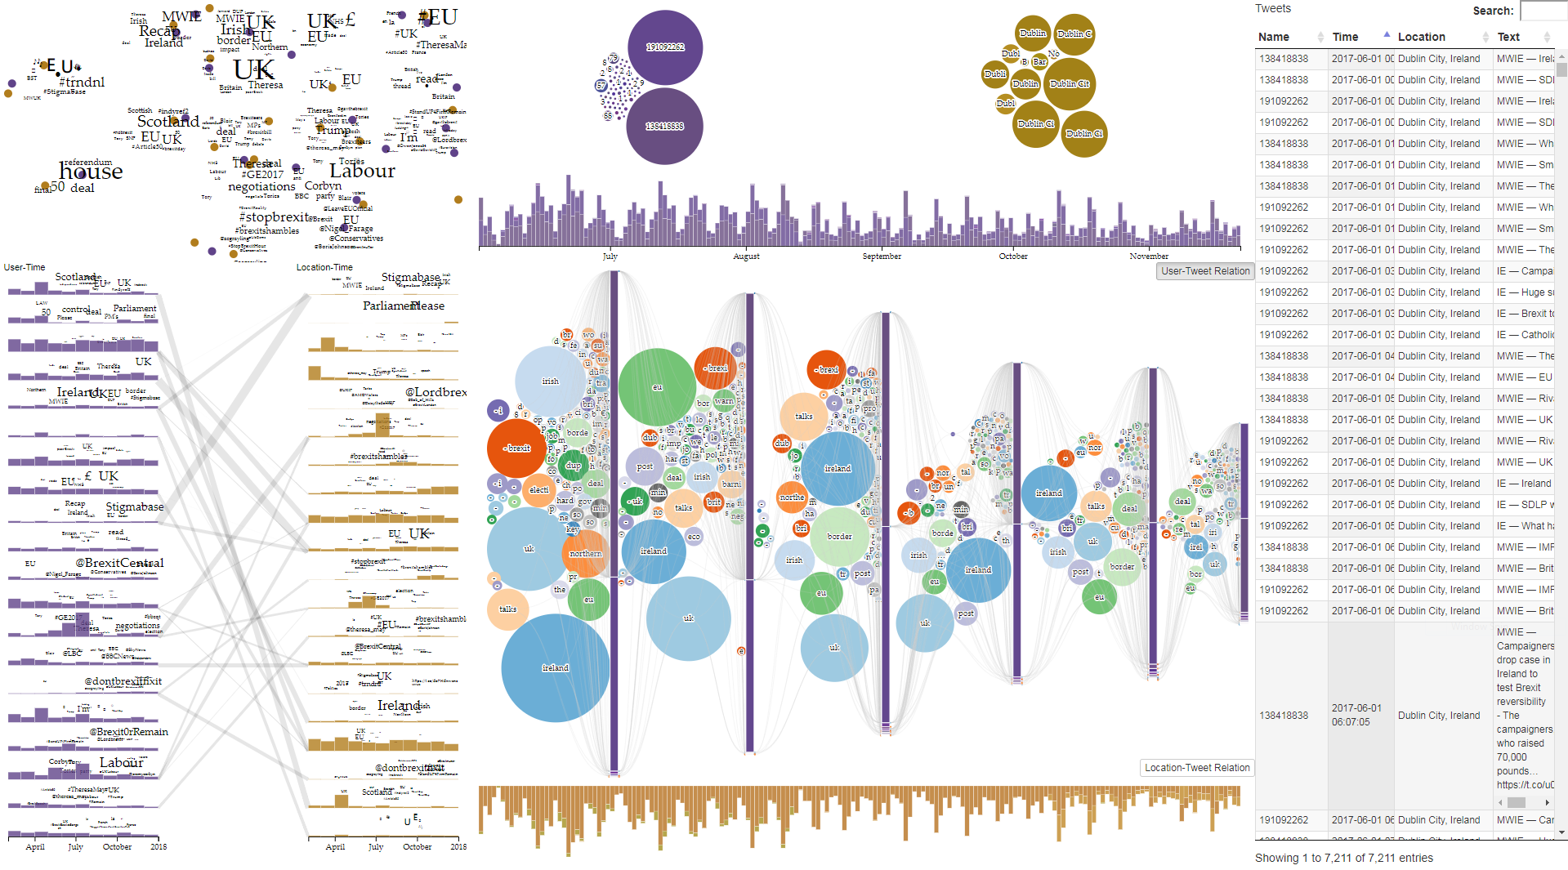
Problem Statement
“Fancy visuals, cool interactions, but what does this mean? and how can I see these findings together? What is the whole picture?”
Gap
Visual analytics (Supporting analysis) -> Analysts -> multifaceted analysis results
General audience -> Requires understanding in an accessible way
Goal
How to proceed from analysis to result communication, enabling analysts to tell story of their analysis findings and results

Slide 3
Conceptualization of the Research Problem

Slide 4
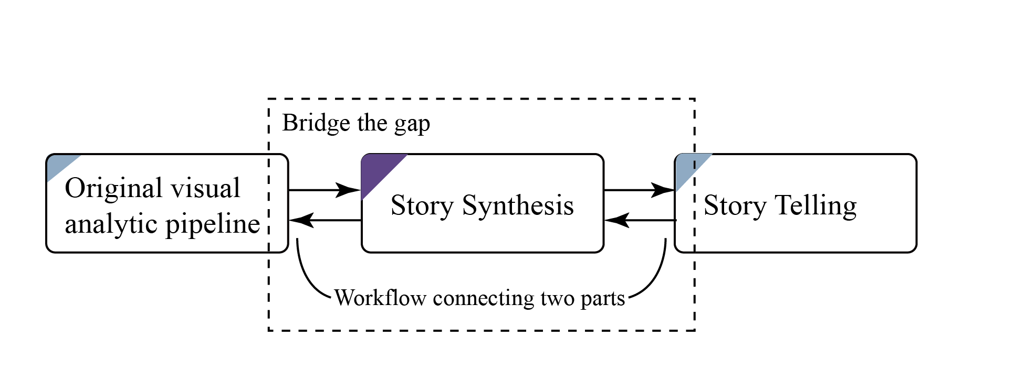
Approach
We propose to organize information in the story synthesis workspace according to the existing facets, or information dimensions.
Arranging and aggregating
Creation of multi-perspective presentations
We implement the proposed workflow in social media data analysis, specifically addressing on the people’s reaction analysis in events

Slide 5
Data Description
Dimensions
People (users of social media)
Geographic locations
Time
Dataset
380,000 tweets in UK/Ireland in 2017, about ‘Brexit’
People produce text messages at different times being at specific locations. The messages have semantic contents (meanings).
Our goal: propose a way to analyze and tell stories of the relationships of the message contents to the people, time, and space.

Slide 6
Extending Visual Analytics Workflow

Slide 7
Visual Analytics Interface
(a) topic projection view, (b) topic comparison view, (c) user/location distribution view, (d) temporal view, (e) story slice generation parameters, and (f) raw data table.
Notes:
data amount ---
manipulation

Slide 8
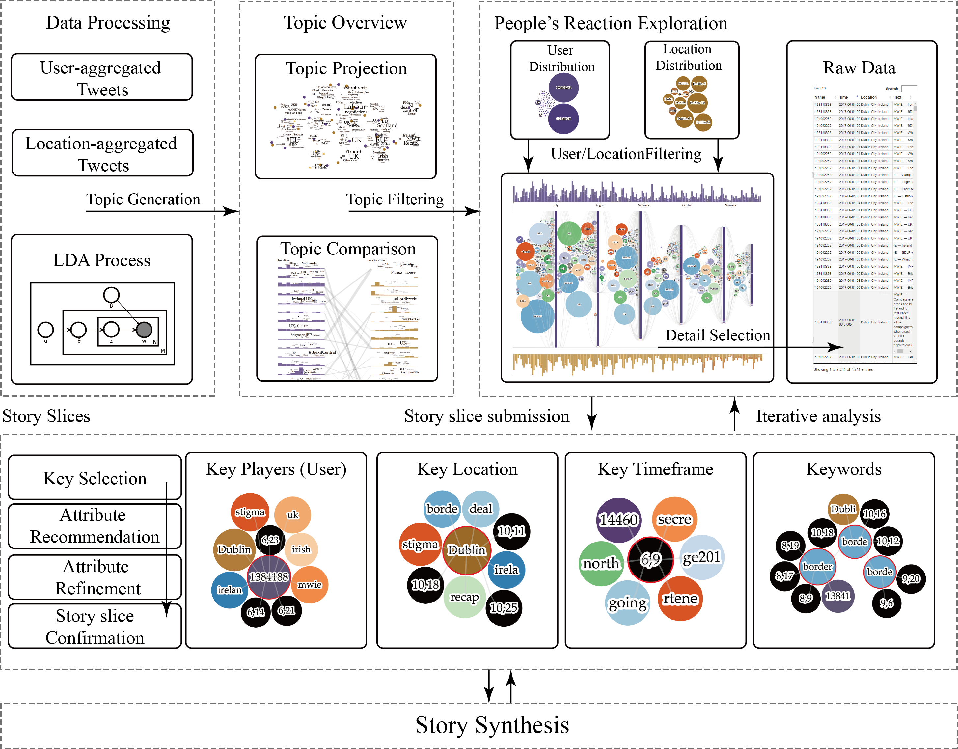
Visual Analytics Workflow
We support the visual analytics from overview to detail on demand, with topic / user / time / location / keyword filtering functions to enable iterative exploration.
After topic modeling, analysts explore the collection of messages from four perspectives and extract story slices.
Notes:
keywords,
your whole pipeline is based on text analysis --- what I do all the time

Slide 9
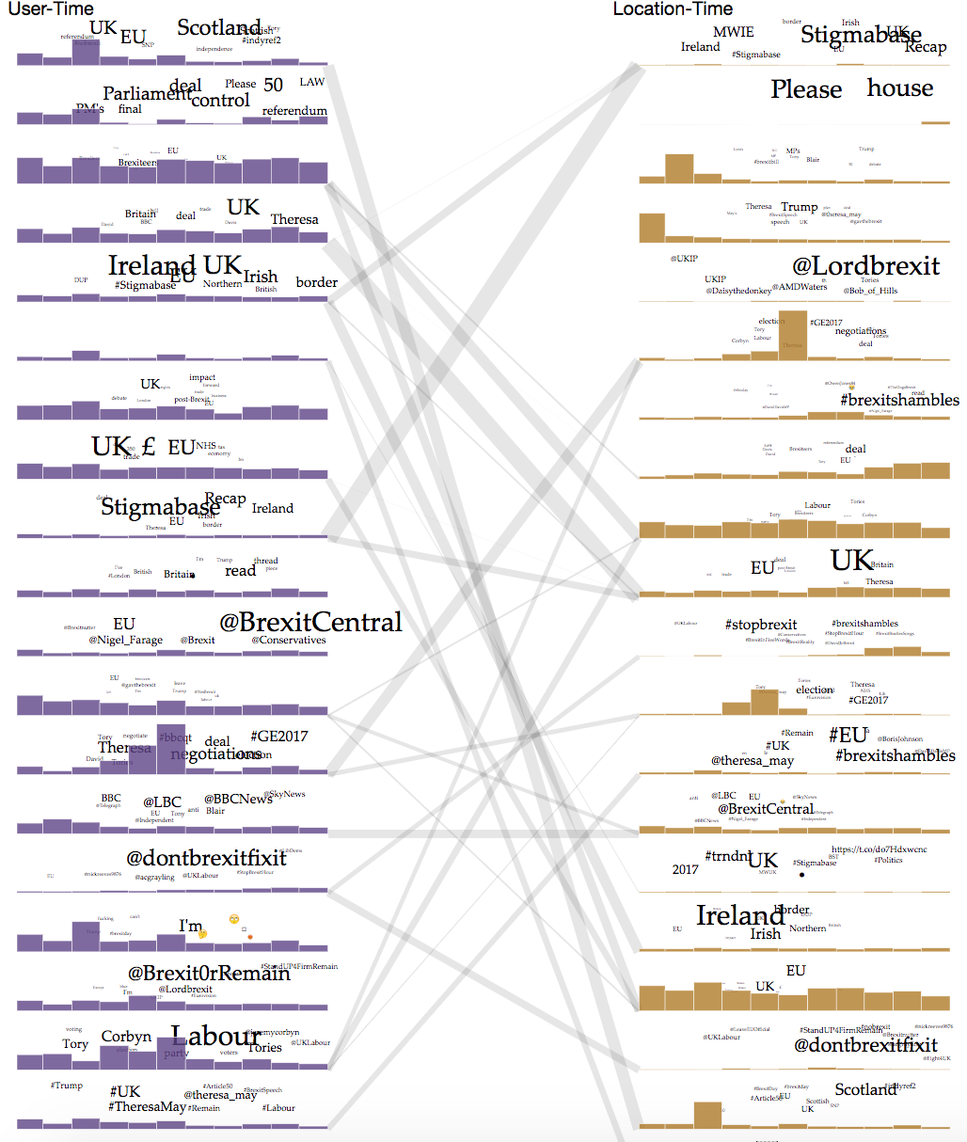
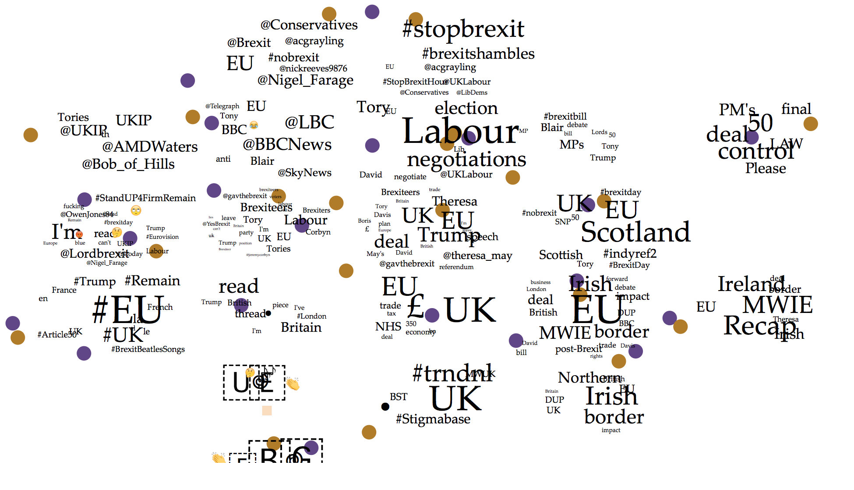
Visual Analytics Steps (1) – Topic Overview
Topic Projection
T-SNE with the topic distance of accumulating word distance
Projection with keyword distribution
Topic Correlation
Identify similar topics (Correlate their spatial / user distribution)
Notes:
topics
- time
-- stopwords
---

Slide 10
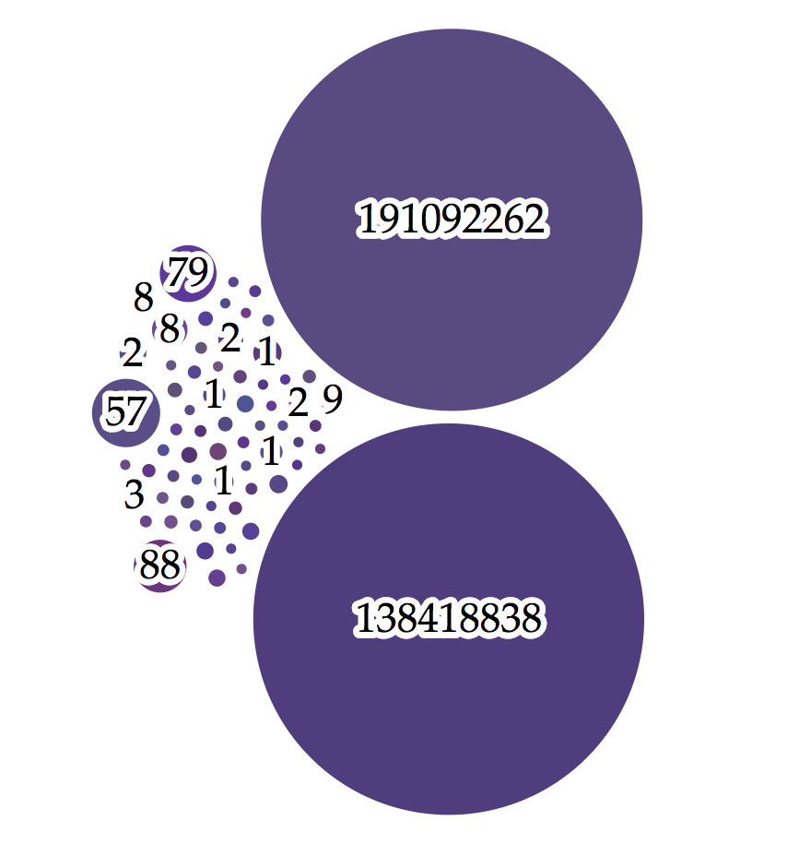
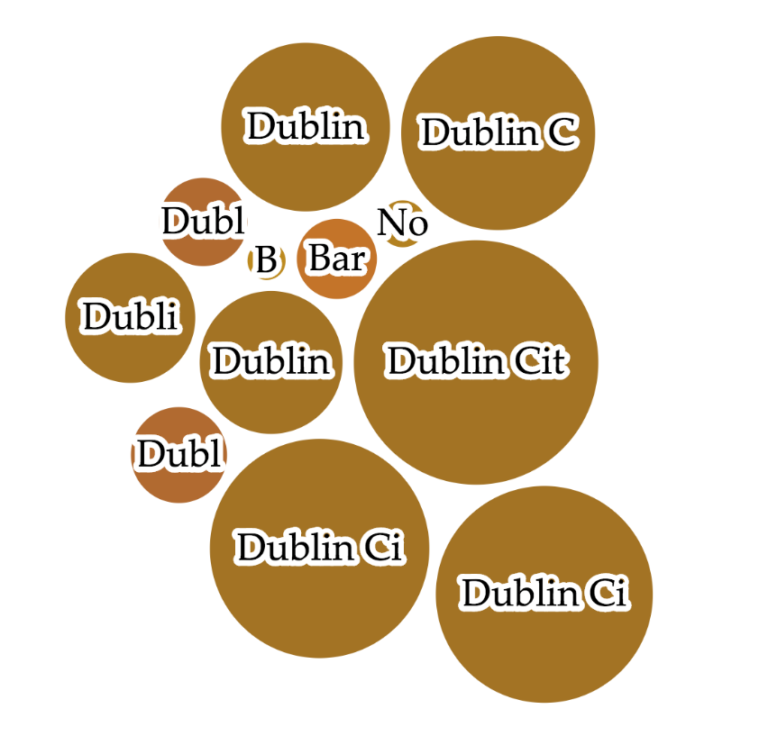
Visual Analytics Steps (2) – People’s Reaction Exploration
Selecting interested topics and filter a subset of tweets
Visualize the distribution User/time and Location/time
The size encoding the corresponding tweet number
Design Goal
Enable understanding who are important users or where are representative locations in the selected topics
Enable further user / location selection of users and locations
User/time Distribution
Location/time Distribution

Slide 11
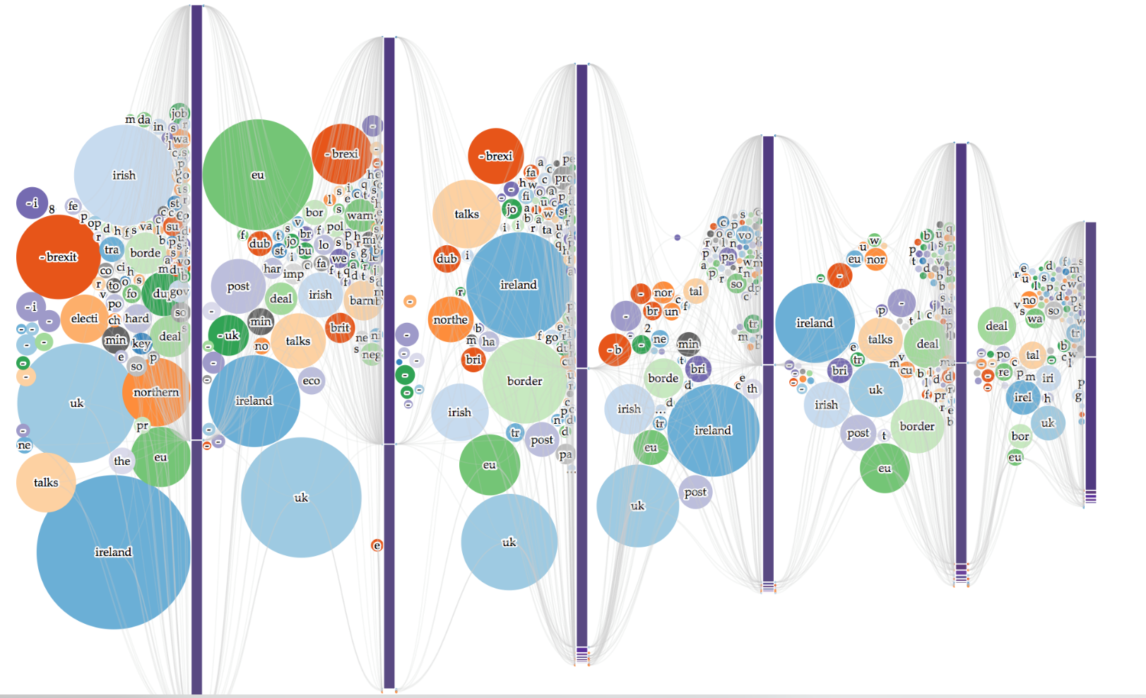
Visual Analytics Steps – People’s Reaction Exploration (2)
Visual Encoding
Tweet distribution along the time (User / Location)
Tweet aggregation and keyword distribution (Monthly) – Circle size encoding the tweet number containing specific keyword
User/location aggregation – Bar height encoding the tweet number of specific user/location
Keyword evolution and correlation with users/ locations
Notes:
stop words
-
russian --- bots -
user classicification
communicate -- techniques to identify human behaviors

Slide 12
Visual Analytics Steps – People’s Reaction Exploration (3)
Interaction
Hovering for highlighting user/location
Filter topics / user / location
Keyword evolution and correlation with users/ locations
Exclusion for drilling down
Goal
Identify different ‘Topic Waves’
Explore the dynamic changes of users/locations’ discussion keywords
Drill down to the detail data

Slide 13
Drilling down to user detail
One user’s keyword flow

Slide 14
Story slices submission
We refer to pieces of information that need to be assembled and arranged as Story Slice
In social media data, we define the slice as <user, location, time, keyword>

Slide 15
Illustrative Case

Slide 16
Input of Story Synthesis
Time
User
Location
Keyword

Slide 17
Story Synthesis
Provide multi-faceted information layout, to enable analysts to tell stories from multiple perspectives with the flexibility to express the ideas

Slide 18
Story Synthesis (1)– Aggregation and facet-based layout
Generating story overview from multiple perspectives
Notes:
social clustering, spatial clustering -- amount of the clustering
--zero to 1
--intensity of clustering
===
lda -- topic = social users

Slide 19
Story Synthesis (2) – Detail on Demand
Explicit visual representation of all relationships would greatly increase the display complexity.
Show the core idea and reduce the complexity

Slide 20
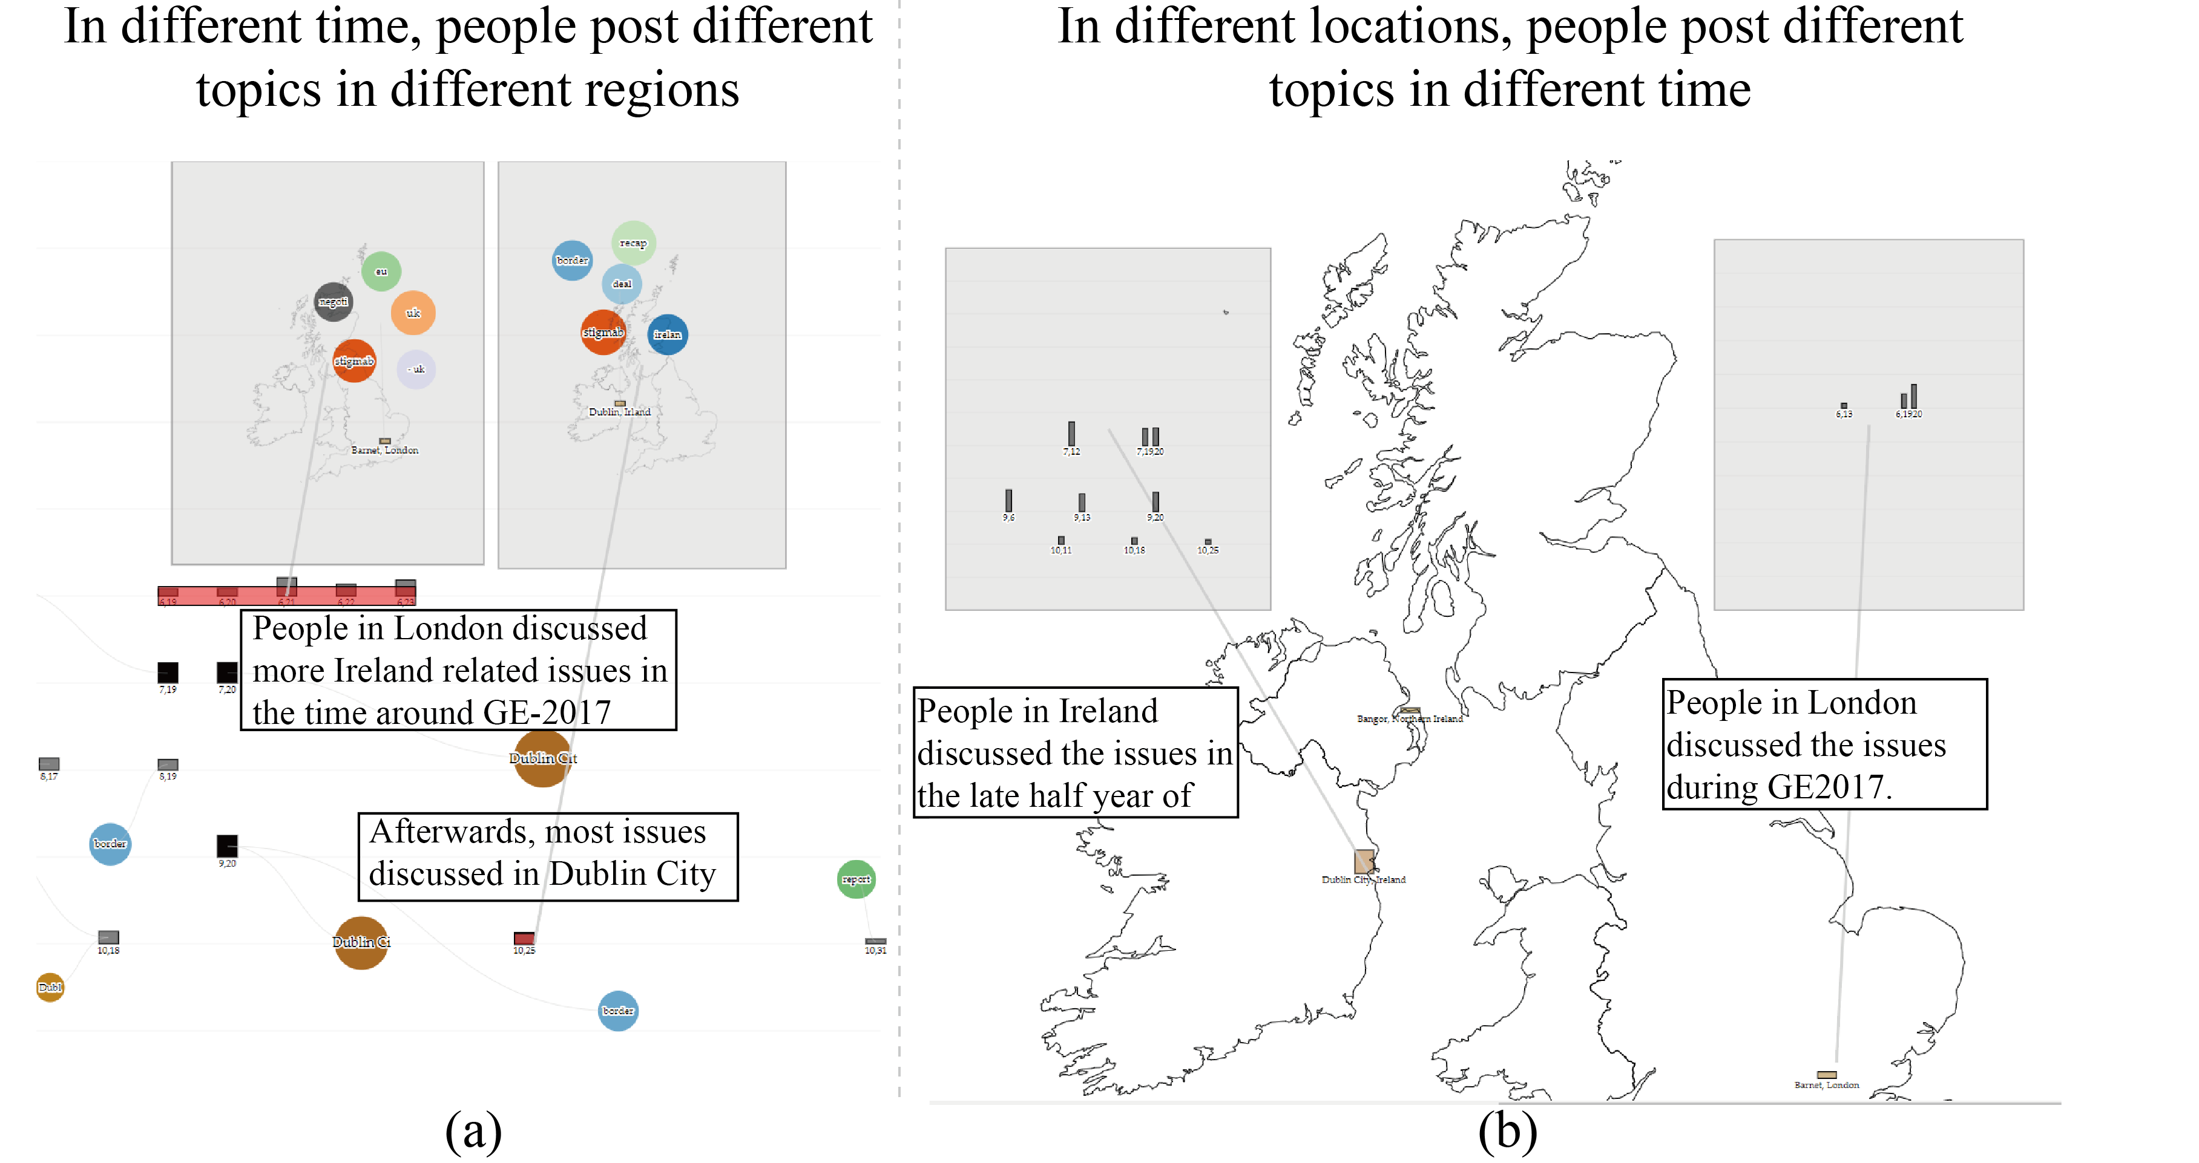
Story Synthesis (3) - Nested Layout and Comparison
Provide flexibility for information arrangement
Conduct comparison and reveal details
Notes:
manipulate the story..
ethic
how you manipulate the story
--- be objective
select -- interactively remove -- select
-intensionly

Slide 21
Illustrative Case

Slide 22
Expert usage on Brexit (1) - Analysis
User types and their reactions analysis and story telling
Supporters / Opponents / Neutral
Their distributions in space and time

Slide 23
Expert usage on Brexit (2) – Story Synthesis

Slide 24
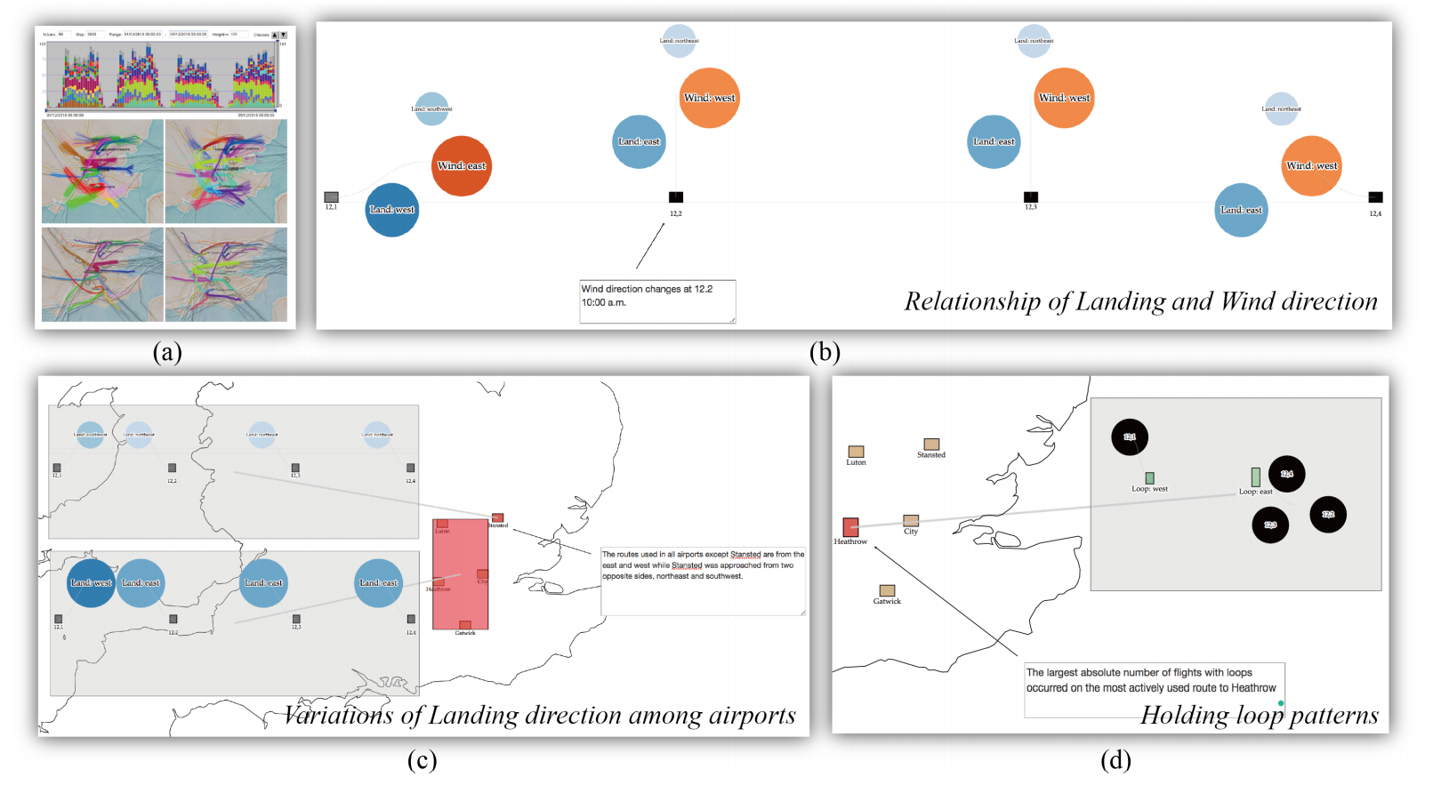
The Other Example Application: Trajectory Visual Analytics and Storytelling
Application of the framework to the analysis results [1], telling the stories of the findings
[1] G. Andrienko, N. Andrienko, G. Fuchs, and J. M. C. Garcia, “Clustering trajectories by relevant parts for air traffic analysis,” IEEE Transactions on Visualization and Computer Graphics, vol. 24, no. 1, pp. 34–44, Jan 2018

Slide 25
Summary of Our Story Synthesis Approach
We consider the essential differences between visual analysis and storytelling and on this basis describe the problem of conveying analysis results to the general audience and the challenges that need to be addressed.
Bridging the gap: We define the necessary activities for story synthesis and propose a general approach in which information facets are exploited for organizing analysis results.
Demonstrating the approach: We demonstrate an implementation of the general approach in application to complex data with multiple heterogeneous facets.

Slide 26
Thank you
http://simingchen.me
http://geoanalytics.net/and/

