Slide 1


R-Map: A Map Metaphor for Visualizing Information Reposting Process in Social Media
Shuai Chen, Sihang Li, Siming Chen, Xiaoru Yuan

Slide 2
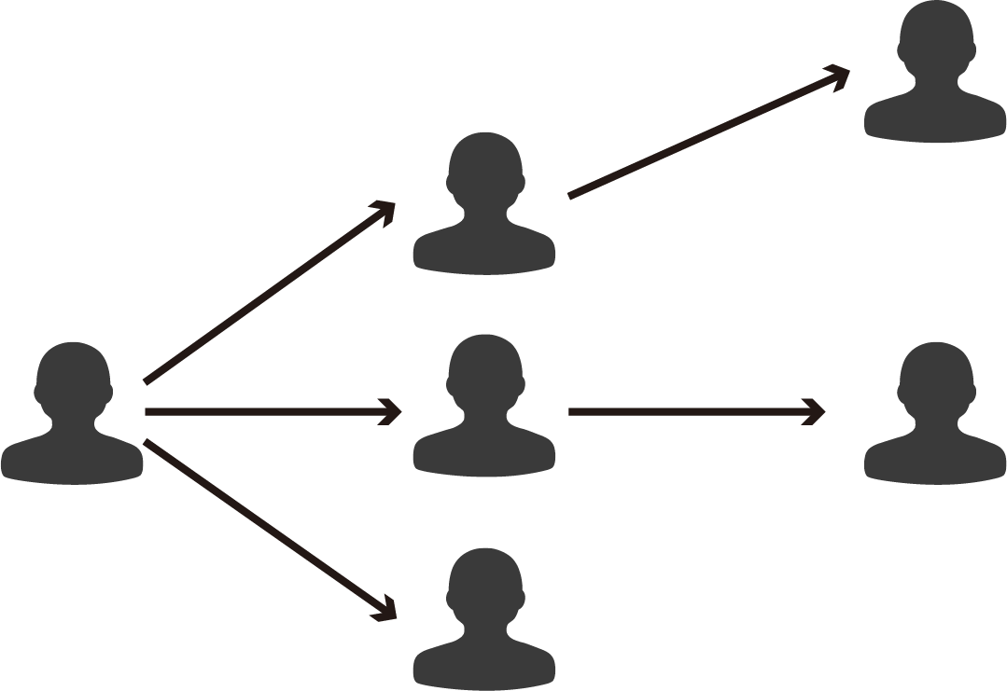


Information Propagation
Reposting
messages
Reposting tree
1

Slide 3
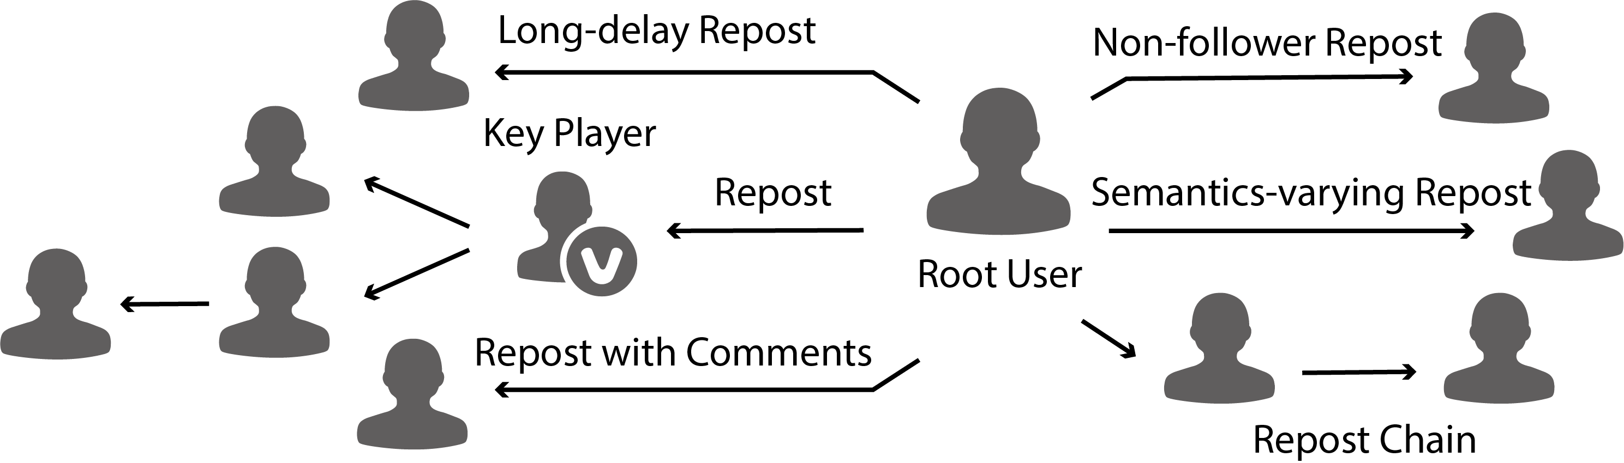
Reposting Analysis
For one weibo with large-scale cascading repostings, the reposting process is complex
  Hierarchical structure
  Key player’s influence
  Dynamic diffusion process
  Different reposting behaviors
2

Slide 4
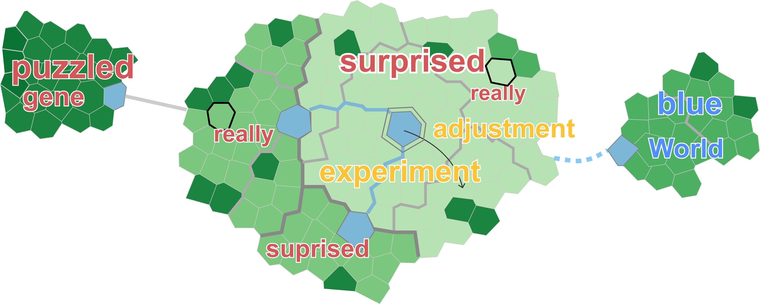
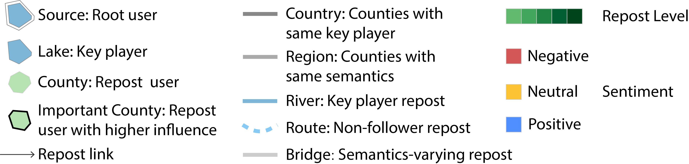
R-Map
Multifaceted information encoded with different map symbols
Intuitive representation of a reposting tree with a compact layout
3

Slide 5
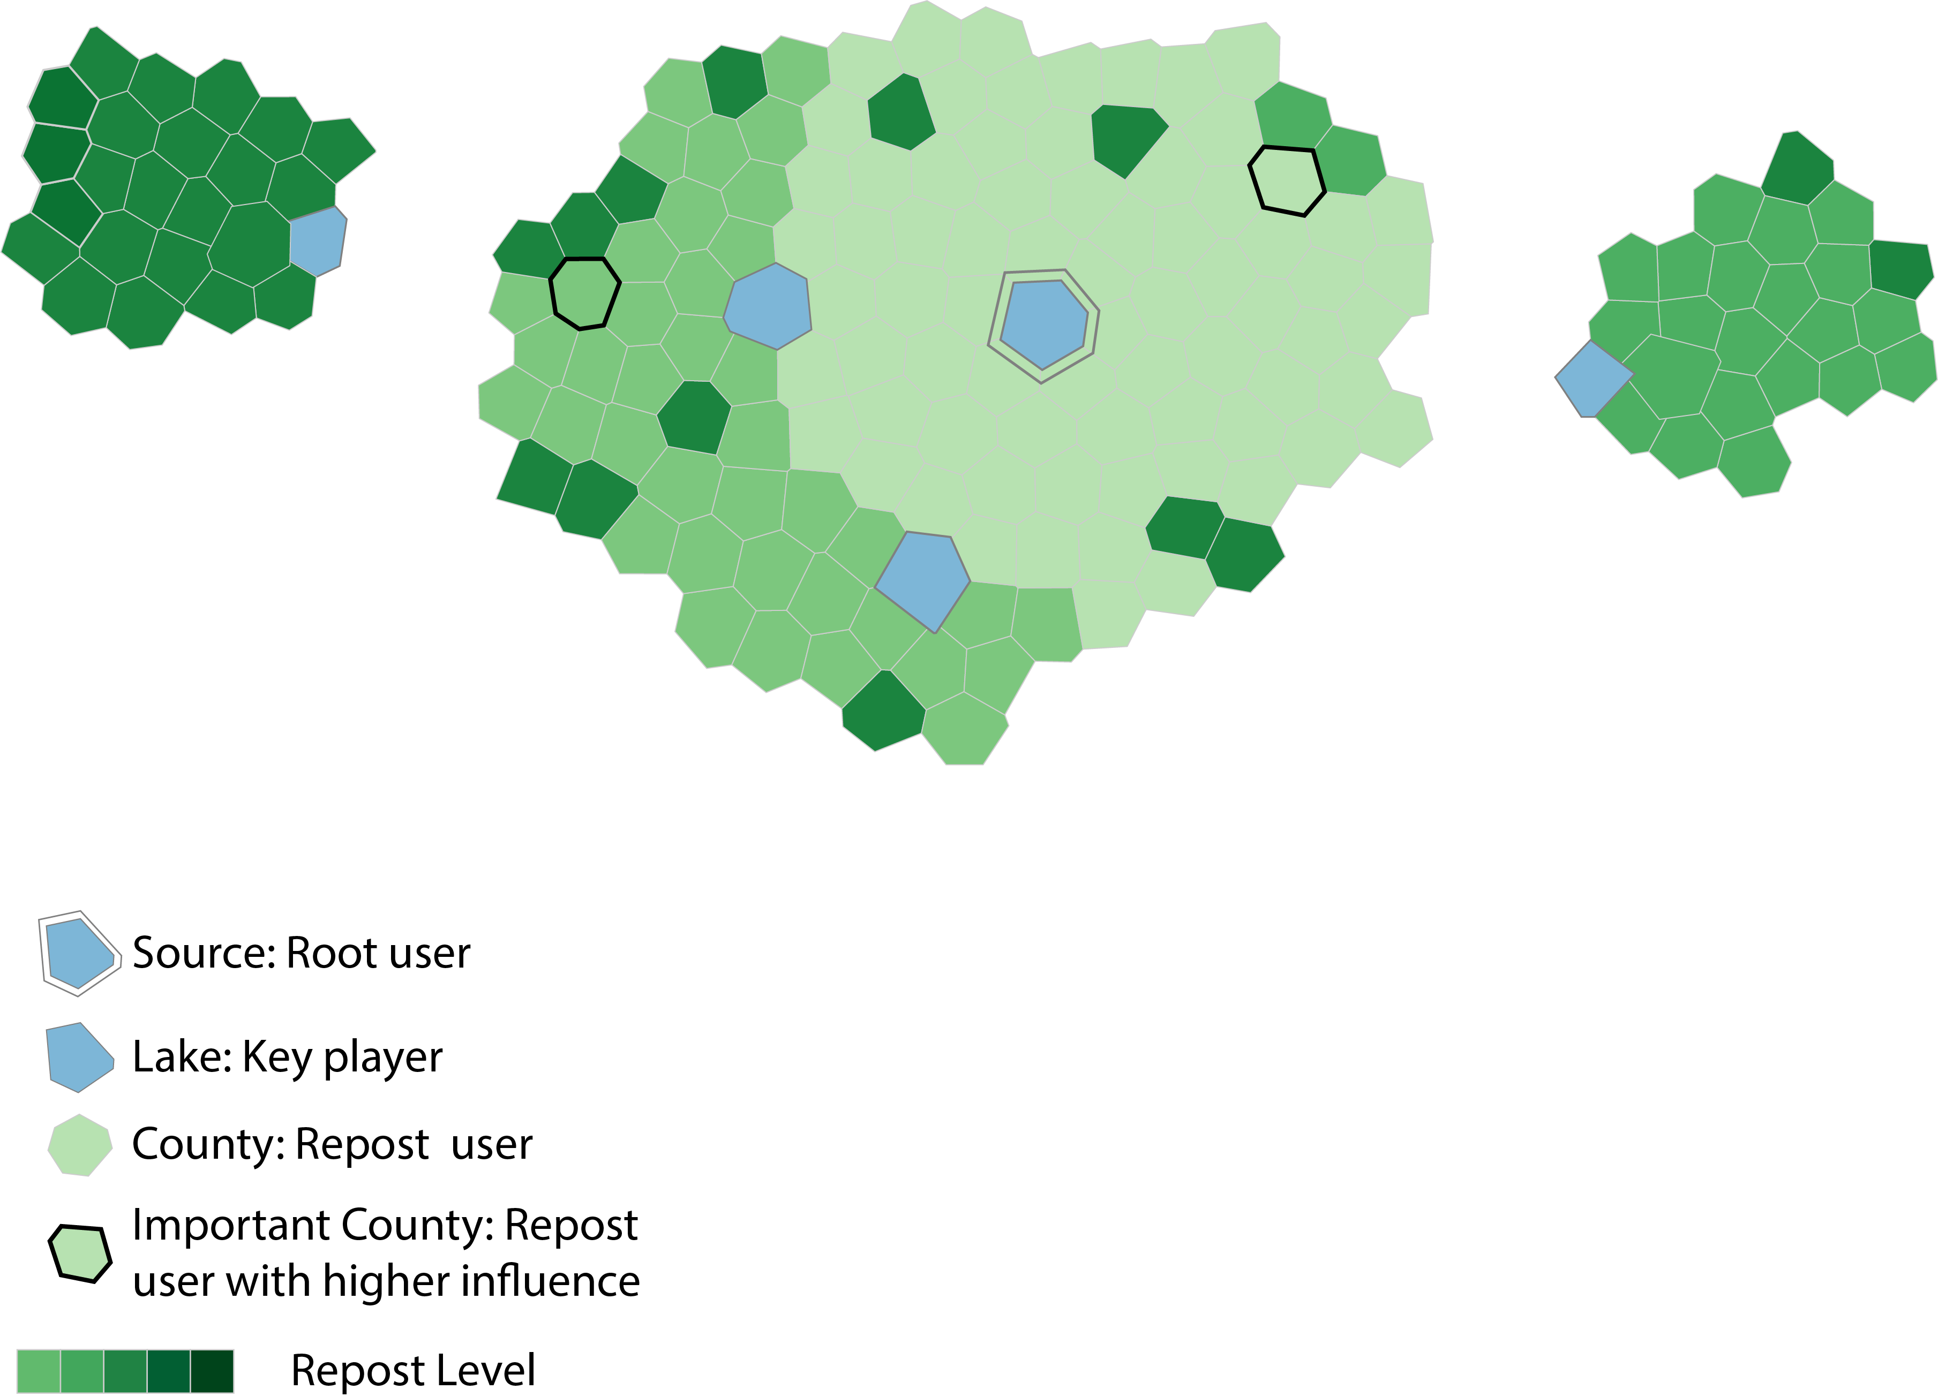
R-Map Design
Source: Root user
  Creator of the original message
4

Slide 6
R-Map Design
Source: Root user
Lake: Key player
  Reposted by a certain number
  of accounts (5% of all accounts)
5
Notes:
Blue polygons are lakes. They represent key players in the reposting process. if one message is reposted by a certain number of accounts, we consider the creator as a key player.
In our data, we set the threshold as 5% of all accounts.

Slide 7
R-Map Design
Source: Root user
Lake: Key player
County: Repost user
6
Notes:
The left polygons are counties. They are reposting users with less influence.

Slide 8
R-Map Design
Source: Root user
Lake: Key player
County: Repost user
  Important county
    Reposted by a certain number
    of accounts (1% of all accounts)
7
Notes:
Some important counties are highlighted.

Slide 9
R-Map Design
Source: Root user
Lake: Key player
County: Repost user
Color
  Reposting level
8
Notes:
To compensate the structure information loss, we use green color with different saturation to indicate the level of reposting user in the reposting tree.

Slide 10
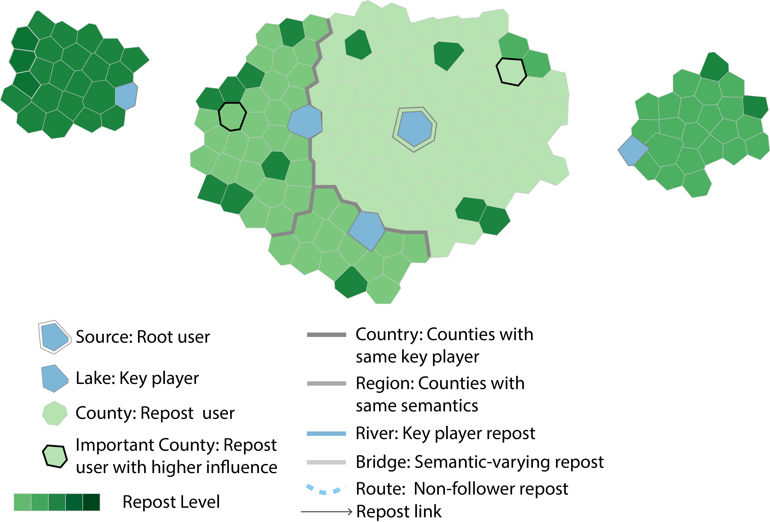
R-Map Design
Country
  Counties with same key
  player
9
Notes:
Counties reposting the same key players form a country on the map. The countries are separated by dark boundaries.

Slide 11
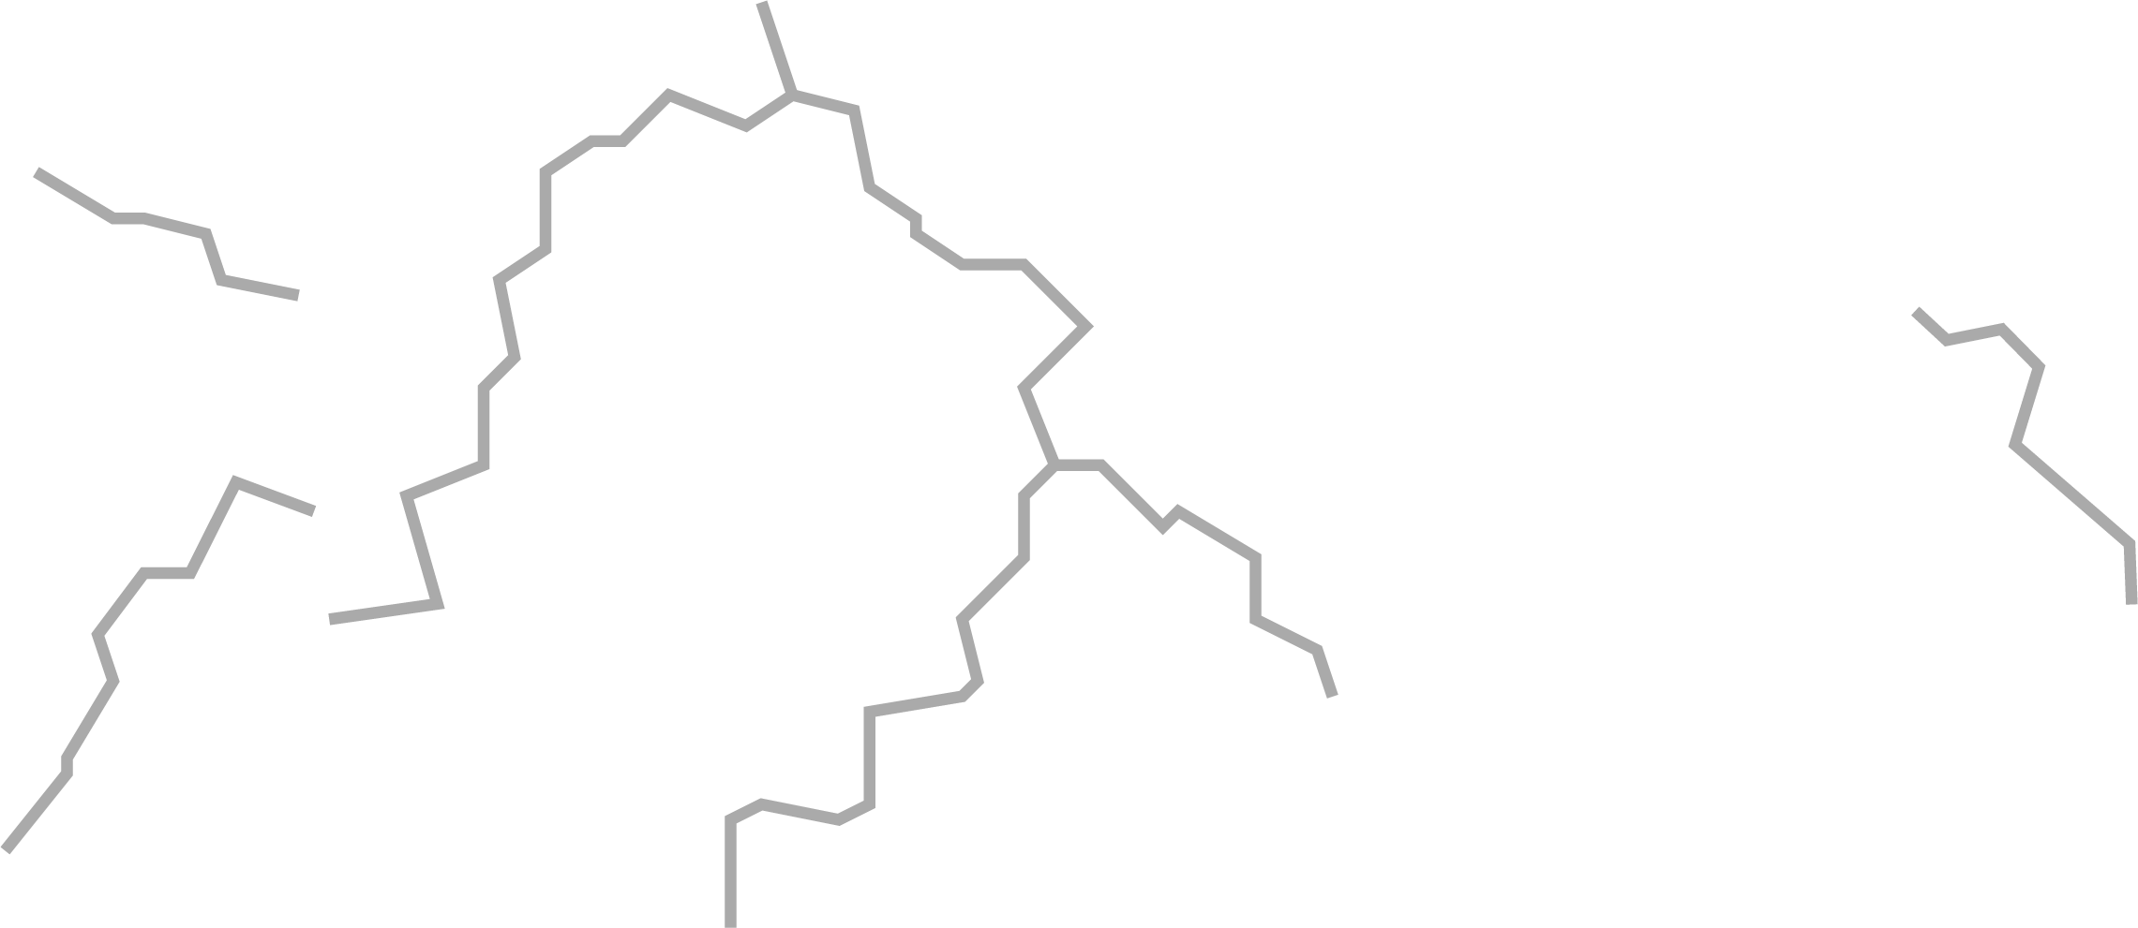
R-Map Design
Country
Region
  Counties with same semantics
10
Notes:
Each country can be divided into different regions. Regions contain counties with same semantics.

Slide 12

R-Map Design
Country
Region
River
  Connect key players with
  reposting relations
11
Notes:
Rivers connect different key players with direct reposting relations.

Slide 13

R-Map Design
Country
Region
River
Bridge
  Messages reposting the two key players are
  different in semantics
12
Notes:
Bridges indicate that the messages reposting the two key players are different in semantics.

Slide 14

R-Map Design
Country
Region
River
Bridge
Route
  One key player does not follow
  the reposted key player
13
Notes:
If one key player does not follow the reposted key player, we use a blue route to connect them.

Slide 15
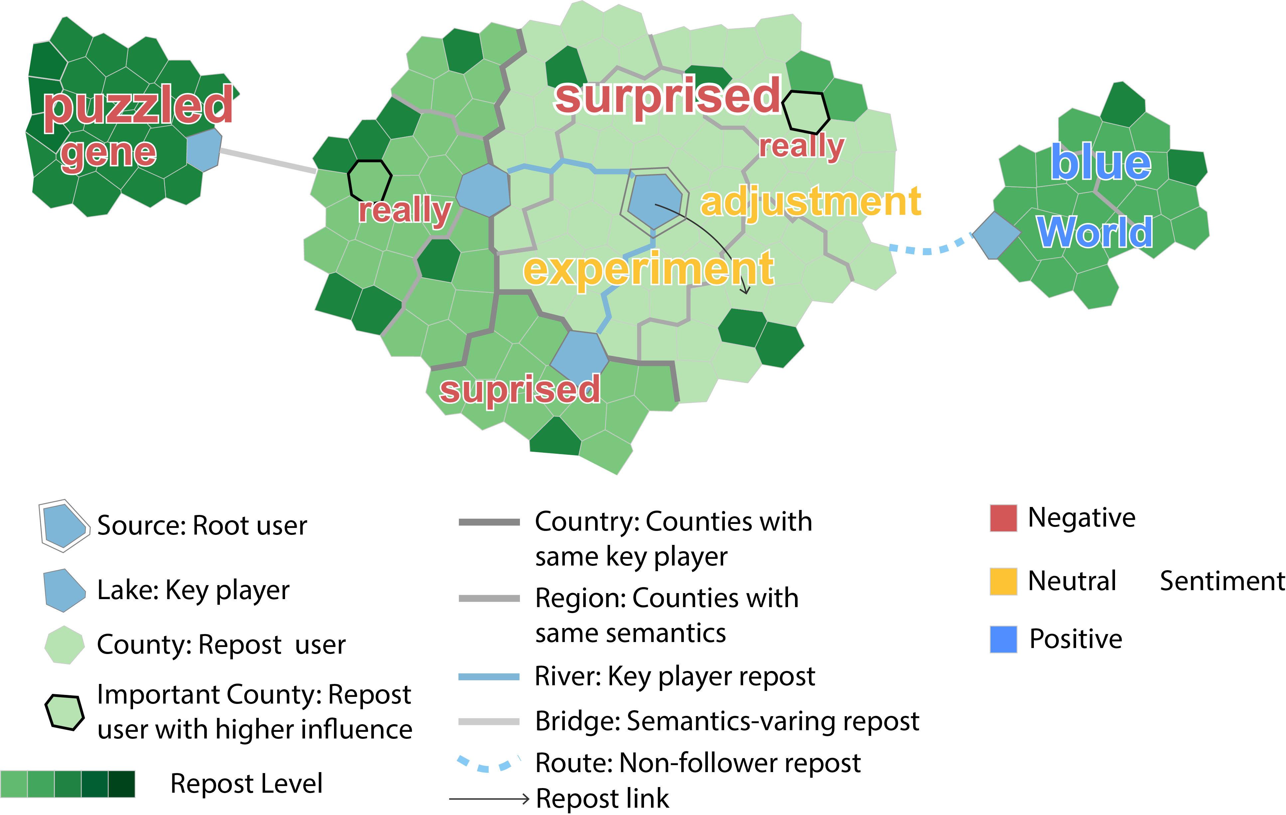
R-Map Design
Keywords
  Topics discussed in different
  regions or countries
  Color
    Red: negative
    Yellow: neutral
    Blue: positive
14
Notes:
We embed keywords on the map to show what topics people discuss directly in different countries or regions.
The color indicate the sentiment of keywords when people discuss them.

Slide 16
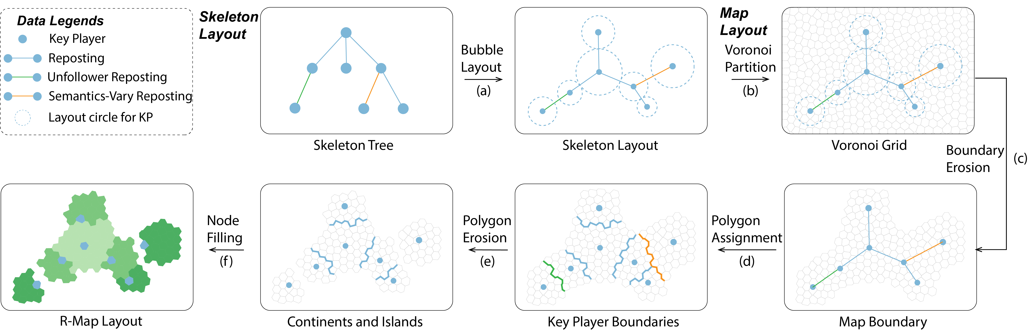
R-Map Construction Process
Extract key players
Construct skeleton and fill in nodes
Layout Pipeline
15
Notes:
To construct R-Map, we first extract key players to constitute the skeleton of the reposting tree.
We calculate the layout of key players and then fill in the left nodes.

Slide 17
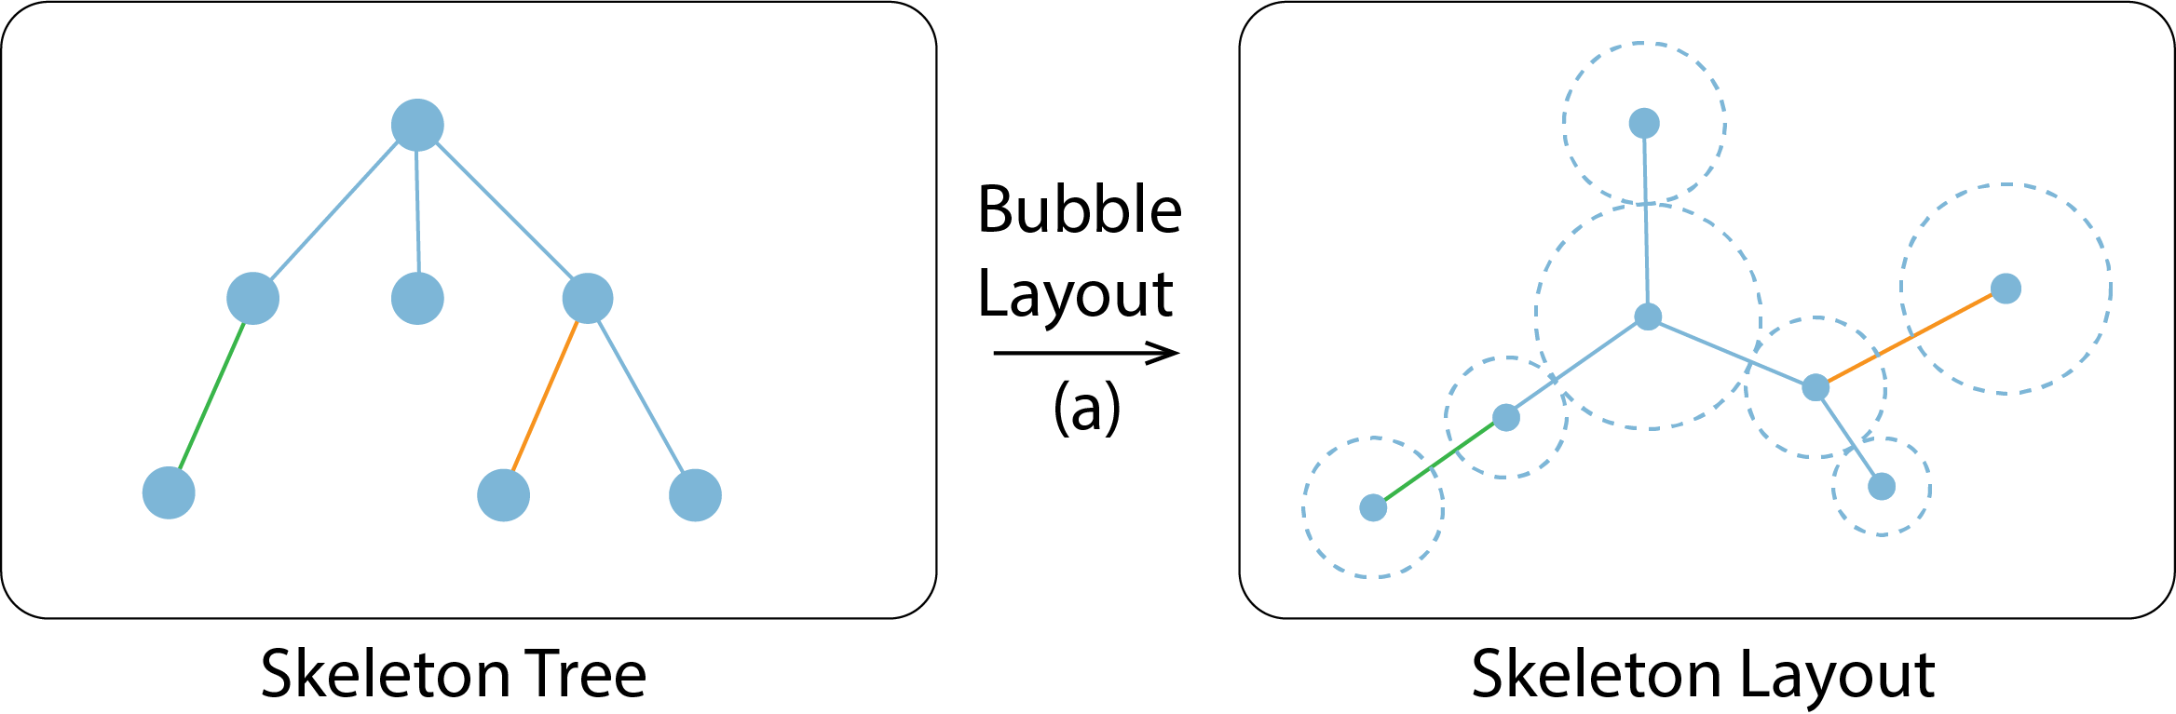
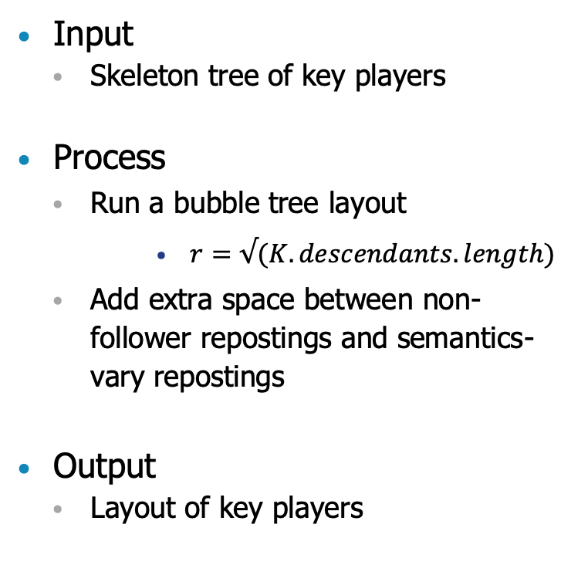
R-Map Construction – Bubble Layout
Input
  Skeleton tree of key players
Process
  Run a bubble tree layout
    $r=√(K.descendants.length)$
  Add extra space between non-follower repostings and semantics-vary repostings
Output
  Layout of key players
Sébastien Grivet, David Auber, Jean-Philippe Domenger, Guy Melançon. Bubble Tree Drawing Algorithm. ICCVG 2004: 633-641.
16
Notes:
In the first step,
After extracting the tree of key players, we run a bubble tree layout algorithm to get the position of key players.
The radius of bubble for each key player is the square root of its descendants number.
In this step, extra space is added between non-follower repostings and semantics-varying repostings to generate islands in the following step.

Slide 18
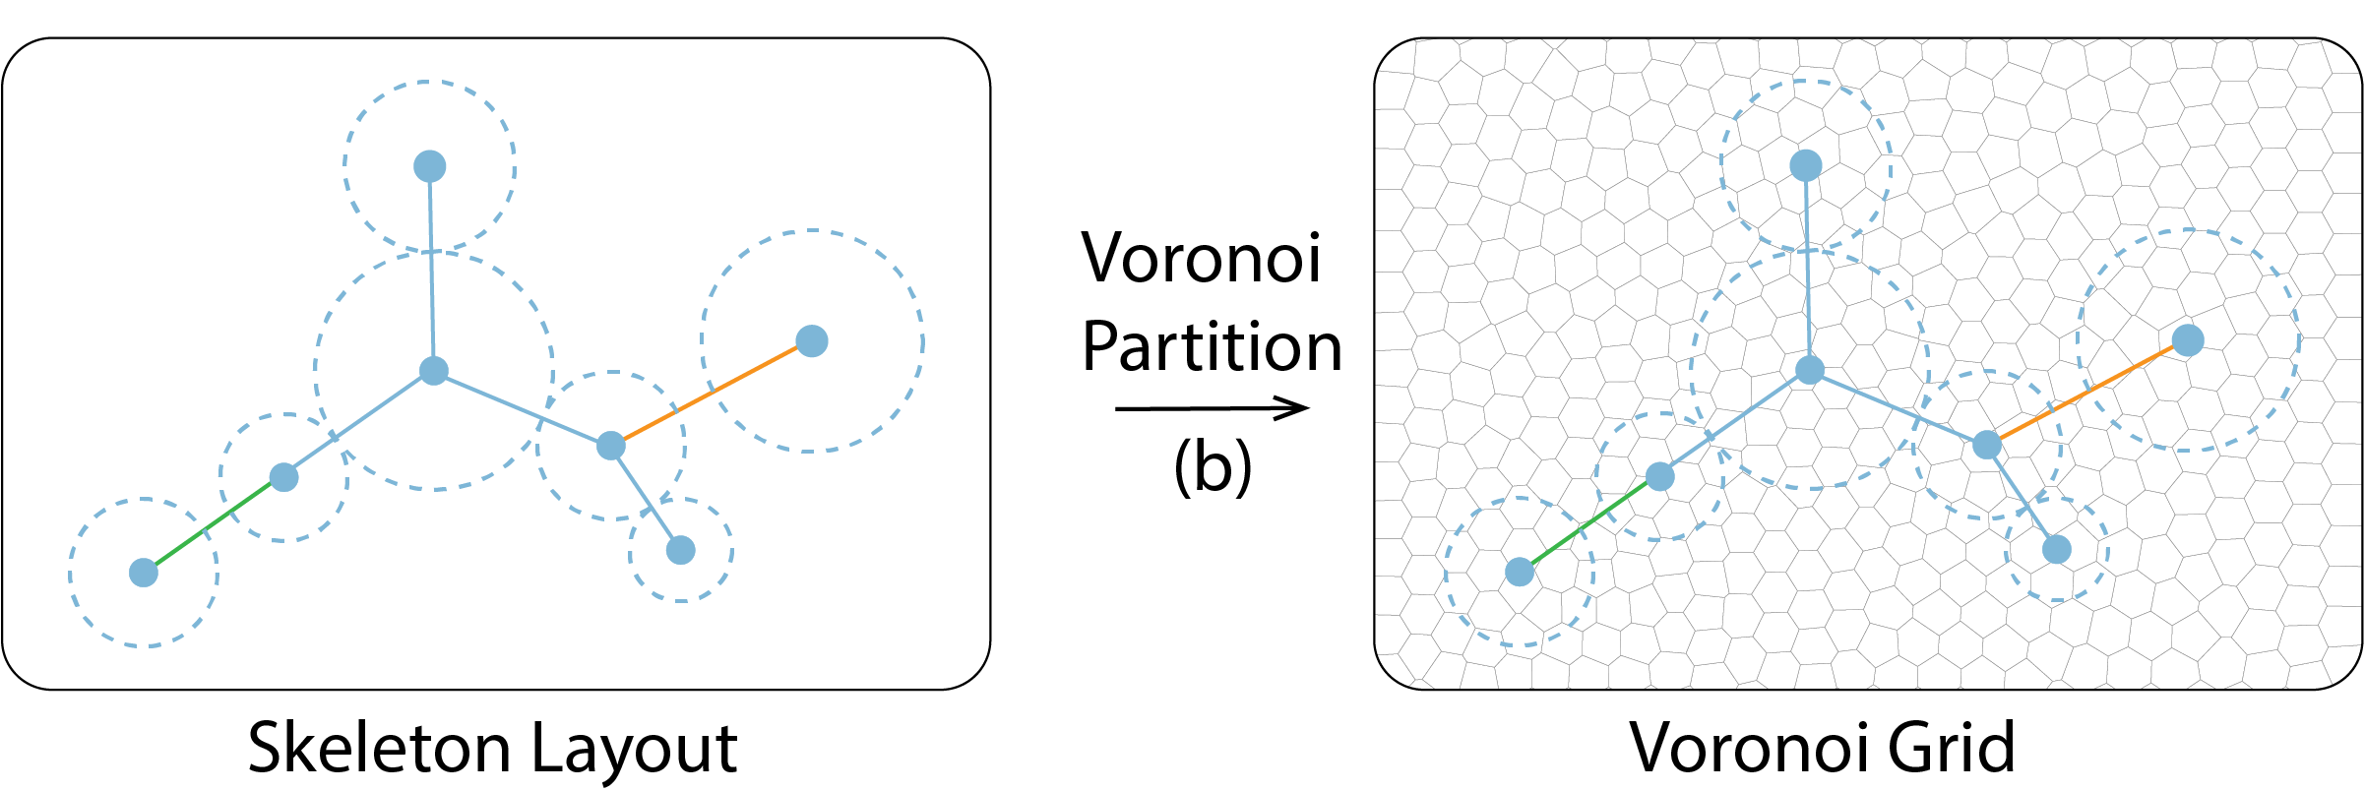
R-Map Construction – Voronoi Partition
Input
  Key players layout
Process
  Calculate the bounding box
  Divide the plane by a Voronoi diagram
Output
  A Voronoi diagram
17
Notes:
With key players positions, we calculate the bounding box of layout area and divide the plane by a Voronoi diagram.

Slide 19
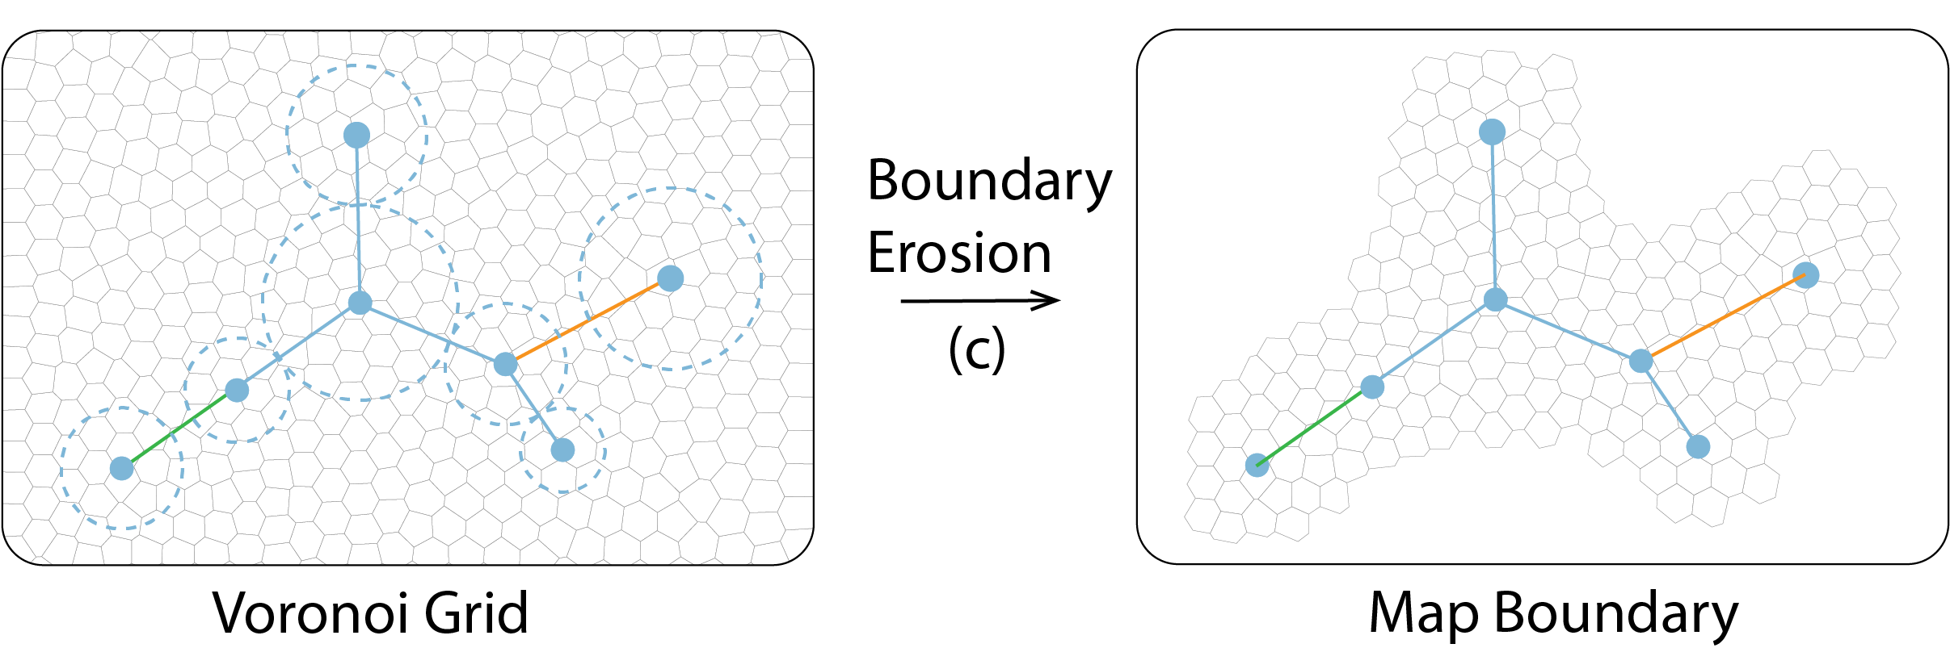
R-Map Construction – Boundary Erosion
Input
  Key player layout
  Voronoi diagram
Process
  Make a splatting of the key player node using a Gaussian Kernel
  Filter out polygons with density value below the threshold
Output
  Initial map shape
18
Notes:
Not all cells of voronoi diagram will be used in the final map. We make a splatting of the key player node using a Gaussian kernel,
We filter cells with density value below the threshold to get initial map shape

Slide 20
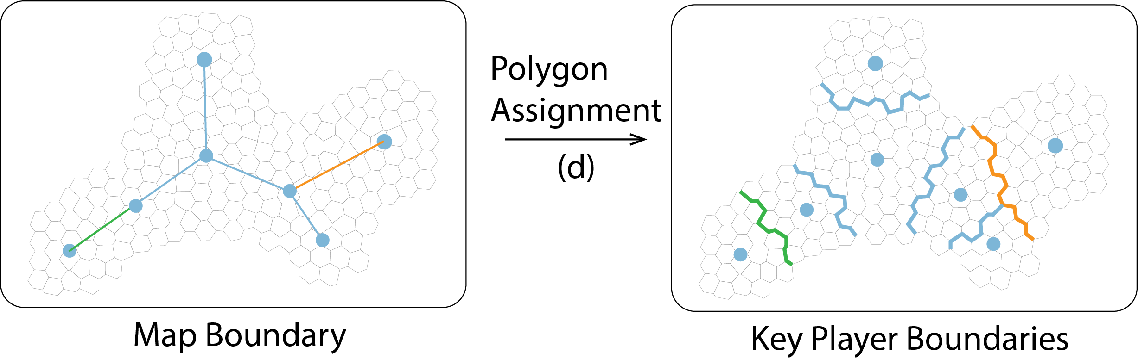
R-Map Construction – Polygon Assignment
Input
  Key players layout
  Initial map polygons
Process
  Assign polygons to key players according to Euclidean distance
Output
  Allocated polygons
19
Notes:
In this step, we assign polygons to each key player node according to Euclidian distance.
The map is divided into different countries.

Slide 21
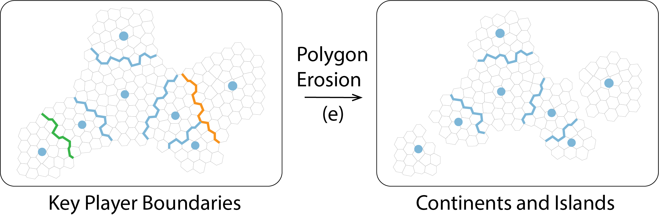
R-Map Construction – Polygon Erosion
Input
  Key players layout
  Allocated polygons
Process
  Adjust polygons
    Make the number of polygons equal to the descendants
    Split out islands
Output
  Final map shape
20
Notes:
Then, we further adjust the polygons for each key player and get islands and continents on the map.

Slide 22
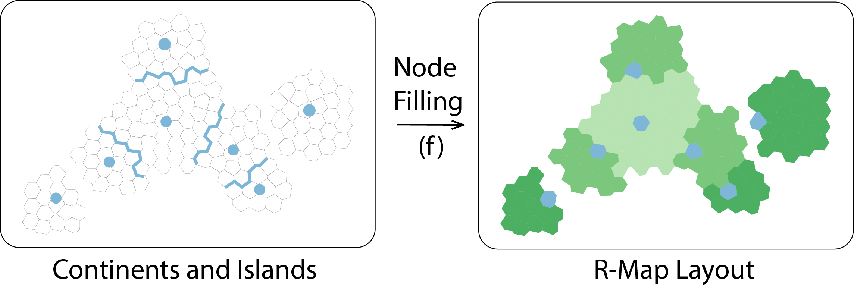
R-Map Construction – Node Filling
Input
  Key players
  Map polygons
Process
  Assign allocated polygons of key players to its descendant nodes
Output
  R-Map Layout
21
Notes:
Finally, we assign polygons to each node on the reposting tree.

Slide 23
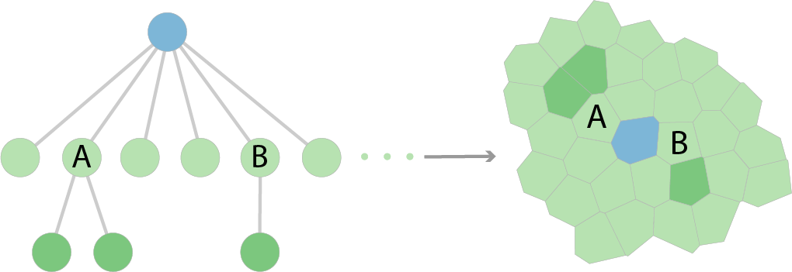
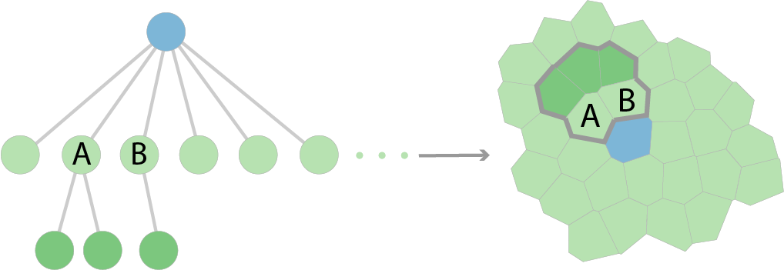
Filling Methods
Time
  Place nodes chronologically from inside to outside with a depth-first strategy
  Keep nodes of a subtrees within a continuous area
Semantics
  Group siblings with similar semantics first
  Place nodes chronologically from inside to outside with a depth-first strategy
  Generate regions on the map
t
Place nodes chronologically
Place nodes semantically (B is reordered)
22
Notes:
Here, We considered two filling methods.
The first one is based on time. We place nodes chronologically from inside to outside with a depth-first strategy so that nodes of subtree will stay within a continuous are.
The second one is based on semantics. We first group subtree of each key player according to semantics and layout them together so that similar subtrees form regions on the map.
For more details of the layout algorithm, please refer to our paper.

Slide 24
Source Weibo List
Map View
Timeline
User Information Panel
Word Cloud
Map Legend
Notes:
To support the analysis of reposting process, we developped a visual analytic system.

Slide 25
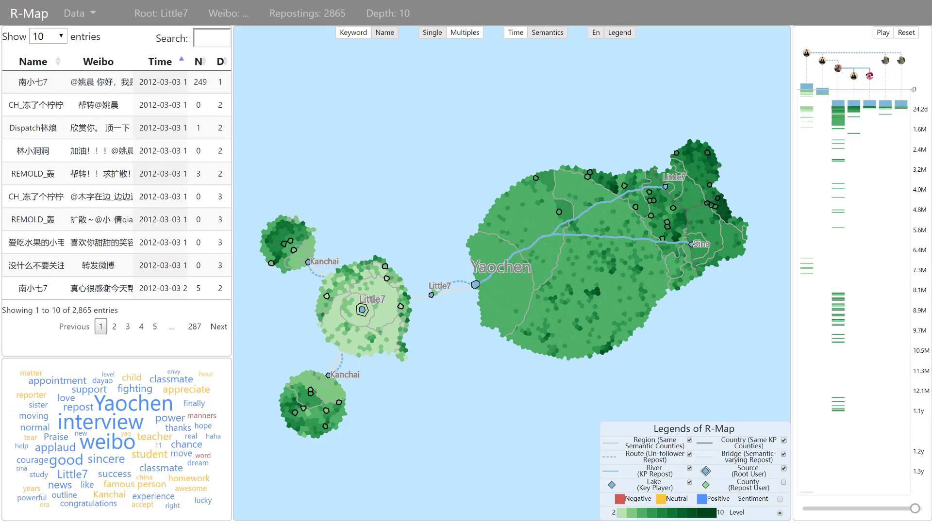
Notes:
The map legend show visual encodings of the map.
User can change the color encoding of the map to show semantics of repostings.
Users can show the keywords , change layout, check individual reposting on the map. The information panel show detailed features about the reposting.
The table view list all repostings. The word cloud view list keywords in the reposting process.
Users can select a keyword to check where related discussions happen on the map.
The timeline view list the repostings of keyplayers.
We use histogram equalization to equalize the temporal mapping of repostings. The equalized timeline reduces overlappings.
Users can play the timeline to see the diffusion process or select areas of interest.

Slide 26
Case 1: Key Players’ Influence
Data
  An account ID “Little7” invited a famous account ID “Yaochen” for an interview on Sina Weibo
  2864 reposting weibos in total
26
Notes:
I will introduce two cases about our system.
The first case is about an account ID Little7 wishing to interview a famous account ID Yaochen on Weibo.
The original message was reposted by over 2000 times.

Slide 27
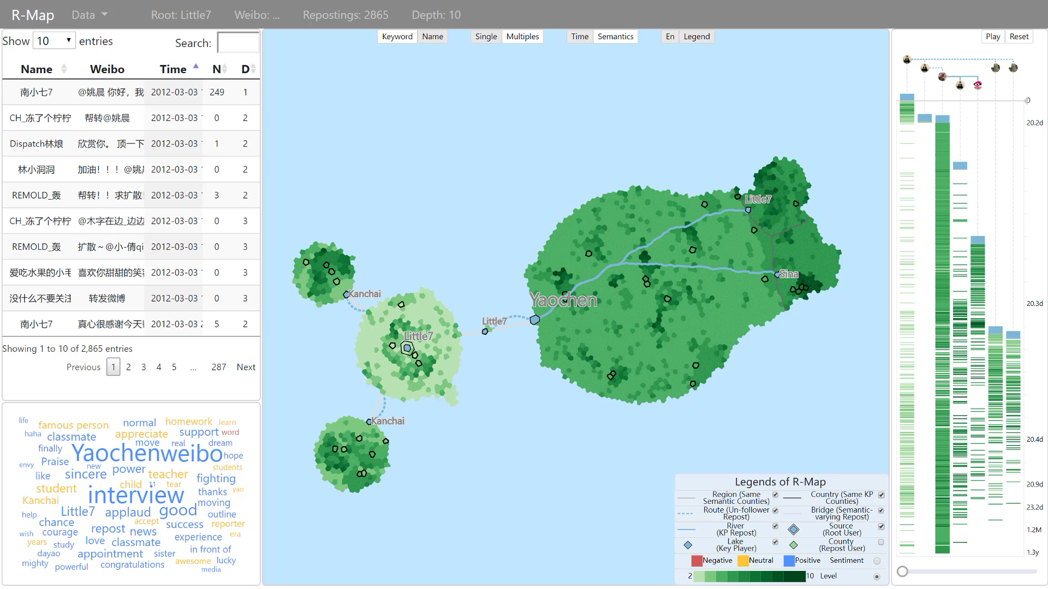
27
Notes:
The reposting process has three different stages. We can find the original message on the map.
Little7 posted a message about interviewing Yaochen. People reposted this message at the beginning stage.
After 20 days, Yaochen replied to Little7. The route indicates that Yaochen did not follow Little7
Yaochen has over 80 milllions followers. Many people reposted her message.
Little7 and an another account Sina then reposted Yaochen’s messages after several hours, promoting the diffusion of this event.
Sentiments of keywords were positive at this stage.

Slide 28
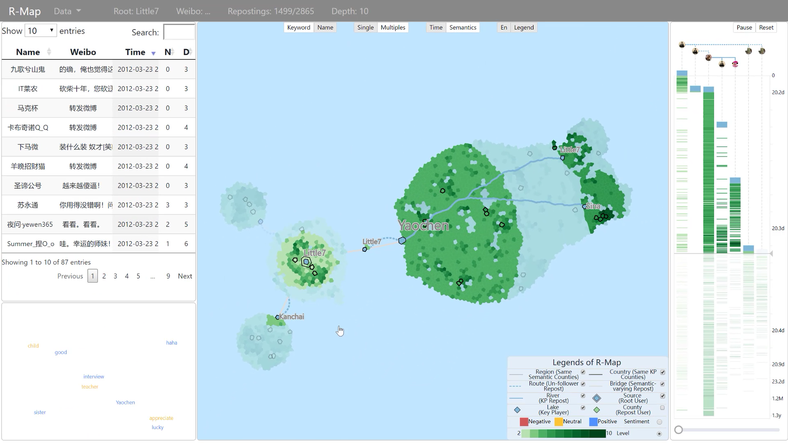
Notes:
Then, another account Kanchai reposted the original message twice, generating two islands on the map.
In fact, he thought that lille7 did not show enough respect to Yaochen.
Sentiments of keywords were changed to be negative in this stage.

Slide 29
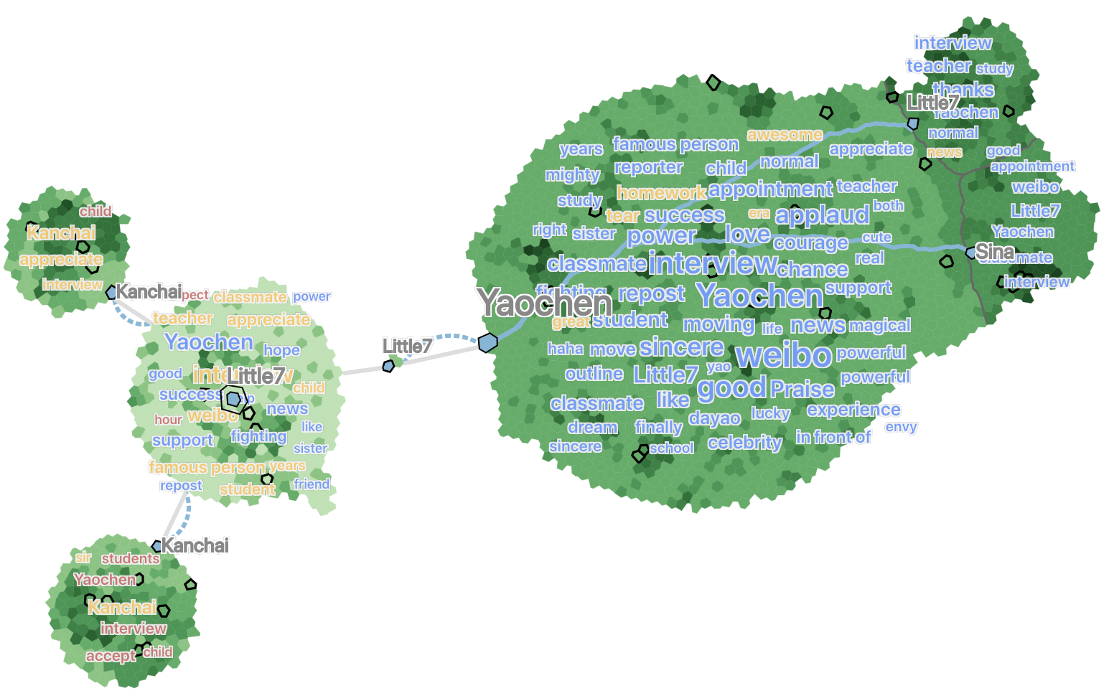
Notes:
For this case, we can find how the original message diffused to a large number of people
through reposting by key players, who not only change the temporal
patterns of reposting but also introduce different sentiments and
topics.

Slide 30
Case 2: Sentiment and Semantics Interpretation
Data
  The news about gene-edited babies born in China
  9596 reposting weibos in total
27
Notes:
The second case is the spread of news about gene-edited babies born in China.
There are almost 10 thousand repostings in this diffusion process.

Slide 31
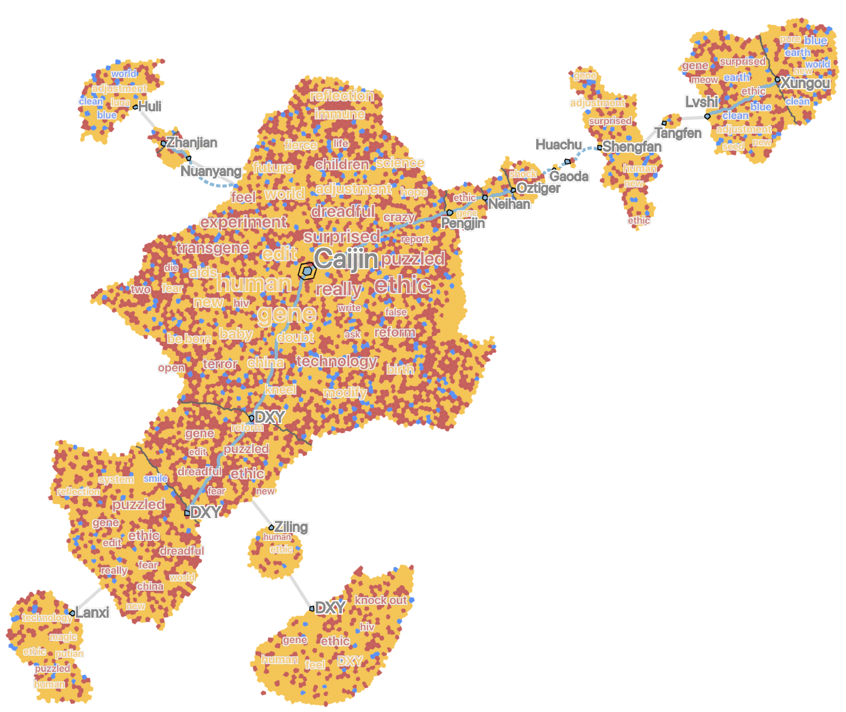
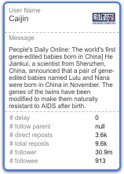
Overview
Caijin reported the news “gene-edited babies are born in China”
28
Notes:
The is overview of the map. The account Caijin first reported the news “gene-editied babies are born in China”. We find most people were negative to this news in the diffusion process.

Slide 32
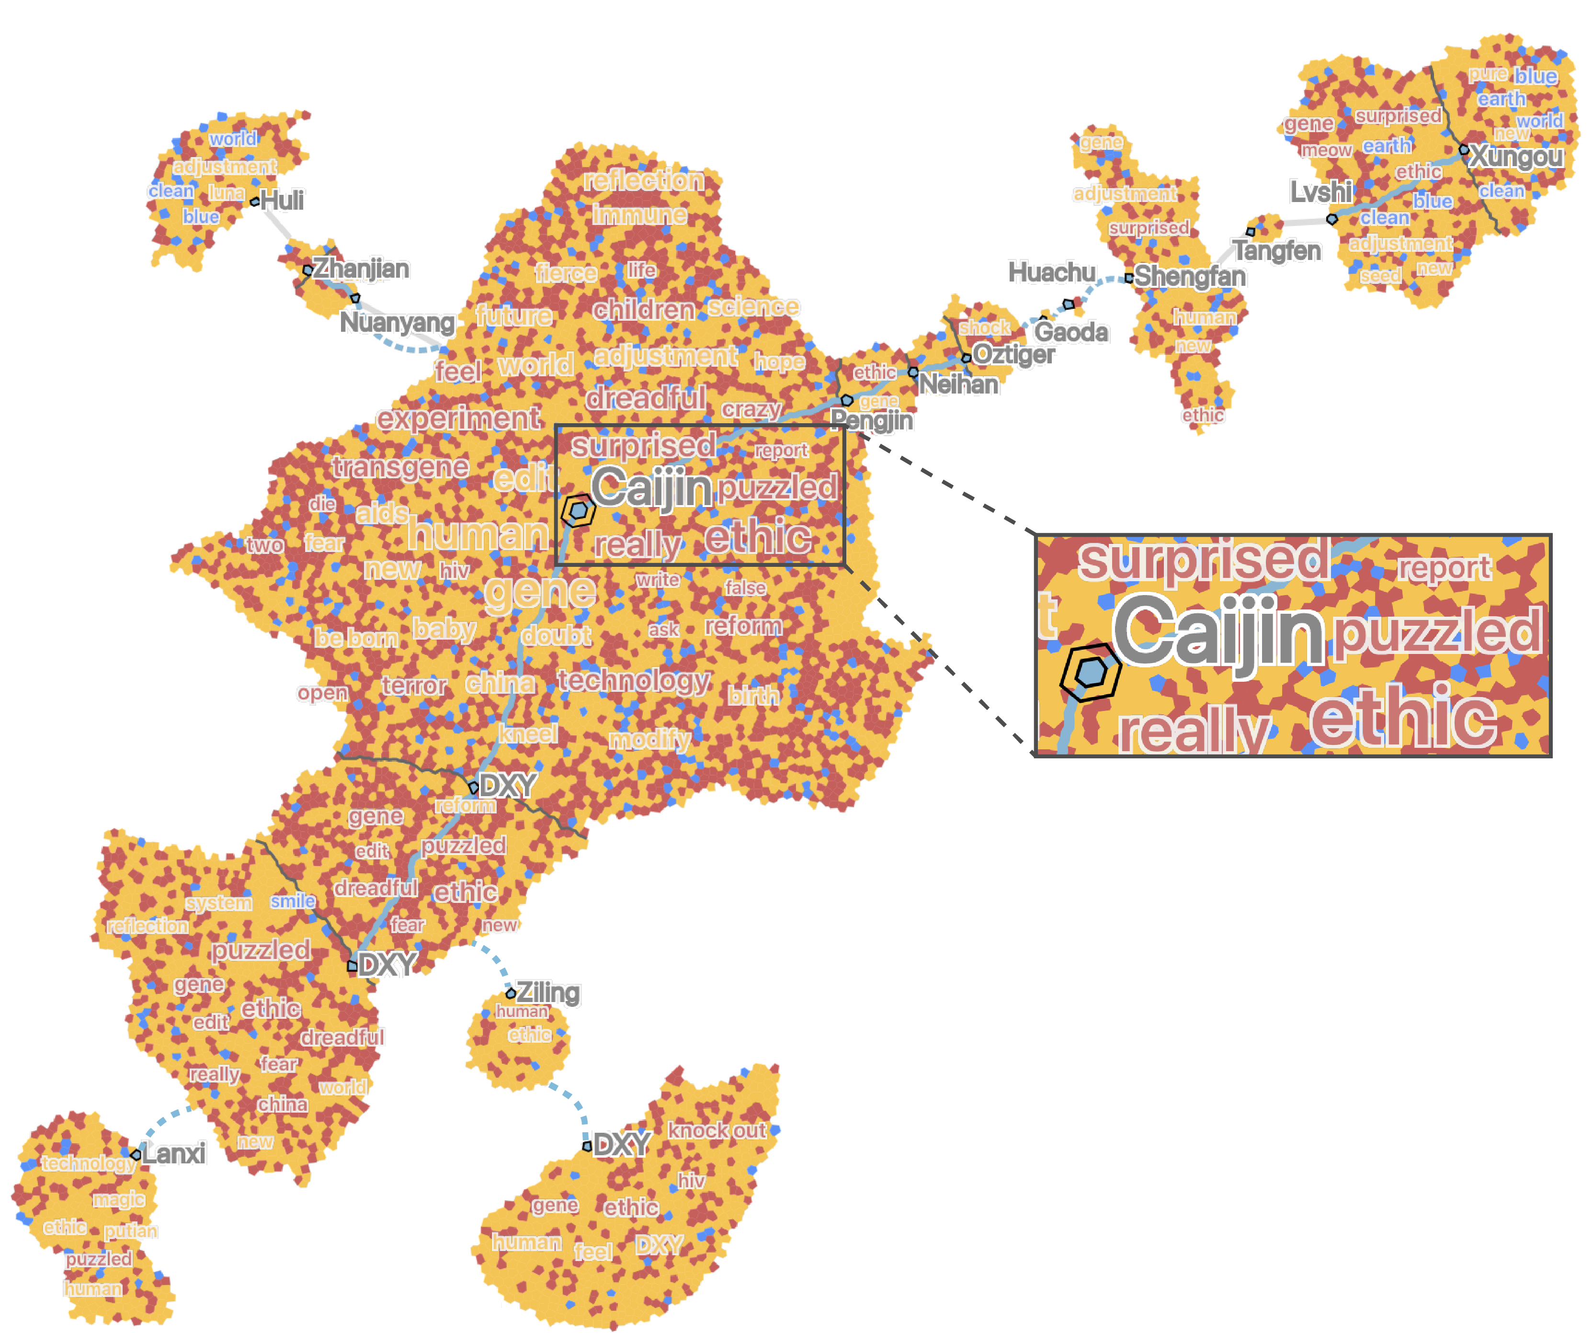
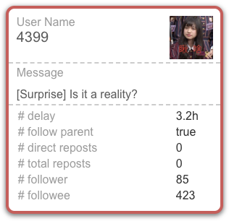
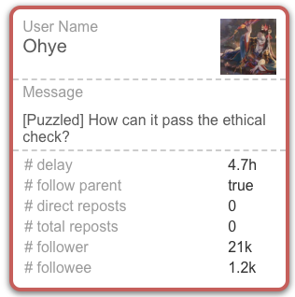
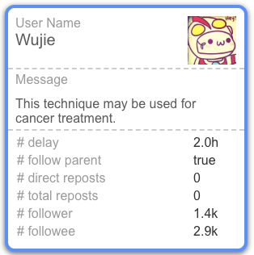
Continents
Negative keywords, e.g., surprised, puzzled, ethic.
29
Notes:
In the center of map, we can find that people express their negative opinions with words, like puzzled, surprised, ethic.
But there are still some people positive in this event. For example, one thinks this technique may be used for cancer treatment.

Slide 33
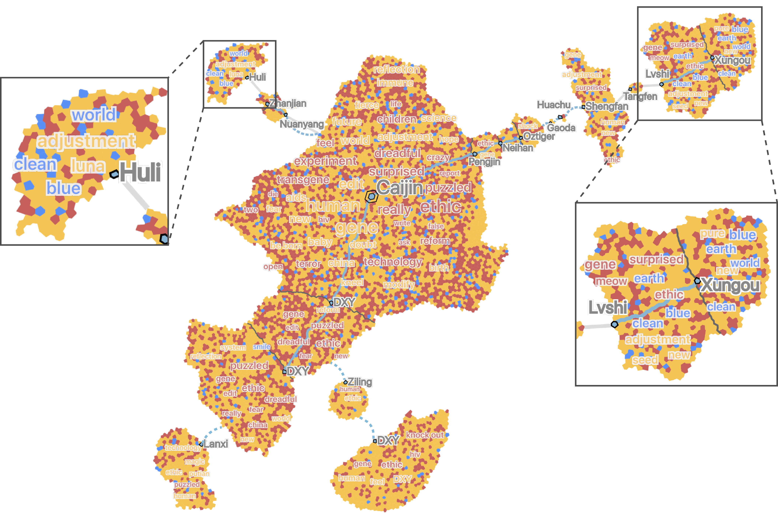
Islands
Some positive keywords, e.g., world, clean, blue
30
Notes:
Then, let’s look at two islands on the top. The majority of the opinions are negative to the news. But, we can still find some positive keywords, like world, clean, blue.

Slide 34
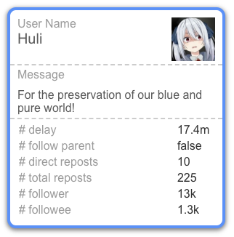
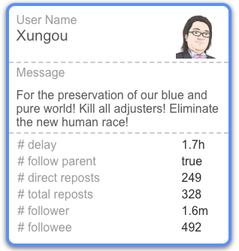
Islands
Some positive keywords, e.g., world, clean
The phrase “For the preservation of our blue and pure word” from a comic called “GUNDAM SEED”
Concerns and irony about the event
31
Notes:
In fact, these keywords are from the phrase “For the preservation of our blue and pure word” in a comic callded “GUNDAM SEED”. It tells the story
of a war between humans and coordinators, who are genetically modified humans.
People express concerns and irony about the event with this phrase.

Slide 35
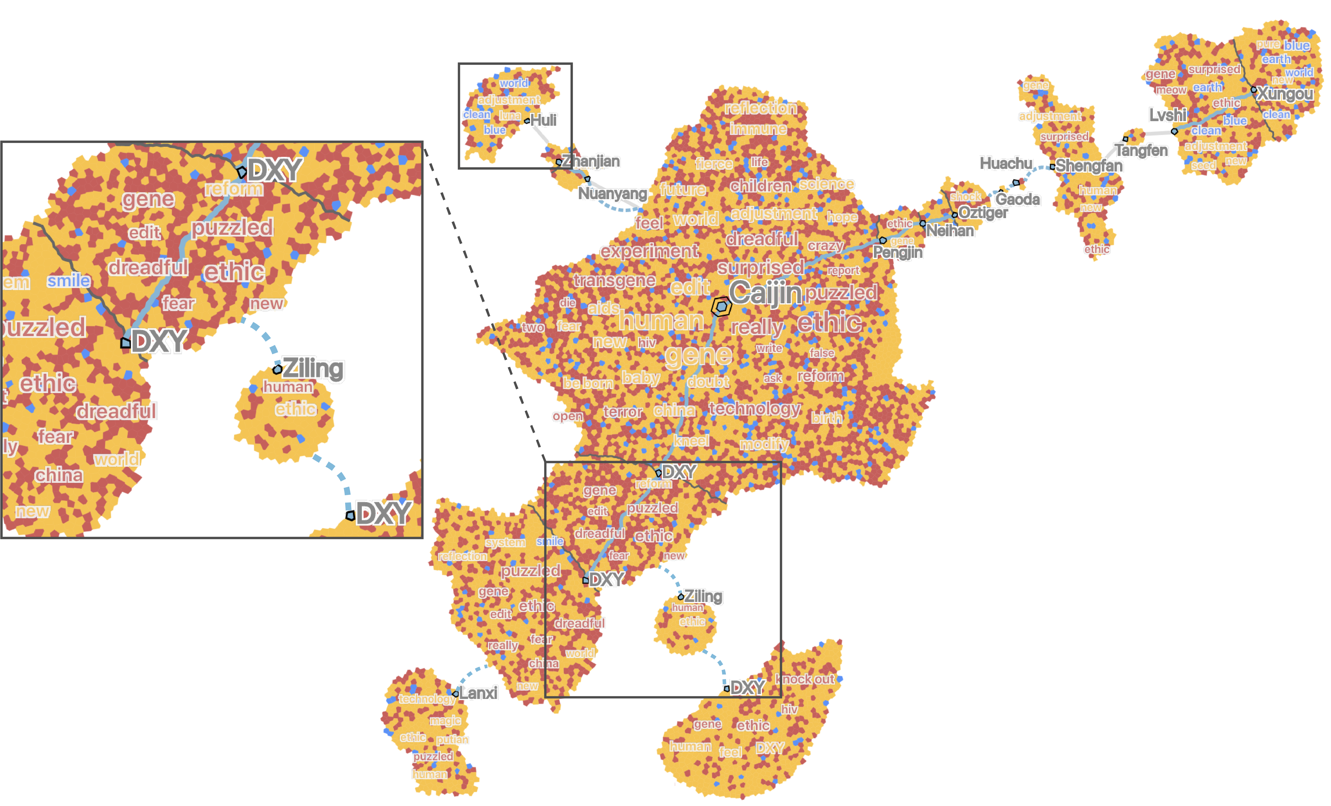
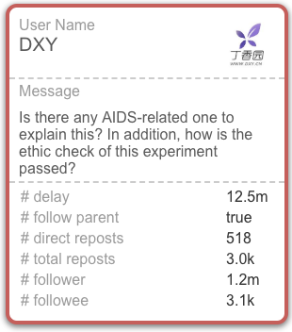
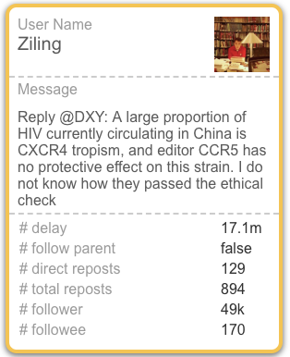
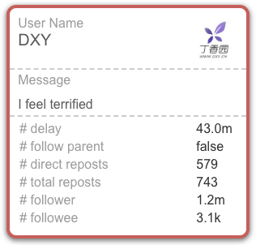
Key player’s behaviors
Discussion of the experiment from a professional perspective
  DXY -> Ziling -> DXY
32
Notes:
The bottom-left part shows discussions of experiment from a professional perspective.
DXY first asked a question about ethic. Ziling replied to DXY, although not following him as the route indicates. DXY further expressed concerns about this event.

Slide 36
Notes:
In this case, by analyzing weibos reposting a hot event, we can see that although the topics of repostings varied, they were related to the central
event.

Slide 37
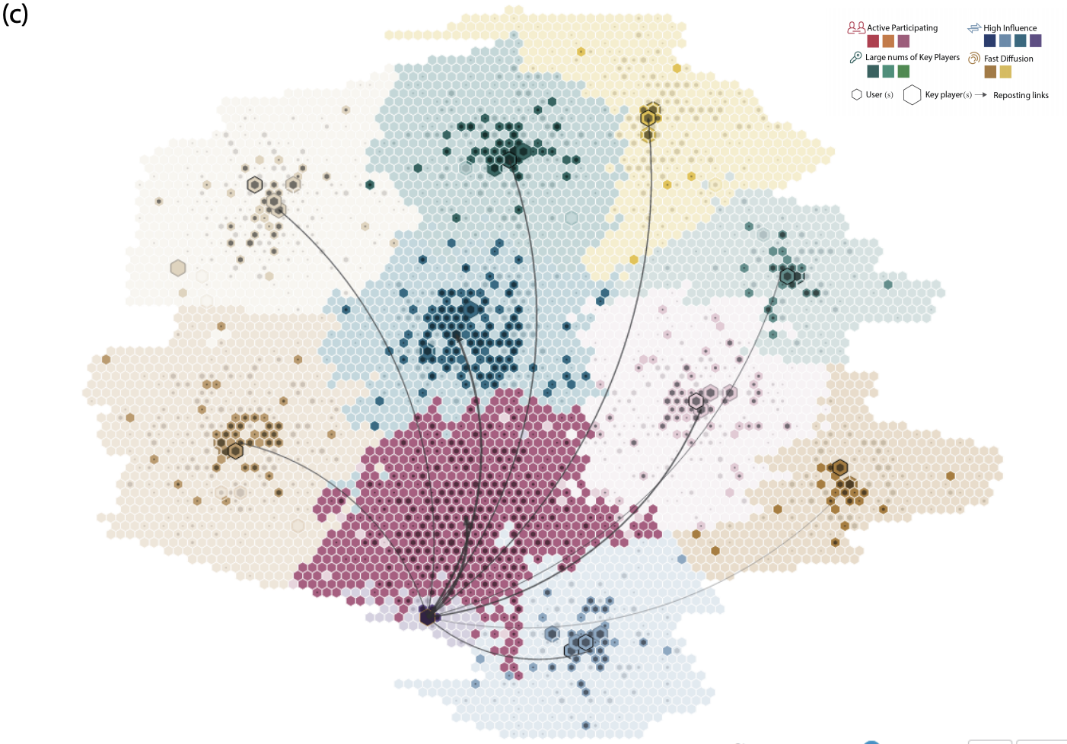
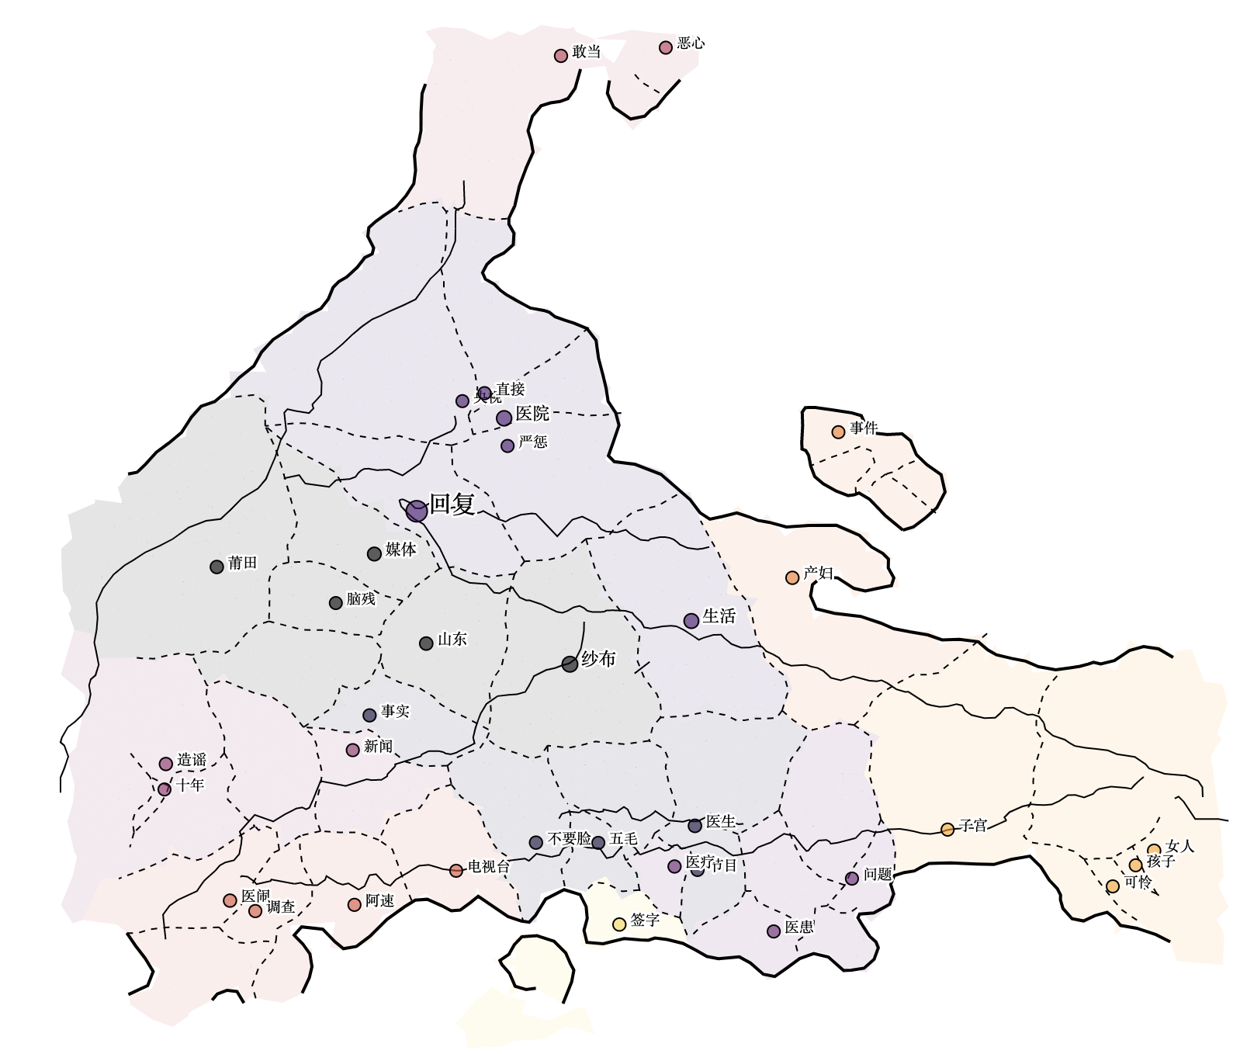
Conclusion
We propose a map-based visual metaphor (R-Map) for visualizing the propagation process of one single message
R-Map. Chen et al. VAST 2019
D-Map. Chen et al. VAST 2016
E-Map. Chen et al. VAST 2017
33
Notes:
In this work, we propose a map-based visual metaphor for visualization the propagation process of one single message.
Previously, we proposed D-Map to analyze ego-centric diffusion patterns of a series of messages from one center user.
We also proposed E-Map to analyze the event evolution based on a series of messages from multiple users.

Slide 38
Future Work
An automatic layout algorithm to adapt to streaming data
A unified framework to build map-based visualizations
34

Slide 39
Thanks!
Any question?
This work is supported by
  National Key Research and Development Program of China (2016QY02D0304).
  National Program on Key Basic Research Project (973 Program) No. 2015CB352503
  PKU-Qihoo Joint Data Visual Analytics Research Center

